Slide 1
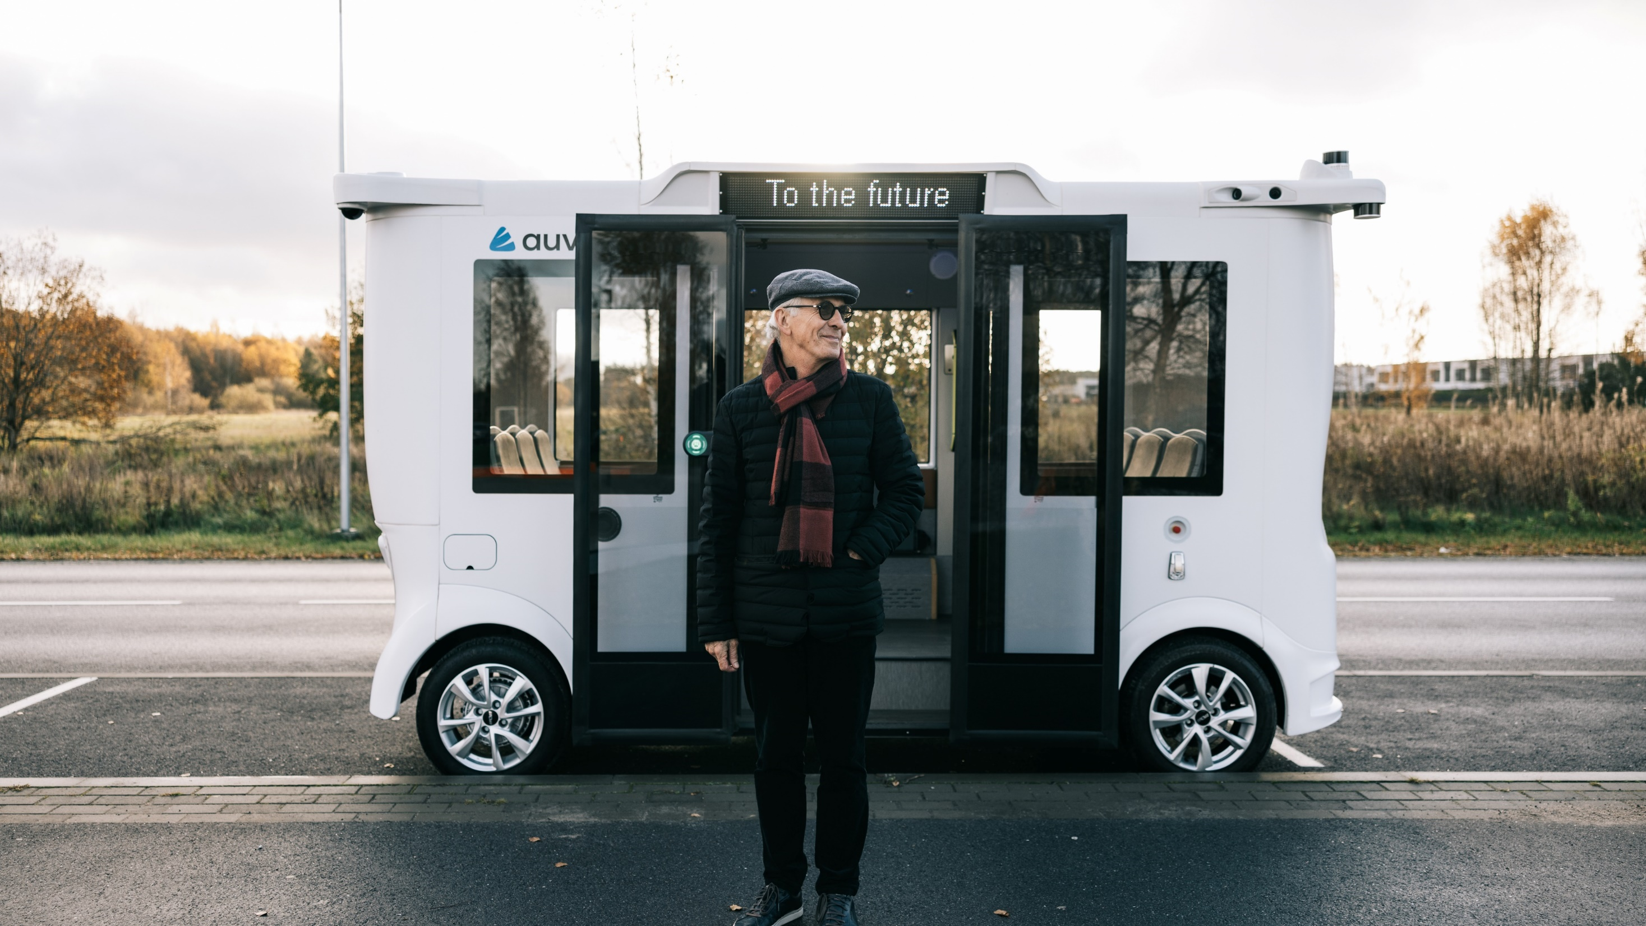
e-estonia: beyond digital
the coolest digital society
Author
Date
Notes:
Hi! My name is X and today I will tell you about the various aspects of digitalisation in Estonia:
Why was the decision made to go digital?
How did digitalisation become so pervasive in Estonian society?
We’ll talk about different areas of digitalisation, be it healthcare, business or education
And of course we will also talk about the future!
Before we get started, I would like to let you know that this presentation and a wide range of factsheets and Q&A’s are all on the website https://e-estonia.com/facts-and-figures/

Slide 2

a modest country
extending beyond its borders
population: 1.3 million
area: 45,339 km2
currency: Euro
member of: UN, EU, NATO, OECD, WTO, CERN etc.
employees in the ICT sector contribute to 10% of the GDP
Notes:
But let’s talk about the roots of all of this. I suppose the question on everyone’s mind is: Why did digitalisation happen here?! There are several factors that came together in the end – some of them provide factual context, others depend on more intangible things such as culture and values.
Estonia is a sparsely populated country with limited resources. When it regained independence in 1991, the entire government budget was around €130 mln. Quite frankly, it couldn’t support traditional bureaucratic structures because of the lack of money and manpower. Developing digital services was a way to provide better access to government services for the people living in the most remote areas of Estonia.
At least equally important as these fundamental challenges was the fact that Tallinn had been the home of the Soviet Union’s cybernetics institute since the 1960s, so some of the required IT talent was already in place.
Another factor may very well have been the Estonian culture. You see, Estonians are not the most talkative of people, so for them digitalisation would save not just time and money but also the need to interact with people at government offices.
All of this came together in 1994 when the parliament signed the first draft policy on digitalisation. As you can see, these developments were based not only on a forward-thinking mindset but also on bare necessity.
Of course, there were also challenges. When Estonia started building its information society about three decades ago, there was no digital data being collected on its citizens. The general population did not have an internet connection, let alone devices with which to access it. It took great courage to invest in IT solutions and take the information technology route. Luckily, our decision-makers made bold and difficult decisions that were necessary to stay on the digitalisation course.
Source: https://media.voog.com/0000/0034/3577/files/IKT%20valdkonnas%20majanduse%2C%20k%C3%B5rghariduse%20ja%20R%26D%20v%C3%B5imekuse%20anal%C3%BC%C3%BCs.pdf (page 7-8)

Slide 3






benefits
fastest decision making
99,6% banking transactions done online
100% of services are online
1000+ years working time saved
2% GDP saved thanks to digital signature
tax declaration
in 3 min
Notes:
The only public service we cannot do online at the moment is divorce. The are planning to make that possible by the end of this year.
Most of the banking transactions are done online. This is not that suprising, but why I want to bring it out specifically is because banks played a significant role in popularising digital service use in Estonia in the beginning of the 2000s. It was a time when digital identities were just issued by the government and not suprisingly people were not happy about it. You had to buy this plastic card that didn’t have any public serviced attached to it so it was basically useless. For the Scandinavian banks digital ID was a great way to skip building their own authentication systems, save resources and start using the government issued solution that was proved to be safe. They even started giving out ID-card readers for free. And as banking services are a daily nessessity for most people the change had a big impact on popularising the use of e-ID.
BTW: a good question about the 99.6% is that what is the other 0.4%? Yes there are still people who prefer to go to the bank office and do their dealings there. Digitalising does not mean that the previous options are closed off. We have a ‘’This and…’’ not a ‘’This or…’’ attitude.
Declaring taxes is the prime example of one of the most popular e-service in Estonia, as it only takes 3 minutes to file a pre-filled declaration form. The Tax Board is in charge of collecting all my data needed and I only need to confirm that the data presented is, indeed, correct.
They had a amusing campaign with tax declarations in the beginning of the 2000s. People were told that if they declare their taxes online, then they would get their tax returns first, i a matter of weeks actually. Knowing estonians competitive nature, the message spread like wildfire and by now declarig taxes has become like a national sport and everyone knows that 15. of Feb is the day. And this myth has stayed so strong that today the Tax and Customs board actually pleads people to wait a day or two because the system keeps crashing under the pressure.
Digitalising has clearly showed its benefits.We are saving years worth of working time and with that also money.

Slide 4
our highest rankings
#2
#4
#1
#2
FREEDOM HOUSE 2024
internet freedom
DESI 2025
digital public services for citizens
OECD 2025
tax competitiveness index
UN e-Government Survey
2024
Notes:
Estonia's pioneering role in the global digital transformation places us at the forefront of what lies beyond. Digitalisation has never been an end in itself. Together with enhanced cyber security it has enabled us to modernise the public sector, promote transparent democracy built on trust and foster economic development. We are heading towards a future where digital technology is integral to our lives.
Estonia has progressed through various stages of digital development, from the first e-solutions to full-fledged digital governance. Our next step is towards greater proactive and personalised governance. Imagine a world where society integrates with reliable services that operate sustainably and respond in real-time to people’s changing needs and expectations - a digital lifestyle shaped by people.
We collaborate with public and private entities to build a better digital tomorrow that promotes positive changes for all individuals, businesses and the state.
e-Estonia paves the way toward a digitally empowered future, significantly impacting how we connect and live our lives.
https://freedomhouse.org/report/freedom-net/2023/repressive-power-artificial-intelligence
https://digital-strategy.ec.europa.eu/en/policies/desi-digital-public-services
https://ncsi.ega.ee/ncsi-index/?order=ränk
https://www.itu.int/en/ITU-D/Cybersecurity/Pages/global-cybersecurity-index.aspx

Slide 5

essential
clear and honest principles
digital-minded leadership
citizen-centric
public-private partnership
internet access for everybody
all individuals own their personal data
Notes:
How do we really benefit from digitalisation and what could be your gain also if you implemented the similar principles of the Estonian digital governance?
Next are only a few of examples of money and time saved when using online services. Thanks to having 100% of the services online, we can benefit from fast transactions. The Banking sector was one of the first private services that was tied to electronic identity because it was much more effective to use already safe authentication provided with the Government-issued electronic identity than to issue authentication methods by the banks themselves.
Declaring taxes is the prime example of one of the most popular e-service in Estonia, as it only takes 3 minutes to file a pre-filled declaration form. The Tax Board is in charge of collecting all the data needed and I only need to confirm that the data presented is, indeed, correct. In case of filing the declaration online, I can expect a tax return in a matter of weeks. When filing the declaration the classical, on-paper form, I could wait for the excess tax to be returned for months.
Digital signature can have an economic savings of around 2% of GDP, which is equivalent to the Security commitment Estonia is investing in NATO. Moreover, thousands of years of working time is saved thanks to the interoperability of the data through X-Road, which I will introduce to you in more detail very soon.
Optimised procedures and digitalisation saves us valuable working time that can be put into building unique businesses, instead.
These are only some of the benefits we can enjoy thanks to fast decision-making through digitalisation.

Slide 6

living the digital future
seamless integration of digital services into everyday life
once-only principle
all Estonians have a state-issued digital identity since 2002
all government services are available online
  e.g.:
    100% of medical prescriptions are handled online
    e-portal of Transport Authority provides 6x faster and 20% cheaper transparent services
    e-marriage and e-divorce via e-population register
Notes:
One of the most important factors that helped to streamline the government databases was the once-only-principle which exists to this day. This means that any type of data related to an individual can only be collected by one specific institution, thereby eliminating duplicate data and bureaucracy. So, while in most countries many different authorities have the right to ask you for your address, in Estonia only the population register can ask your address and any other authority that needs your address has to get that information from the population register. This is also a necessary pre-condition for the fully-functional use of X-Road about which we will talk a bit later.
If you are wondering about the legal foundation for the once-only principle, it stems from a combination of different legal acts and regulations. For instance, the Public Information Act of Estonia lays down the prohibition of establishing separate databases for the collection of the same data (2007). More specifically, the General Part of the Economic Activities Code Act prohibits requesting information twice (2014). Also, the Principles for Managing Services and Governing Information specifically prohibits requesting resubmission of data that is already stored in any database belonging to the state information system (2017).
Estonia has further pushed for the implementation of the principle at the EU level with the Tallinn Declaration on eGovernment, outlining the objective to implement the once-only principle for key public services, at least as an option for citizens and businesses (2017).
Imagine living in a country where state services are 100% digital. We sign documents on the way to choir practice and declare our taxes during an elevator ride. There are virtually no bureaucratic hurdles. Public services are available 24/7, regardless of location and are personalised to the needs of individuals and businesses. It is empowerment through efficiency: valuing people and their time and allowing everyone to reach their potential. Open and transparent governance promotes trust in our digital public services and assures wide adoption.
Everyone is invited to embrace the digital future.
All Estonians have a state-issued digital identity, no matter where they live. This electronic identity system, called e-ID, has existed for over 20 years and is the cornerstone of the country’s e-state. e-ID and its ecosystem are part of the citizens' daily transactions in the public and private sectors. People use their e-identities to pay bills, vote online, sign contracts, shop, access health information and much more. Among others:
100% of medical prescriptions are handled online and repeat prescriptions can be issued without appointments.
An e-portal for drivers and vehicle owners that provides services six times faster and 20% cheaper than the physical office while also increasing transparency.
e-marriage enables people to get married by submitting a marriage application online via the e-population register.
e-divorce enables people to get divorced by submitting a divorce application online via the e-population register. Launched 2024, the last government service that was digitalised. Now, we are 100% digital and 0% bureaucrazy.

Slide 7
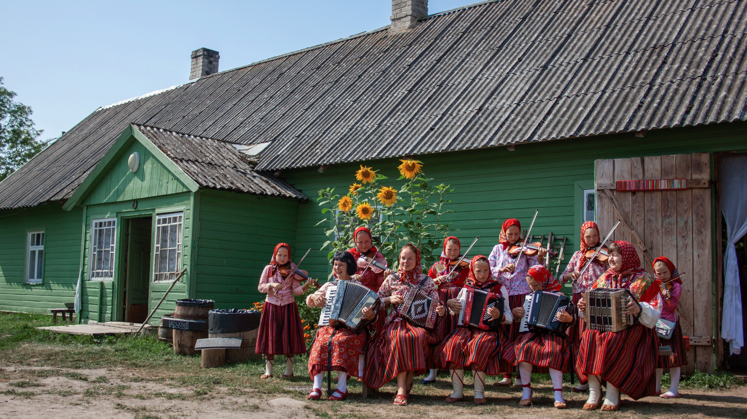
digital society is a team sport
shared responsibility and teamwork inspire innovation
public-private partnerships
cooperation with the academia
e-Government solutions built by the private sector, used by the public
security-by-design based on Estonia’s cyber security expertise
Notes:
How do we really benefit from digitalisation and what could be your gain also if you implemented the similar principles of the Estonian digital governance?
Next are only a few of examples of money and time saved when using online services. CLIC Thanks to having 99% of the services online, CLIC we can benefit from fast transactions. The Banking sector was one of the first private services that was tied to electronic identity because it was much more effective to use already safe authentication provided with the Government-issued electronic identity than to issue authentication methods by the banks themselves.
Declaring taxes CLIC is the prime example of one of the most popular e-service in Estonia, as it only takes 3 minutes to file a pre-filled declaration form. The Tax Board is in charge of collecting all my data needed and I only need to confirm that the data presented is, indeed, correct. In case of filing the declaration online, I can expect a tax return in a matter of weeks. When filing the declaration the classical, on-paper form, I could wait for the excess tax to be returned for months.
CLIC Digital signature can have economical save of around 2% of GDP, which is equivalent to the Security commitment Estonia is investing in NATO. Moreover, thousands of years in working time is saved thanks to the interoperability of the data through X-Road, which I will introduce you in more detail very soon.
Optimized procedures and digitalisation saves us valuable working time that can be put in CLIC building unique businesses, instead.
In fact, the only 2 things you cannot do online in Estonia, is marriage and divorce. Well, for now.
These are only some of the benefits we can enjoy thanks to fast decision making CLIC through digitalisation.

Slide 8
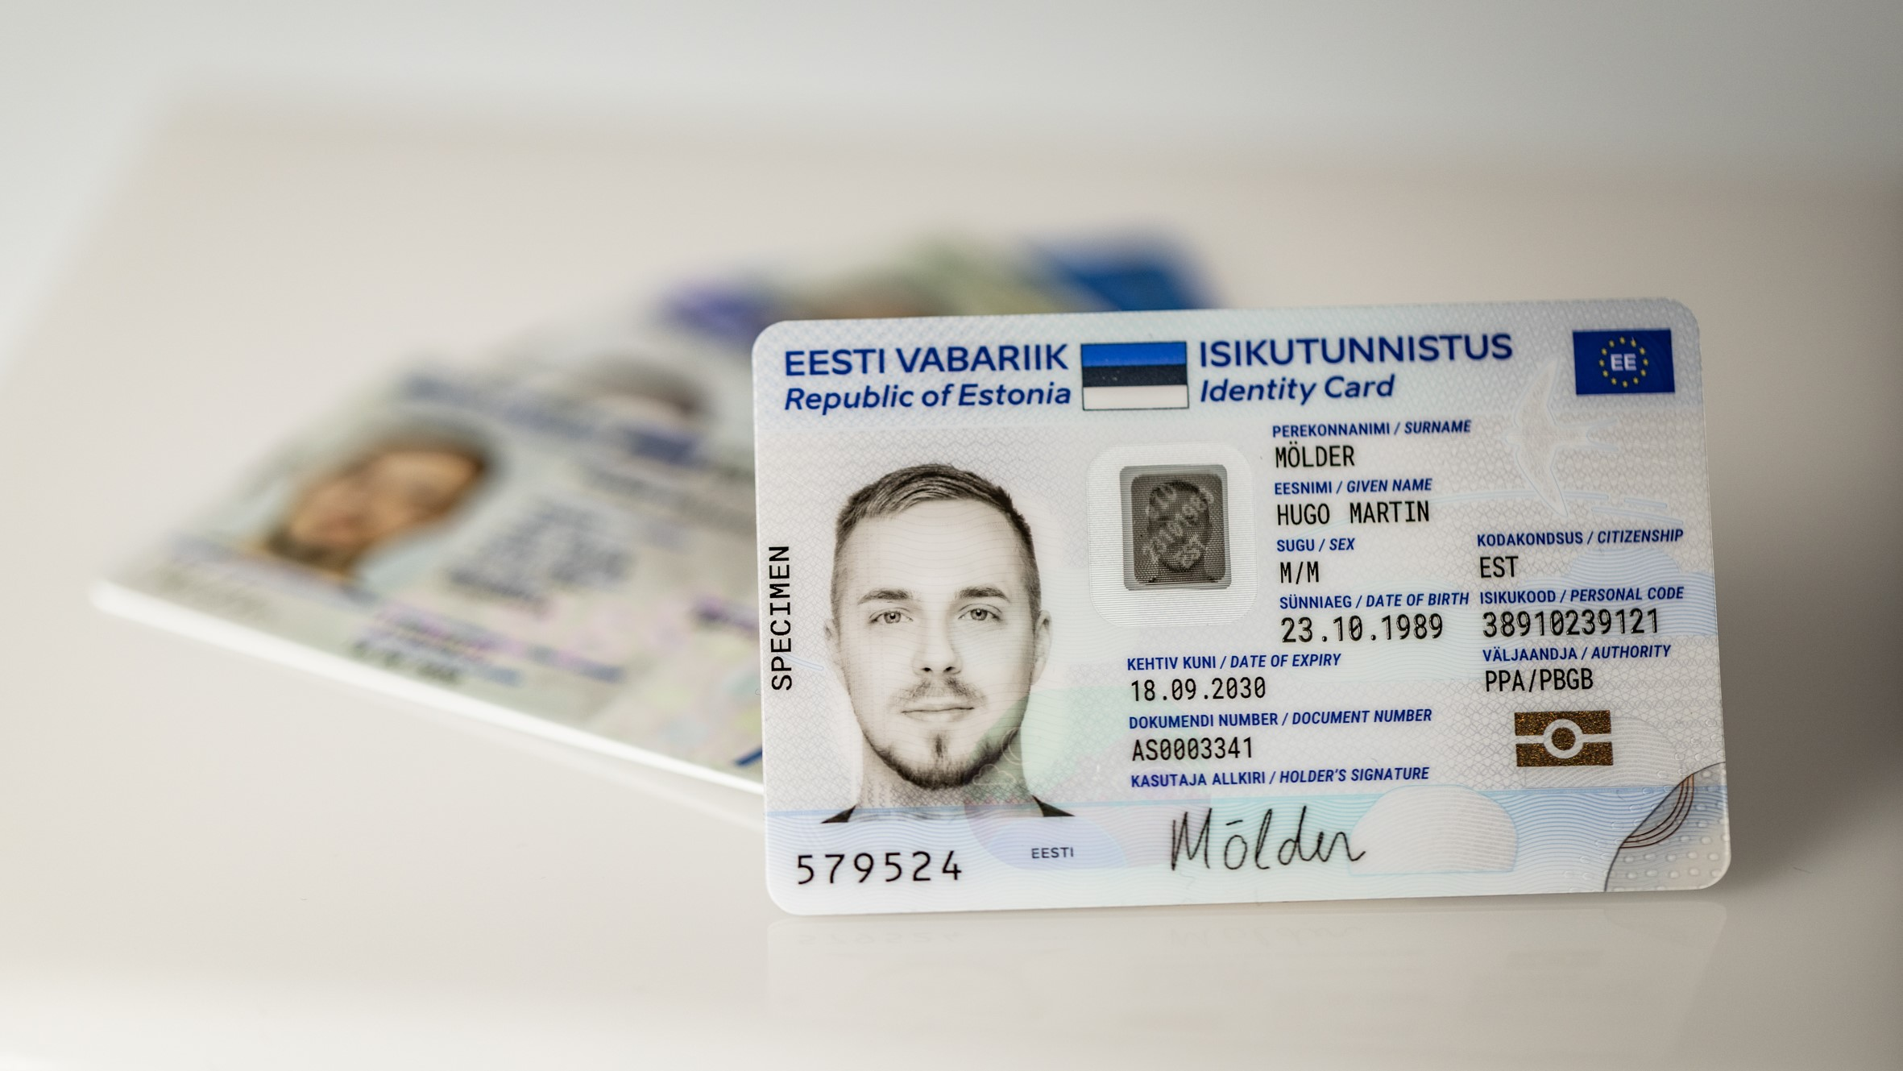
electronic ID
the strongest identity since 2002
electronic ID is compulsory
64% use ID-card regularly
19% people use mobile-ID
53% use smart-ID
142 000+ e-Residents
Notes:
Now that we’ve touched on the fundamental principles of e-Estonia, it’s time to talk about how these things were put into practice. One of the cornerstones is undoubtedly the electronic ID which enables Estonian citizens and residents alike to prove their identity online benefit from convenient, safe and fast hassle-free e-services. We’ve got this card since 2001.
Nearly every one of Estonia's 1.3 million citizens and residents has an ID card, which is a mandatory national card with a chip that carries embedded files and functions as definitive proof of ID in an electronic environment. The ID card is in compliance with the highest EU standards (particularly eIDAS).
But if you find using that card on a daily basis too bothersome – and the truth is that many Estonians do – you’re in luck because there are several other eID-carriers! The first one is called mobile-ID which allows people to use their mobile phone as a form of secure digital ID. Mobile-ID is a different kind of SIM card that you can get from your network provider, pop into your phone and use it just like the ID-card: it can be used to access secure e-services and digitally sign documents, but has the added advantage of not requiring a card reader. This option is particularly attractive for people who don’t own a smartphone because it is not an app-based solution.
If a SIM card is also too much hassle, you might be interested in Smart-ID which is an app that you can download and use for authentication just like the aforementioned solutions. You can use Smart-ID on a smartphone or a tablet, on an iOS device just as easily as on Android. When using Smart-ID, you only need a Wi-Fi network or mobile internet connection, no data roaming is necessary.
Finally, there is a method of electronic identity that literally everybody in this room can have as well. It’s called the e-Residency card and in many ways it is the culmination of many of Estonia’s previous efforts. Anyone around the world aged 18 or older can get this card – with it, they can create a company on Estonian legal soil, meaning inside the European Single Market and also give digital signatures that are legally binding, just like Estonian citizens and residents can with their ID cards. With this solution, we solve different problems for people living in different countries: People from non-EU countries are interested in having an EU-based company, but we also have surprisingly many e-Residents from EU countries, primarily because they want to make use of the digital signature and creating and running a company might be more expensive, bureaucratic and time-consuming in their home country. Bear in mind though that the digital ID is not a physical identification or travel document, nor visa or citizenship and does not display a photo.
All these authentication methods gives Estonians the strongest electronic identity since 2002.

Slide 9
x-road
probably the world’s most widely used
digital public infrastructure for data exchange
X-Road® – an open-source platform for secure data exchange between organisations, used by the world's leading digital nations.
X-tee – the Estonian X-Road® ecosystem since 2001
  saving 3 million working hours annually
  over 3,000 different services
  over 2,5 billion transactions per year
  over 500 million citizens as end-users
Notes:
Now when you think about all of that data exchange that’s happening between the hundreds of different government servers, you might be wondering: How do we ensure the efficiency and safety of these data exchanges? In Estonia, we are using X-Road since 2001. It’s the software backbone that encrypts and transfers our data. It works like an open-source highway for data traffic. X-Road interconnects public and private databases, which are held in a distributed manner. While every institution manages its own processes, government institutions can decide independently which platforms and technologies they use over X-Road. So yes, different authorities can choose different kinds of software and server infrastructure, what matters is that they are all compatible to the X-Road. This decentralised approach means that there is not one big super-database which would be extremely attractive for hackers. All data transfers are end-point to end-point encrypted. And we can see that we’re on the right track because many other countries have gotten onboard with our solution. Some of them are on the screen but I’m sure that there is also a country in your neighbourhood that’s at least considering using X-Road as we speak.
One of the most frequently asked questions that we get is: Do you use Blockchain? The answer is yes, but not like you think. We do not store personal data on the Blockchain as that would be a data protection and privacy nightmare. But: All the data exchanges, M2M communications, data at rest, and log files are independently and fully accountable thanks to Blockchain technology. With KSI Blockchain deployed in Estonian government networks, history cannot be rewritten by anybody, and the authenticity of the electronic data can be mathematically proven. It means that no one – not hackers, not system administrators, and not even the government itself – can manipulate the data and get away with it.
X-road is operational in Argentina, Azerbaijan, Bangladesh, Barbados, Brazil, Cambodia, Cayman Islands, Colombia, Djibouti, Dominican Republic, El Salvador, Estonia, Ethiopia, Faroe Islands, Finland, Germany, Iceland, Japan, Kyrgyzstan, Madagascar, Mexico, Palestine, Vietnam.
Useful links:
Publicly available source code of the X-Road: https://github.com/nordic-institute/X-Road
Great visualising tool, select threshold 500 and service level: https://logs.x-tee.ee/visualizer/EE/
Finally, some encouraging news: A public sector data exchange facility between Finland and Estonia was created in 2017. This means that in the future health or education data on Estonian citizens can also be accessed by the Finnish government or private sector, regardless of whether the person is living in Estonia or Finland. Our business registries are already interoperable as we speak (source: Case study: The business registers of Estonia and Finland — X-Road® Data Exchange Layer). Hopefully, cross-border data exchange will soon become possible between all European countries, but as you can see, in general, digitalisation is very rarely a technological problem – usually, it’s a political question.
X-Road world map: https://x-road.global/xroad-world-map
Case studies: https://x-road.global/secure-data-exchange-to-the-japanese-energy-sector & https://x-road.global/piloting-digital-prescriptions-in-germany-through-secure-data-exchange

Slide 10
three pillars
the safest combination to information security
Integrity
KSI blockchain
Data Embassy
Data Tracker
Integrity
KSI blockchain
Data Embassy
Data Tracker
Integrity
Data Embassy
Data Tracker
Confidentiality
e-Identification:
ID-card
mobile-ID
Smart-ID
e-residency card
Integrity
KSI blockchain
Data Embassy
Data Tracker
Availability
X-Road®
Notes:
To recap: From the security perspective, a model known as the CIA TRIAD, Estonia information security relies on a combination of three pillars: data confidentiality, data availability, and data integrity.
The electronic ID allows citizens to access only their data and restricts access to unauthorized people. Estonia offers several e-ID carriers that people can use and combine, issued both by the state and public sector to guarantee confidentiality and privacy of data.
The X-Road serves as the basis for secure data exchange – so different public and private databases have trustworthy data available at all times to work with. This way, data packages can be exchanged in a smooth and interoperable manner, keeping data end-to-end encypted, that allows institutions to provide efficient public services using and re-using the data.
Finally, integrity is crucial to maintain the trustworthiness of the data that we see and avoid the illegal loss, duplication, or manipulation of the datasets, software components or log files. With KSI Blockchain technology deployed in the Estonian government databases, history cannot be rewritten by anybody and the authenticity of the data can be mathematically proven. This means that no one – not hackers, not system administrators, and not even the government itself – can manipulate the data and get away with it.
With these three pillars in place, there is a good chance that a country can push on toward offering secure digital services that attract the interest of the population.
TRUST
Estonian experience: trust and cooperation are the foundation of a digital society
In the early 90s Estonia started as a very low trust society. The high trust in Estonia has been created mostly by reliability of end-to-end services and radical transparency. If someone misuses my data in the government, then it’s “in the news tomorrow”.
Reliability
People trust services that work and are better than analog counterparts.
Radical transparency
As a citizen, I will always see in real-time who has accessed my personal data.
Impartial data protection institution
Under Ministry of Justice and impartial.

Slide 11


cyber security
the strongest competence
first large cyber attack against a nation state in 2007 and constant cyber attacks to this day
home of NATO CCDCOE and EU IT agency
Locked Shields
cyber defence league, cyber command and cyber reserve
data embassy
Estonian CyberTech
cluster
Notes:
Another cornerstone of e-Estonia is its secure cyberspace. Naturally, a digital society will be exposed to cyber threats. With solid investments in cyber security infrastructure, Estonia has developed extensive expertise in this area, becoming one of the most recognised and valued international cyber security experts. Did you know that the average discovery of data breaches takes around 7 months around the world? Thanks to Estonian Blockchain technology these breaches can be discovered instantly. In fact, Estonia was the 1st country in the world to use blockchain technology on a national level for security purposes when it was implemented in 2012.
→ Estonia ranks as the 5th most secure country on Global Cybersecurity Index
Since 2016 we have had a NIS directive in EU that recuires institutions and companies who provide vital services to ensure the cyber security of their systems and data. At the moment we have an updated NIS2 directive from 2023.
How did Estonia become a globally heard voice in cyber security? Through personal experience. In 2007 our government decided to remove a soviet monument from the centre of Tallinn because it had become a place for pro-Kremlin russians to gather and was even 16 years after regaining our independence a place where it was sometimes unsafe to wave an Estonian flag. While removing the statue our eastern neighbour orchestrated a riot on the strelets and simultaneously started a weeklong cyber attack on our most important ministries, banks and biggest media houses.
We managed to live through it without any breaches in our cyber security, the worst that happened was some systems being down for a few hours. The overall system architecture proved to be highly resilient. The bigger harm happened on the streets.
After that in 2008 Tallinn became the home of NATO’s Cooperative Cyber Defence Centre of Excellence which manages cyber security research and traning for the whole alliance. It brings together experts from 20 nations- researchers, analyts, trainers etc.
The EU IT Agency, situated in Tallinn since 2012, is tasked with the development, protection and management of all EU-wide security IT-systems (SIS, VIS and the Eurodac information system for asylum seekers). So the defence of the European Union’s critical information systems and the NATO cyber security think tank are both led from Estonia.
These days, there are other contributing factors such as the Cyber Defence League which involves professional volunteers in national cyber defence and Cyber command which consolidates cyber competence in the defence structures and is an official part of the Estonian Defence Forces.
Another thing that you might wonder is: What happens if the physical servers in Estonia are somehow destroyed?
That is a very fair question and for this reason Estonia decided to set up a Data Embassy for ensuring our national digital continuity, making Estonia the first country to do so. We chose Luxembourg to be the host of our 10 most precious data servers due to their Tier IV high security data centres. Luxembourg has also proven to be a constructive partner and shares similarities with Estonia as another small, agile and innovative country.
On the policy-side of things, Estonia remains an active member of the international community. Between 2020 and 2021 Estonia served as a non-permanent member of the United Nations Security Council and one aim was to put forward legislation that would govern the reaction to cyberwarfare as Estonia and several other countries have experienced it by now.
KSI blockchain:
Blockchain ≠ Bitcoin
Estonia used blockchain inspired technology for integrity verification of government registries and data. No data is saved to the blockchain.
Something that might be surprising to hear is that Estonia used the Blockchain technology before it was cool. With solid investments in cyber security infrastructure, Estonia has developed extensive expertise in this area, becoming one of the most recognised and valued international cyber security experts. After Estonia’s experience with the 2007 cyber attacks, scalable blockchain technology was developed to ensure integrity of data stored in government repositories and to protect its data against insider threats. We need to be clear here: Blockchain is used in Estonia and around the world to make sure networks, systems and data are free of compromise, all while retaining 100% data privacy. In Estonia, no personal data is stored on the Blockchain. Instead, it works as an independent trust anchor. With blockchain technology deployed in Estonian government networks, history cannot be rewritten by anybody and the authenticity of the electronic data can be mathematically proven. It means that no-one – not hackers, not system administrators, and not even government itself – can manipulate the data and get away with that.
We didn´t use the blockchain technology for every single registry in Estonia, but here are some of the most important ones:
e-Health: The Electronic Health Record (e-Health Record) is a nationwide system integrating data from Estonia’s different healthcare providers to create a common record every patient can access online. So, it doesn’t matter whether you went to three different clinics and one of them was a private clinic. With regards to e-Health, Blockchain is used to assure the integrity of retrieved electronic medical records as well as system access logs. This means that no one can change your bloodtype illegally, or fake health records.
e-Business: Estonia’s e-Business Register is an advanced and secure tool that allows entrepreneurs to register new business online in just minutes without having to go to a notary or some other official. Here, Blockchain maintains a reliable record of registered entities.
e-Court: The e-Court system is incredibly useful and offers automated court processes and electronic communication tools – the so called e-Justice solutions. In 2006, the Court Information System (KIS) was launched, offering one information system for all types of court cases: Estonian courts of the 1st and 2nd instance and Supreme Court. KIS enables the registration of court cases, hearings and judgments, automatic allocation of cases to judges, creation of summons, publication of judgments on the official website and collection of metadata. In this context, Blockchain is used to secure these crucial datasets so a single cyber attack can’t simply rewrite ownership of buildings, marriages, case verdicts etc.

Slide 12

space cyber range
protecting satellites, securing trust
building Europe’s first space cyber range with ESA
providing a safe environment to test and certify satellites and ground systems
enabling cyber defence training through live-fire and spoofing/jamming simulations
supporting ESA, NATO CCDCOE and industry to secure space infrastructure
integrating CybExer’s cyber range with Spaceit’s satellite operations platform
preparing for rollout from 2026 with ESA missions and OPS-SAT ORIOLE
Notes:
Estonia is pioneering Europe’s first dedicated Space Cyber Range, developed together with the European Space Agency (ESA). This initiative builds on Estonia’s reputation as a global leader in cybersecurity, extending our expertise to the rapidly growing space sector.
The Space Cyber Range provides a safe, virtual environment to test, validate, and certify satellites, ground systems, and communication networks against cyber threats. It enables operators, governments, and industry partners to simulate and respond to real-world attack scenarios, including GNSS spoofing and jamming, ransomware in mission control, and multi-satellite coordinated cyberattacks.
This project combines CybExer’s advanced cyber range technology, trusted by defence and critical infrastructure sectors, with Spaceit’s proven satelliite operations platform. Together, these capabilities allow training, live-fire exercises, and digital twin testing that replicate the complexities of space missions.
Estonia’s Space Cyber Range supports ESA, NATO CCDCOE, and Industry stakeholders in strengthening the resilience of Europe’s space infrastructure. It fosters knowledge sharing, International cooperation, and the development of standards for secure space operations.
Operational rollout is planned from 2026, aligned with ESA’s OPS-SAT ORIOLE mission and other European initiatives. This positions Estonia at the forefront of space cybersecurity innovation, contributing not only to Europe’s strategic autonomy but also to global space safety and security.

Slide 13
data embassy
digital continuity of Estonia as a state
first data embassy in Luxembourg
strategically important datasets
highest level of security
future: additional locations
Estonia as a host country
Notes:
Estonia was the first country in the world to set up a Data Embassy for ensuring our national digital continuity. And since Estonia is such a small country, it is extremely important to distribute its risks concerning data. We chose Luxembourg as the host of our first data servers outside Estonia because of its Tier IV high-security data centres, its flexibility, and its similarities to Estonia as a fellow small nation.
The Data Embassy is an extension of the Estonian hybrid government cloud, which means the state owns server resources also outside its territorial boundaries. We have currently identified 10 critical data sets to be stored in the data servers there. Those resources are under Estonian state control, secured against cyber attacks or crisis situations and must be capable not only of providing data backups, but also of operating the most critical services. This is an innovative concept for handling state information, as states usually store their information within their physical boundaries.
Critical data sets stored in data servers today:
The State Treasury
Registry of taxable persons
Social protection information system
e-File
e-Land Register
Business Register
State Gazette
Population register
Land cadastre
And with the opening of a new large-scale purpose-built data centre in Estonia called Greenergy Data Centres, unique possibilities to host data embassies were created as it will meet the highest standards of security (Tier IV) and redundancy.

Slide 14
e-Estonia acts timeline
§ Digital Signature Act digital signature has the same legal validity as a handwritten signature
§ Personal Data
Protection Act
set rules for data processing and privacy supervision
§ Population Register Act
established citizen records, address registry, and data significance
§ Pact Amending the Status of Judges, Courts, Land Register, Commercial Code, and Marital Property Register
electronic land register
§ Act Amending the Riigi Teataja Act and Databases Act electronic Riigi Teataja
§ Public Information Act
mandated online public info access,
e-portals
§ Databases Act
created national info system, electronic registers, model law
§ Act Amending the Taxation Act
e-tax declarations
§ Archives Act
digital drafting of documents
§ Riigikogu Election Act i-voting
1996
1997
1998
2000
2001
2002
Notes:
Laws that Created the Foundations and Laid the Groundwork for the Development of the e-State
Here are ten key laws that not only established the prerequisites and legal framework but also spurred the implementation of technological solutions for creating the e-state and introducing e-services. This list is historical; many of these laws have since been updated, refined, and reworded into new versions.
The list has been compiled based on the principle of significance. It includes only the laws that significantly influenced and laid the foundation for transitioning to the e-state. Laws adopted for the implementation of individual services and regulations established to enforce these laws are not included, as they did not impact the general development. Exceptions include the electronic land register and tax declarations, which were significant e-services at the time. Later analogous services based on electronic registers and data were created under the laws listed here, using special laws or regulations within the framework of the state information system and electronic data management.
Personal Data Protection Act
Adopted: June 12, 1996 | Enforced: July 19, 1996
Established rules for the automated processing of personal data and the protection of privacy, as well as provided the foundation for creating the personal data supervisory and data protection authority.
Amendments to the Judges Act, Courts Act, Land Register Act, Commercial Code, and Marital Property Register Act
Adopted: June 26, 1996 | Enforced: July 29, 1996
Set the transition and rules for maintaining an electronic land register.
Databases Act
Adopted: March 12, 1997 | Enforced: April 19, 1997
Provided for the establishment of a comprehensive state information system and the creation and management of electronic registers. It also systematically enhanced criminal law by addressing computer and data processing crimes. This regulation was globally unique and served as a model for many countries.
Archives Act
Adopted: March 25, 1998 | Enforced: May 1, 1998
Transformed the concept of a document into an information-based definition, separating it from its physical carrier. This laid the foundation for electronic document formatting and the creation of a digital archive.
Digital Signature Act
Adopted: March 8, 2000 | Enforced: December 15, 2000
Established the basis for providing an electronic signature equivalent in evidentiary value to a handwritten signature and required state and local government institutions to process and accept digitally signed documents.
Population Register Act
Adopted: May 31, 2000 | Enforced: August 1, 2000 | Implementation: January 1, 2002
Created a basis for accurate accounting of Estonian citizens and permanent residents, including the registration of residence, which was important for tax collection and exercising voting rights. It also provided legal significance to the basic data collected on individuals for fulfilling public duties.
Public Information Act
Adopted: November 15, 2000 | Enforced: January 1, 2001
Established the foundation for the unrestricted electronic dissemination of information created by the public sector and in the performance of public duties on the internet. It required state and local government institutions to adopt official websites and provide information primarily in electronic form upon request.
Amendments to the Riigi Teataja Act and Databases Act
Adopted: January 24, 2001 | Enforced: February 23, 2001 | Electronic version introduced: June 1, 2002
Introduced the electronic version of the Riigi Teataja (State Gazette) as the official publication of the state, available online. It published all valid laws and regulations in their complete texts, providing real-time legal status—a first in Europe and likely the world.
Amendments to the Taxation Act
Adopted: June 13, 2001 | Enforced: July 12, 2001
Provided for the electronic dissemination of tax documents and the submission of official electronic tax declarations.
Riigikogu Election Act
Adopted: June 12, 2002 | Enforced: July 18, 2002 | Electronic voting implemented: 2005 parliamentary elections
Created, for the first time globally, the possibility for all voters to participate in internet-based electronic voting.

Slide 15
e-Estonia timeline
electronic Riigi Teataja
e-cabinet
e-school
e-tax
board
digital
signature
m-parking
X-Road®
id-card
eesti.ee
id bus
ticket
2000
2001
2002
2003
2004
Notes:
Of course, digitalisation was not done in a day. It took 5 years from changing legislation to offering the very first online service. And also after that initial breakthrough, creating good digital services and generating acceptance for those services takes time. Still, here is a timeline that describes Estonia’s journey pretty well.
2000 – e-Cabinet - database and scheduler for streamlining governmental decision-making processes.
2000 - Estonia had an online e-Tax Board already in 2000, while many other countries have created similar online versions only in recent years.
2000 – m-Parking - a system that enables drivers to pay for city parking via mobile phone.
2002 – e-ID - digital identification based on the mandatory ID card.
2002 – electronic Riigi Teataja (official journal)
2005 – Estonia was the first country in the world to use i-Voting. Since then, there have already been 9 elections in Estonia where people could cast their vote using i-vote – 30% of Estonians cast their vote via the i-voting system from 128 countries all over the world.

Slide 16
e-Estonia timeline
e-police
system
e-notary
mobile-id
keyless signature infrastructure
i-voting
e-justice
company
registration
portal
e-health
system
2005
2006
2007
2008
Notes:
2005 – i-Voting has become one of the most popular services in Estonia and also one of the hallmarks for which Estonia is known abroad. Estonians can vote online in municipal, national and European Parliament elections online using their electronic ID card or alternatively the Mobile-ID SIM card. In the most recent election in 2019, 46.7% of votes were cast online.
2006 – e-Justice – in 2006 the Court Information System (KIS) was launched, offering one information system for all types of court cases: Estonian courts of the 1st and 2nd instance and Supreme Court. KIS enables the registration of court cases, hearings and judgments, automatic allocation of cases to judges, creation of summons, publication of judgments on the official website and collection of metadata.
2007 – Mobile-ID - allows people to use their mobile phone as a form of secure digital ID. Like the ID-card, it can be used to access secure e-services and digitally sign documents, but has the added advantage of not requiring a card reader.
2008 – e-Health - a nationwide system integrating data from Estonia’s healthcare providers.

Slide 17
e-Estonia timeline
visualised
business
register
e-service of the Estonian Road Administration
e-prescriptions
EV quick
charging
network
public services green paper
e-residency
smart grid
2010
2011
2012
2013
2014
Notes:
2010 – e-Prescription - a centralised paperless system for issuing and handling medical prescriptions.
2013 – Public services green paper - Mapping challenges and solutions for developing state e-services to address the e-state’s current shortcomings and assure its sustainability and future development.
2014 – e-Residency - A borderless digital society for any global citizen to join. The aim of e-Residency is to find new and innovative ways to attract international business and talent to Estonia.

Slide 18

e-Estonia timeline
NIIS
X-Road®
consortium
kick-off: proactive government
AI strategy
e-receipt
data
embassy
cross-border
e-prescription
reporting
3.0
2015
2017
2018
2019
Notes:
2017 – data embassy in Luxembourg was established. Data Embassy is an extension in the cloud of the Estonian government, which means the state owns server resources outside its territorial boundaries. This is an innovative concept for handling state information, since states usually store their information within their physical boundaries. Data Embassy resources are under Estonian state control. They are secured against cyberattacks or crisis situations with Blockchain technology and are capable of not only providing data backups, but also operating the most critical services.
2019 – AI strategy - We have launched an expert task force, led by the Government Office and the Government CIO. The task force released a report in May 2019 on a national AI strategy on how we will advance the uptake of AI solutions in public sector as well as wider economy.
2019 – Reporting 3.0 - the automatic data collection environment. With enforcement of Reporting 3.0 strategy, Estonia has already managed to improve the quality of data collected by its government statistical organisations; thereby lowering the administrative burden on enterprises with regards to communicating basic information to Statistics Estonia or the Estonian Tax and Customs Board.

Slide 19
e-Estonia timeline
proactive family benefits
e-notary for
remote verification
mobile app
50 public sector AI
use cases
e-divorce
7 invisible services
bürokratt
e-marriage
100% services online
AI Leap
Eesti..ai
2020
2021
2022
2024
2025
2026
Notes:
2020 – proactive family benefits - As soon as child has been born and registered in the population register and given a name, a population entry activates all of the following services - also the Social Security Agency will send an email to the parents to receive family benefits.
2020 – e-notary for remote veification - With the e-notary service now rolled out to its total capacity, you can trade or transfer company shares, buy or sell real estate, attest credentials, or carry out other notarial acts from anywhere you are in the world.
2020 – 50 public sector AI use cases - To increase the user-centricity of public services, the process of data analysis, and efficiency Estonia launched by the end of 2020 at least 50 AI use cases in the public sector
2020 – 7 invisible services - Today, a shift in the service delivery approach provides the basis for a truly seamless digital state. As citizens have no need to be aware of government complexity and do not wish to fill multiple complex paper or web forms, government services as a whole, or partly, need to become more seamless, reusable, and proactive.
2021 - Bürokratt will, in the future, allow a person to get everything they need from one device and through a virtual assistant in one communication session. Bürokratt is thus an interoperable network of public and private sector AI solutions, which from the user's point of view, act as a single channel for public services and information.
2022 – e-Marriage, being one of the proactive government services, enables people to get married by submitting a marriage application online via the e-population register.
2024 – mobile app, the State App called Eesti.ee is a compact mobile application that allows citizens to access government services conveniently from their smartphones.
2025 – e-divorce, being one of the proactive government services enables people to get divorced by submitting a divorce application online via the e-population register. All Estonian state services are digitalised. Estonia is now 100% digital.
2025 – AI Leap is an educational innovation programme that helps Estonia’s education system adapt to the age of AI. It brings AI tools and skills into schools, preparing students and teachers for a future where AI is part of everyday learning and work.
2026 – Eesti.ai is a national programme that accelerates the adoption of artificial intelligence across the economy and public sector.

Slide 20
e-Estonia timeline
id-card
e-residency
personal government
X-Road®
mass digital literacy trainings
data
embassy
10 unicorns
digital
signature
digitally minded leadership
kick-off: proactive government
200+ public sector AI
use cases
online tax declaration
legislative framework
i-voting
AI strategy
100% services online
1990s
2000s
2010s
2020s

Slide 21
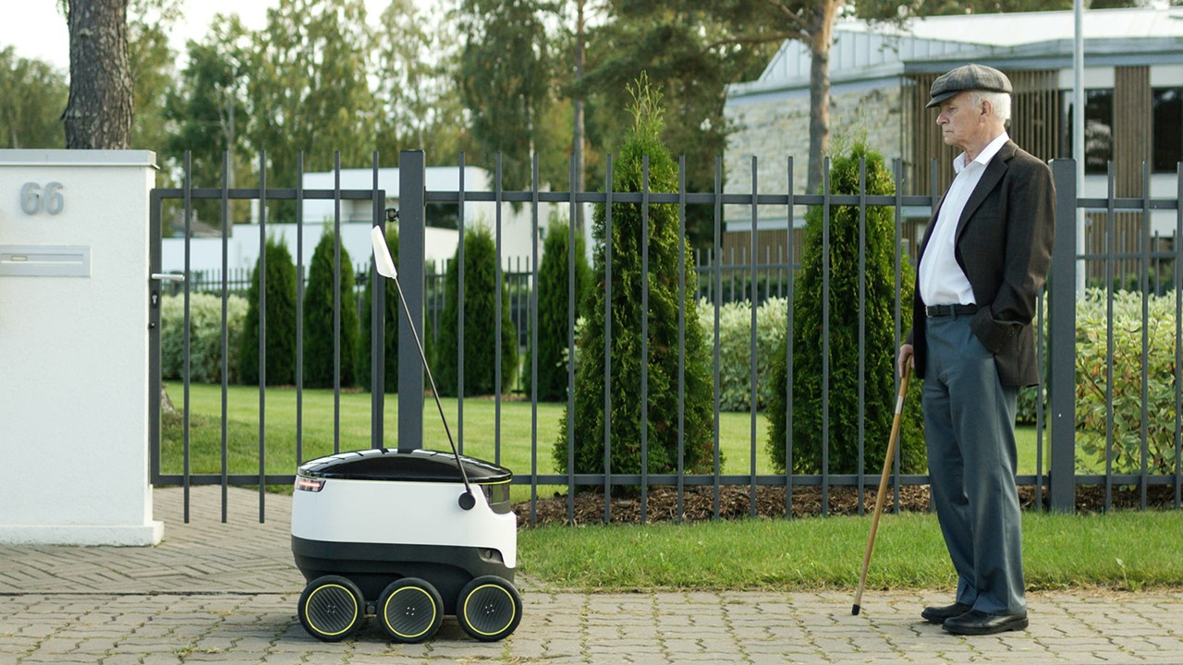
innovating for a future-proof tomorrow
future-ready mindset is our starting point
10 unicorns, #1 per capita in Europe
#1 largest share of data economy in Europe
digital integration in education, e-diary eKool since 2002
cryptography and blockchain pioneers, KSI blockchain #1 in national use
Notes:
We are committed to designing solutions that anticipate change and tackle pressing societal issues including environmental sustainability and AI readiness. Our legal framework supports the testing and validating of innovative ideas – such as self-driving cars or personal pickup lockers – before widespread implementation. We innovate and refine through structured experimentation, preparing for future challenges and opportunities.
We have created the ideal testing ground, welcoming trailblazing ideas from everywhere.
Our future-proof tomorrow is built on a top-tier education system, a business-friendly environment, and innovative thinkers.
Related facts:
Estonia is hailed as the world’s most advanced digital society. The innovative mindset is evident in the digitised services and solutions: from world-leading ICT to sustainable wood and food industries.
Estonia is known for a result-driven mindset – the digital environment supports us being the perfect test bed to try out new ideas and fail fast at minimum cost.
Estonia is a world leader in unicorns per capita, counting 10 today and hopefully more in the future.
Naturally, digital integration has also extended into education. Since the e-diary platform eKool launched in 2002, a myriad of e-solutions, state-sponsored and private, have made the learning experience more accessible. Estonian EdTechs are fuelled by an entrepreneurial spirit and supported by research collaborations, which have earned them local and global recognition.
The blockchain technology KSI is designed in Estonia and used globally to ensure networks, systems, and data are compromise-free while retaining 100% data privacy. Estonia ranks as the #1 country to use blockchain nationally.
A large portion of AI government use cases involve data analytics. Remote sensing and machine vision are widely used —for instance, monitoring snow depth, building surveillance, etc.
The widespread adoption of AI could increase Estonia's GDP by 3 billion euros or 8% annually at its peak.
https://www.kratid.ee/en/ai-use-cases
Success stories:
https://references.e-estoniax.com/

Slide 22

making illegal things legal
paving the way for innovation
prove locally, scale globally
data-driven legislative change
testing solutions in real-world conditions
Notes:
Accelerate Estonia develops targeted policy recommendations for the Estonian government to solve regulatory barriers encountered by businesses, creating an environment where new innovations can thrive and contribute to economic growth.
The need for Accelerate Estonia came from the need for a unified understanding and accessibility for companies to test innovative solutions without getting bogged down in bureaucracy.
A national regulatory framework for testing – similar to a nesting doll of regulations, there is a general framework, inside which are sector-specific regulations inside which are specific projects run by specific organizations or companies.
Example:
First, the Economic Activities Code (EAC) gets amended to accommodate the general norms for testing,
Then, within the EAC, the specific Act, for example the Medicinal Products Act (MPA), gets amended for testing purposes,
Finally, within the bounds of the MPA, The State Agency of Medicines, in collaboration with a private sector representative (Grab2Go), has the opportunity to test their 24/7 self-service pharmacies completely legally, proving the use case.
Estonia is building Europe's first holistic regulatory sandboxing system for businesses to test their unregulated or ahead-of-regulation solutions under real-world conditions. Then turn that data into action and collaborate with policymakers to update regulations. Here’s a real world example. When ride-sharing platforms like Uber and Bolt came to market, their business models weren’t exactly compliant with the laws. But countries saw the market demand and over the years incorporated those new business models into legislation.
✔️Test your illegal solution in real-world conditions
If your innovative solution still breaks a few outdated regulations, that’s alright. Estonia’s experimentation framework will allow to test solutions currently inhibited by sectoral regulations.
✔️Data driven legislative change
We’ll update inhibiting regulations based on data from your pilots and then give you direct access to policymakers to collaboratively enable novel business models indefinitely.
Prove locally, scale internationally
Once proven in Estonia, it's easier to scale both your product and the legislative solution all across the world, with Estonia as the launchpad.
Supportive ecosystem and digital state
With Estonia's e-Residency and startup ecosystem, you can set up a business in minutes. No physical relocation needed with our fully digital public services.
More examples of work done and companies:
Grab2Go portable, self-service pharmacies
Gelatex, novel food production
ÄIO, novel food production
Elektrilevi, Pattern Building project
Sources:
ÄIO and Gelatex make an exit: Now is the best time to develop food innovation! - Accelerate Estonia
Grünfin’s employee investment package: Impact analysis results and key takeaways for the future - Accelerate Estonia
Impact analysis: 24/7 automated pharmacies - Accelerate Estonia
A blueprint for change: How Accelerate Estonia helped Estonia pilot the first Pattern Building - Accelerate Estonia

Slide 23

straight to business
nothing should get in the way of a good idea
under 3 hours to start a company
paperless and hassle-free e-taxation
e-Residency – Estonian e-services for world citizens
Startup Nation – supporting ecosystem
Notes:
We stand out as a global business hub thanks to a highly educated workforce and cutting-edge digital capabilities. We have eliminated all bureaucratic obstacles to starting a business. The process can be completed online in minutes, along with essential tasks such as tax declaration. Through our e-Residency program, we extend these services to global entrepreneurs, providing a digital identity to launch and manage their EU businesses from any corner of the globe. Our tight-knit ecosystem nurtures new entrepreneurs, connecting them to a business network and unlocking doors to exponential growth opportunities. We welcome individuals worldwide through startup and scale-up visa programs tailored for digital nomads and international talent.
The speed and seamlessness of every interaction define our business environment.
Related facts:
Estonia's open and stable economy is characterised by adaptability and innovation. With a conservative budget policy, flat-rate income taxation, extensive freedom for foreigners to own land, and 100% profit repatriation, Estonia is one of the most business-friendly countries in the whole world.
Estonia ranks 6th in economic freedom in Europe in 2026 and 9th globally.
Estonia ranks 1st in International Tax Competitiveness Index 2025, 12th year in a row.
99% of banking transactions are done online and 98% of all companies are established online. Estonia has the 2nd fastest court proceedings in Europe.
There is 0% tax on retained and reinvested profits, and 14-20% tax on distributed profits. All taxes can be declared online.
Transparent, stable, and functioning legislation makes doing business in Estonia easy.
Remember one of the first slides that contained all those rankings? In one of them, Estonia ranked #1 worldwide in the area of entrepreneurial activity. And it’s easy to see why. From starting a company and declaring taxes to filing annual reports you can do effectively everything without leaving your couch. It’s a simple fact – where business is easy, business will grow. That’s why Estonia is also among the countries hosting the highest concentration of start-ups per capita.
In Estonia, establishing a company takes around half an hour, though our record lies at only 18 minutes. This had been a world record for quite a long time until Oman snatched the #1 spot from us – although it’s worth point out that Estonian IT companies provided the solution for Oman. Still, this simple environment is most likely why 98% of people prefer establishing their companies online. With 99.8% of all banking transactions made online, running a company in Estonia is easy.
What’s more, declaring your taxes is incredibly simple. In Estonia, 96% of all income tax declarations are filed online. The main reason for this is that it takes around 3 minutes on average to do it – everything is pre-calculated, you just have to log into the tax portal, confirm the data, and if it turns out that you are to get a refund from the government, it usually takes around 5 working days.
By the end of 2020 we want to implement Reporting 3.0 which is targeted at reducing the burden on entrepreneurs of the obligatory submission of data to state institutions. A new e-Tax and Customs Board portal will be completed in 2020, in which information exchange between companies and the tax authority will be automatic and require only the granting of access to the necessary data. This will save valuable time and money, so companies can focus on growth and people can work more productively.
And of course e-Residency is another important business factor. By now there are more than 13,000 companies made by e-residents which have added €11m in taxes in 2019 alone.

Slide 24

facts
#6
#1
99%
99%
economic freedom in Europe
OECD tax competitiveness index
companies established online
banking transactions online
you can also become an e-resident!
Notes:
#1 OECD Tax Competitiveness Index – 12 years in a row.
https://taxfoundation.org/research/all/global/2025-international-tax-competitiveness-index/
#6 economic freedom in Europe, in World #9
https://www.heritage.org/index/ranking
Estonia is low red tape country.
#8 in Corruption Pereception Index in 2025 https://www.transparency.org/en/cpi/2025

Slide 25
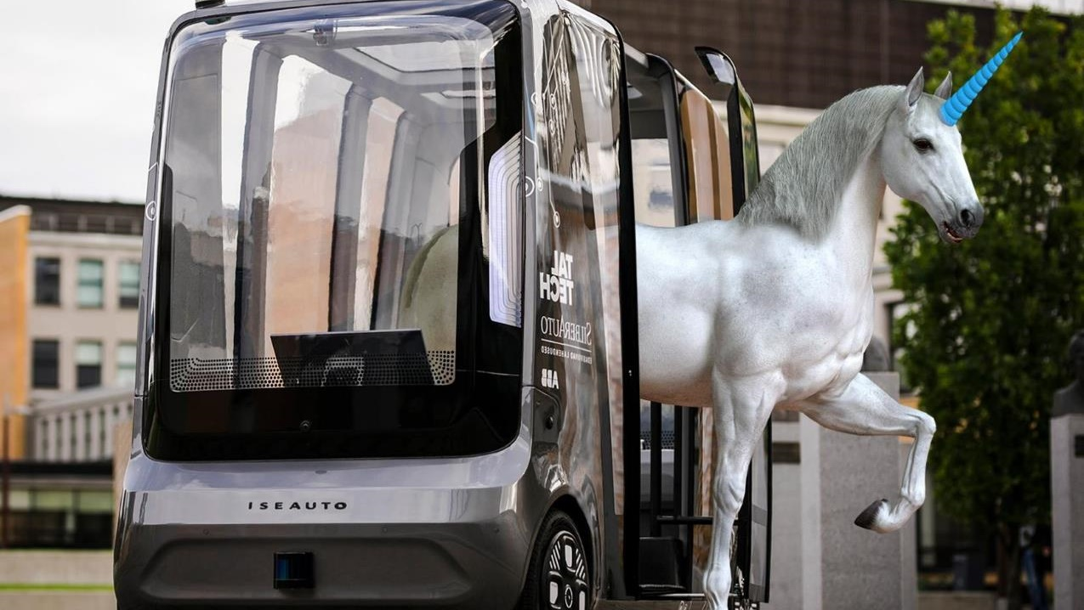
estonian startup ecosystem
1600+ startup sector companies
10 unicorns - #1 per capita in the European Union
1% of companies attract 12% of private R&D expense
Startup Estonia - support, model documents & visas
an agile and close-knit ecosystem
Notes:
What is a startup? In Estonia a startup is defined by 5 traits: an 1) innovative 2) technology company, that 3) has a scalable business model and 4) global growth potential and 5) up to 10 years old.
Official: A startup (iduettevõte in Estonian) has been defined by the Estonian legislator in § 62⁴ (2) of the Alien Act, which states that a start-up is a business entity belonging to a starting Estonian company, the purpose of which is to develop and launch an innovative and replicable business model with high global growth potential, that shall significantly contribute to the development of the Estonian business environment.
Observations from the Estonian Founders Society (asutajad.ee):
The workforce in Estonia is stable, with growing salaries (avg €4k/month) with profitability becoming the norm.
Runways are lengthening with almost 50% of startups surviving for more than 24 months
Founders main worries are sales, growth and go to market strategies alongside finding product-market fit, followed by fundraising
1600+ startups sector companies - Previously focused on startups, we now embrace a wider spectrum, including startup sector growth companies: mature startups, scale-ups, and successful exits still operating within Estonia.
Growth companies are:
Matured startups – companies that have evolved from the startup phase and are older than ten years.
Exits that remain operational within Estonia.
Scale-up champions as per the following criteria:
workforce of a minimum of 50 employees in Estonia;
paid at least €1 million in labor taxes in the past year;
the past three years showed a minimum 20% growth in cumulative labor tax.
10 unicorns.
In 2025, Estonia’s startup sector generated €1.8 billion in added value, accounting for 4.3% of Estonia’s GDP — three times more than five years ago. What makes this growth especially remarkable is its efficiency because the number of employees in the sector has not grown over the past four years, yet we now generate 2.5 times more added value per employee. The sector’s turnover is forecast to exceed €5.1 billion, nearly 20% higher than last year, while the overall Estonian economy grew by only about 1%.
Estonia has long been a popular destination for startups and entrepreneurs from around the world, thanks in part to its supportive ecosystem and startup-friendly policies. The Startup Visa helps non-EU founders grow their startup in Estonia and it also makes it easy for Estonian startups to hire non-EU talent.
Launched in 2023, the scale-up visa program is designed to help startups that have been in operation for over 10 years but are still rapidly growing. With the program, these companies can continue to grow and hire talent from outside the EU on preferential terms. Technology-based and innovative companies with fast global growth potential that meet the following criteria are eligible to apply for the Scale-Up Visa program:
Have at least 50 employees in an Estonian business entity
Have paid at least 1 million EUR in employment taxes in the last year in the Estonian business entity
Have shown a growth of at least 20% in employment taxes paid in the last 3 years
The ‘’by-product’’ of support organisations is a strong giving-back mentality within its network of mentors, with entrepreneurs who have been active for more than 10 years in Estonian startups like Fortumo, Wise, Bolt, Starship Technologies, and Pipedrive. For developing our startup ecosystem, we gather bimonthly to share experiences and open discussions, as quick information and knowledge sharing is the key to getting informed about what is happening around the ecosystem. Startup Estonia funds organisations by giving out grants to develop new services, events, and smaller projects that support startups in their growth. So, the strength of our ecosystem is its people - thought leaders who help to shape the ecosystem with new endeavours.
The best source of funding and investment news can be found at this crowdsourced table - https://docs.google.com/spreadsheets/d/1csgtaNSl949AumfOBhwhD_S-o7wc1UIhKZdWUS4Vy-Q/edit
A comprehensive database of all the startups in Estonia can also be found here: ecosystem.startupestonia.ee/dashboard

Slide 26

deeptech
research meets innovation in the New Nordic Tech Valley
complex solutions with complex obstacles
cooperation with universities and science parks
regional support with global impact
breaking regulatory barriers
Notes:
Support measures:
business development grant 50 000 EUR​
healthtech accelerator 2025-2027​
Applied Research Program grants up to 2M EUR​
SmartCap governmental fund of funds, incl green funds, new defense fund, deeptech fund​
NATO Innovation Fund, in cooperation with ESA BIC, EstVCA, EstBAN, etc.​
Obstacles - the obstacles to the emergence of deep tech startups are very complex, where the “production” of globally competitive companies that become success stories lacks supporting infrastructure, business knowledge, mentors, finances and regulations that encourage knowledge-intensive entrepreneurship.
+ our goal: 500 deeptech startups by year 2030
+ sectors in focus: defence, healthcare, energy, biotech, AI
According to Startup Estonia, there are 216 deep tech start-ups at the beginning of 2026. In 2025, deep tech start-ups paid €68 million in labour taxes to the state, 27% more than the previous year, demonstrating steady growth. By year-end, the number of employees in science-based companies had grown to 2,544. Deep tech companies attracted nearly €161 million in investment, which accounts for just over 52% of the total €309.9 million invested in the entire start-up sector.

Slide 27

public private partnerships
going the distance together
51% of the ICT sector’s revenue is coming from international clients
19% of total export
6.6% of total employment is ICT specialists with 26.8% women
meeting place for global innovators
future-proofing through expertise
Notes:
51% of the ICT sector's revenue is coming from international clients, showcasing sustained growth and global demand. (ITL, 2024)Use the narrative as a blueprint for crafting engaging content and shaping the overall messaging strategy.
100% of all public services are accessible online, with the infrastructure developed from scratch and continuously maintained & improved by IT companies in close cooperation with the government (2023).
#5 in the EU for the proportion of ICT specialists in total employment.
8% ICT sector contributes to Estonia's GDP The annual growth rate of the Estonian ICT sector has been around 8% in recent years, outpacing the average EU growth rate of 5%. (Eurostat, 2022)
#10: Estonia ranks 10th globally in ICT services export as a percentage of total exports. (WTO, 2022)
30%: ICT services account for 30% of Estonia's total services exports. (Bank of Estonia, 2022)
Estonia’s digital services save around 1407 years of working time annually and has become a hassle-free environment for business and entrepreneurship (e-Estonia)
In the ICT sector, there were 13,906 companies in the second quarter of 2024. Of these, 9,538 companies (approximately 69%) have 0 employees, 3,987 companies (approximately 29%) have 1-9 employees, and 381 companies (2.7%) have 10+ employees.
driving global progress through expertise in Data Analysis, AI, IoT, CyberTech, and smart city innovation
At country level, the highest shares of women among employed ICT specialists were observed in Bulgaria (29.1%), Estonia (26.8%) and Romania (26.0%), while the smallest shares were observed in Czechia (12.4%), Malta (13.8%), Hungary and Italy (both 15.7%). Source: Statistics | Eurostat
Estonian Association of Information Technology and Telecommunications
Non-governmental and non-profit organization – umbrella for the ICT sector. Gathering the most innovative e-Estonia companies and acting as neutral one-stop-shop for collaboration partners
139 members: software developers, consultation providers, telcos, education providers etc
Core working areas:
- Politics and business environment; ‘
- Workforce and education;
- Business development and export
24 years of technology sector development as an umbrella
Combining the joint opinion of the sector
Voicing and representing the opinion of the sector
Organizer of the collaboration between the public and the private sector
Partnership builder in international collaboration through MoUs, workshops, trainings and joint projects
One-stop-shop for most innovative e-Estonia companies and core competences of GovTech
Core competences of GovTech (members who have built e-Estonia and keep contributing to it): e.g. Nortal, Helmes, Cybernetica, Datel, SK ID Solutions etc. + unicorns such as Bolt, Playtech, Skype + consultation organizations such as eGA, Digital Nation, Proud Engineers + education providers such as TalTech, BCS Skills Academy etc.
Success stories: https://references.e-estoniax.com/
Talking points:
Estonia’s ICT sector attracts a diverse and high-caliber international talent pool, which fuels innovation through research and development (Starship Technologies, Moderam).
Our borderless approach ensures that Estonian ICT solutions remain at the forefront of technological advancements (Cleveron, Veriff).
By attracting specialists from abroad (Jobbatical), Estonia addresses local skill shortages particularly in IT and cybersecurity. Comprehensive support helps digital nomads and international talent feel at home, leading to more stable and long-term contributions.
Through supportive initiatives, like the Digital Nomad Visa, Work in Estonia initiative, the country expands its talent pool, reinforcing its reputation as a leading hub for tech and cybersecurity innovation. This, in turn, creates an environment conducive to both personal and professional growth, ensuring long-term socio-economic benefits.
“Estonia's ICT sector has emerged as a hub of excellence, attracting foreign professionals with its efficient business setup processes, commitment to digital innovation, and support for international talent. The collaboration between Estonia's ICT sector and its educational institutions creates a strong ecosystem that nurtures innovation and entrepreneurship.”
Carlos Paniagua
CTO and Co-Founder at Glia

Slide 28
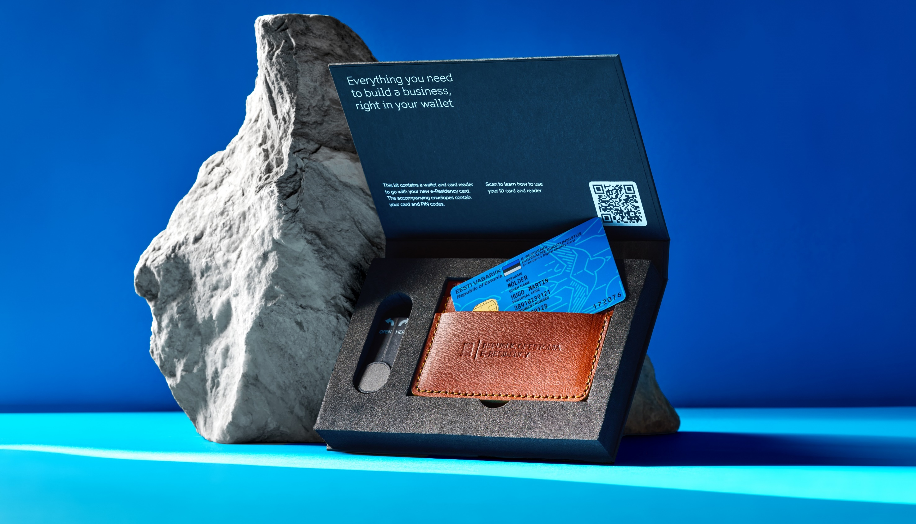
e-Residency
become an e-resident today
first in the world
185+ countries
142 000+ e-residents to date
43 000+ e-resident companies
>400M € direct positive economic impact on Estonia
Notes:
Estonia’s e-Residency is a government-issued digital identity that opens doors for entrepreneurs, freelancers, and business owners worldwide. Launched in 2014, it was the first programme of its kind, offering a unique way for people from any country to start and manage a business entirely online.
With e-Residency, you gain access to Estonia’s world-leading digital infrastructure, allowing you to securely authenticate your identity online, sign documents digitally, and run a company remotely. Whether you’re a freelancer looking to establish a simple business structure or a founder aiming to scale globally, e-Residency provides the tools you need to succeed.
As a digital nation, Estonia has created an open and transparent business environment, supported by cutting-edge e-services. e-Residency makes it possible to tap into these services, giving you the freedom to operate your business 100% online, from anywhere in the world.
With over 142,000 e-residents in more than 185 countries, e-Residency empowers a diverse global community of entrepreneurs who benefit from a secure, trusted, and efficient digital ecosystem. It’s not just about starting a business—it’s about being part of a forward-thinking, digitally connected world where opportunities are endless.
Info if asked:
Where will I pay my company taxes? Your Estonian company will automatically be considered a tax resident of Estonia when it is registered. However, your company can also be considered a tax resident or create a Permanent Establishment in another country, thus have tax liabilities there. E-Residency does not exempt companies from dual tax residency or foreign tax liabilities. To avoid double taxation Estonia has signed treaties with 60+ countries.
Additional FAQs (check bottom of the page: https://www.e-resident.gov.ee/start-a-company/)
Website: https://www.e-resident.gov.ee
Dashboard: https://www.e-resident.gov.ee/dashboard

Slide 29


real-time economy
new mindset change for governments and businesses
first positive use-cases
+ taxonomy - systematized data, not reports
+ transition to automated reporting and once-only principle
+ seamless data exchange directly from ERP to state
+ trustworthy and controllable
+ make value for the company and increase productivity
Notes:
EXAMPLE: Rakvere hospital adopted real time economy principles with their personell management(mainly paying the salaries and sharing that data). The analysis shows an 88% decrease in the time that was needed to deal with any type of reporting. It took a bit over 50h per year to deal with it before and after adopting RTE principle the time cost became 7h a year. This removes repeatedly reporting data that stays the same. For a hospital, it means that they automated the process of reporting this to Tax and customs, statistics estonia, institute of health development.
As we are trying to develop our economic ecosystem we are talking more and more about real-time conomy. It goes hand in hand with digitalisation and is the future of our economy.
In Estonia we have over 420 different reports that our businesses have to fill.
ERP- Enterprise resource planning aka the mangement of main business processes like invoicing, permits, composing declarations, reports and contracts and other similar administrative tasks.
Nowdays a surprising amount of admin is managed on paper. Even in our digital state. And it is time consuming. We are trying to create a system where information would be moving seamlessly in the backround. So imagine making all your invoices in a software that bring everything together and calculates all for you when it is time to send your annual report.Imagine bringing the general once-only principle to the data related to your business. If a bit of data is already inserted into the system, then there shoud not be a necessity to insert it again.
This real time economy isn’t only related to financial data, but all kind of data that the business might need to report. Nowdays we are talking about environmentalreports aswell(waste management, water management, emissions management etc.).
Real-time economy stands for new mindset change for governments and businesses
Starting a business in Estonia is easy, but the struggle that comes after is still a burden. We have recognised our weakness and working on it to be our strength. We are aiming to provide the best business environment in the world
Business data is created every second, it's just not valued enough. Why? Because business data is not in a high-quality and standardised format, therefore the machines can not understand it for automated exchange, which means that data cannot be used to their full value to bring added value back to the entrepreneur.
Real-time economy focuses on improving business data exchange (in or near real-time) with the state and business partners through standardisation to help decrease administrative burden and increase business productivity and profitability.
Real-time economy enables data driven decision making in both private and public sector and helps to achieve real-life goals. RTE is about standardising the business data that is already being created, so that it can be shared easily and automatically, in order to create added value from shared data, i.e for fast, high-quality and data-based financial management or other business decisions.
Why real-time? Today, when we finally get the needed data after long requests, it is not in high-quality format and is already outdated - its value for us has decreased over time or disappeared completely. Annual reports for the last „not so good numbers“ year bring no value if in new year January start-up company included investments for 100M eur.
OBJECTIVE:
Businesses can focus on urgent business matters, on things that ​really make value for the company and increase productivity, ​instead of dealing with various time-consuming administrative activities
TIMELINE: 2020-2027, will be updated and prolonged until 2030
RELEVANCE:
+ Political will: Governmental initiative and priority, related approximately 10 governmental action plan activities
+ Supported by different sector-specific strategies
FUNDING:
+ National budget + different EU fundings ca 30M € (50% for private sector support)
APPROACH:
+ Regulative
+ Quality data and business process
75% of companies prefer that all e-services provided by the state would be accessible on a single central portal
Entrepreneur's digital gateway and event services
Public services must be convenient and efficient for users. If the provision of the service is expected by the user and the necessary data for delivering the service is available, the initiation of the service should, in every possible case, be carried out by the institution.
The Entrepreneur's Digital Gateway brings together reliable information and public services from the eesti.ee portal, making it easy and convenient for entrepreneurs to interact with the state. The platform ensures unified access to public sector information and services and supports proactive and event-driven future solutions for entrepreneurs, utilizing new technologies and the possibilities of artificial intelligence.
https://www.mkm.ee/en/node/9421
https://www.youtube.com/watch?v=rUi2zQbCwGc&list=TLGGe2vogSXiyc4xNDA5MjAyNA&t=25s
INFO VANADELT SLAIDIDELT:
The use of real-time economy solutions, e.g e-invoicing, e-receipts, data-driven reporting, e-waybills, could help save more than 14 million working hours (approx 7000 FTE) and 200 million euros per year in Estonia.
In real time economy we are talking about different data exchange supply chains and use-case – but they all have three things in common:
they are all generated somewhere in standardised form, e.g e-invoices, e-orders, digital product passports, transportation documents;
they are all shared to someone in a secure and trustworthy way using interoperable data exchange infrastructures, e.g reporting to the state, incl VAT and sustainability reporting.
shared data must always bring extra value (or new services) for the entrepreneur, e.g thorugh reusing the data based on the entrepreneurs consent offered by both public or private sector parties.
Current situation in building blocks:
Estonia is still lagging behind with the wider use of e-invoices – 23% of B2B (compared to Finland 70%+)
About 99 % of cross-border transport operations in the EU still involve paper-based documents, which leads to very time and resource consuming business processes.
Estonia has over 400 mandatory reports obligation for businesses with over 60 000 data fields! Pilot standardisation shows almost 90% might be duplicated and can be decreased!
In order to achieve real-time economy, businesses and public sector need to work together. We are working in both streams – we are building technical capabilities in public sector as well as providing support measures for the private sector in paralleel (over 15mln eur). Real-time economy needs both sectors to be innovative, like-minded and focused on the same goal.
Examples:
Data-driven reporting
Unified and standardised taxonomy for reports (e.g Annual Reports, VAT and other tax declarations, sustainiability reports, statistic reports, packageing and fuel reports, waste management, air pollution and water reports) across agencies – meaning one data field is described the same way in both Tax and Environmental Agency – real solution for achieveing once-only principle!
The principle of minimality – reporting data is obligatory as little as possible and as much as is really necessary.
Example: Entrepreneurs dealing with packaging their goods need to submit at least 3 reports with the same data to 3 different authorities. Packaging report for Ministry of Environment, packaging exise duty for Tax and packaging statistics for the Estonian Statistics. After we have standardised the reporting data – businesses will only fill in the data in their own systems and systems will automatically filter out the right data for the right authority and send it on the right time.
Business Viability Index for businesses based on AI
Service displayed free of charge on Eesti.ee
Based on both financial and non-financial information (employees, location, weather data, etc.)
Automated forecasts, automated suggestions and recommendations
Counseling (at the entrepreneur's request and when sharing his data)
Company data is visible only to the entrepreneur
KYC microservice piloting and development:
Making data available to the private sector (open data and based on the consent of the entrepreneur)
Possibility for private sector to create new services with added value
​Providing partners with a quick and trustworthy overview of company's economic indicators
Everything we do in Estonia is meant to be taken as cross-border business (or regional) development. From Estonia, we are only giving the examples of how RTE can be implemented in one country and across borders. The key is to have the same principals across countries.

Slide 30
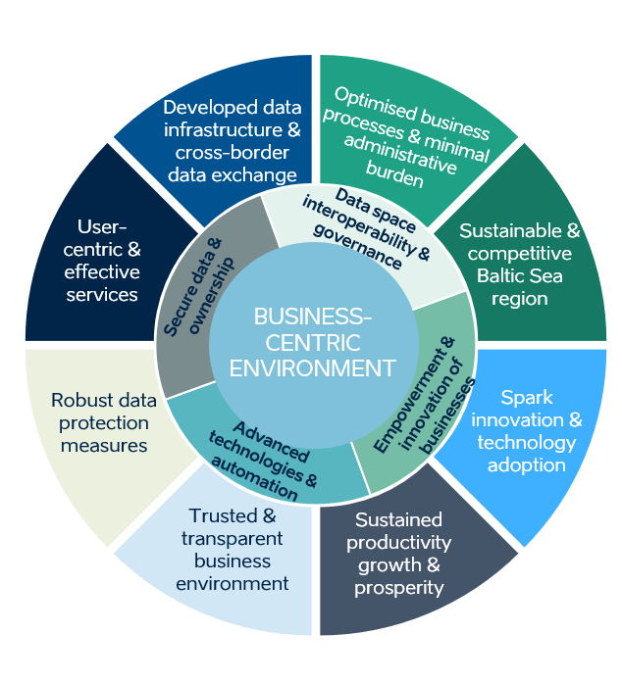
standardised business reporting
Key elements:
Unified and standardised data across agencies
Private sector active participation
Financial and non-financial data on business activities (tax declarations, annual reports & sustainability)
Once Only Principle – inserting vs submitting data
Sustainability (ESG) reporting (water, waste, air, package, fuel, labour and workforce data, etc.)
the principle of minimalism
Notes:
The use of real-time economy solutions, e.g e-invoicing, e-receipts, data-driven reporting, e-waybills, could help save more than 14 million working hours (approx 7000 FTE) and 200 million euros per year in Estonia. Estonia has over 400 mandatory reports with over 60 000 data fields! Pilot standardisation shows almost 90% of them multiples!
In real time economy we are talking about different data exchange supply chains and use-case – but they all have three things in common:
they are all generated somewhere in standardised form, e.g e-invoices, e-orders, digital product passports, transportation documents;
they are all shared to someone in a secure and trustworthy way using interoperable data exchange infrastructures, e.g reporting to the state, incl VAT and sustainability reporting.
shared data must always bring extra value (or new services) for the entrepreneur, e.g thorugh reusing the data based on the entrepreneurs consent offered by both public or private sector parties.
Current situation in building blocks:
Estonia is still lagging behind with the wider use of e-invoices – 23% of B2B (compared to Finland 70%+)
About 99 % of cross-border transport operations in the EU still involve paper-based documents, which leads to very time and resource consuming business processes.
In order to achieve real-time economy, businesses and public sector need to work together. We are working in both streams – we are building technical capabilities in public sector as well as providing support measures for the private sector in paralleel (over 15mln eur). Real-time economy needs both sectors to be innovative, like-minded and focused on the same goal.
Examples:
Data-driven reporting
Unified and standardised taxonomy for reports (e.g Annual Reports, VAT and other tax declarations, sustainiability reports, statistic reports, packageing and fuel reports, waste management, air pollution and water reports) across agencies – meaning one data field is described the same way in both Tax and Environmental Agency – real solution for achieveing once-only principle!
The principle of minimality – reporting data is obligatory as little as possible and as much as is really necessary.
Example: Entrepreneurs dealing with packaging their goods need to submit at least 3 reports with the same data to 3 different authorities. Packaging report for Ministry of Environment, packaging exise duty for Tax and packaging statistics for the Estonian Statistics. After we have standardised the reporting data – businesses will only fill in the data in their own systems and systems will automatically filter out the right data for the right authority and send it on the right time.
Business Viability Index for businesses based on AI
Service displayed free of charge on Eesti.ee
Based on both financial and non-financial information (employees, location, weather data, etc.)
Automated forecasts, automated suggestions and recommendations
Counseling (at the entrepreneur's request and when sharing his data)
Company data is visible only to the entrepreneur
KYC microservice piloting and development:
Making data available to the private sector (open data and based on the consent of the entrepreneur)
Possibility for private sector to create new services with added value
​Providing partners with a quick and trustworthy overview of company's economic indicators
Everything we do in Estonia is meant to be taken as cross-border business (or regional) development. From Estonia, we are only giving the examples of how RTE can be implemented in one country and across borders. The key is to have the same principals across countries.

Slide 31

democracy has a digital spirit
empowering modern democracy in the digital age
personal data and usage available to citizens in Data Tracker
ensure trust through transparent digital services
online participatory tools: i-voting, citizens initiative portal
Estonia among the 12 least corrupt nations out of 180
Notes:
Our commitment to digital democracy is made through transparency, inclusion, and accountability. We empower our citizens by creating a digital environment of openness and trust. Technologies such as i-voting and the citizens' initiative platform have democratised decision-making, giving individuals a direct voice. Digital solutions enable participation, regardless of physical constraints or geographical location. Our commitment to data transparency ensures that individuals retain control over their personal information, safeguarding it from misuse.
As we progress, designing and utilising appropriate digital tools is paramount to protecting democracy.
Established in 2016, Rahvaalgatus has demonstrated the remarkable engagement of Estonians in actively voicing their opinions alongside decision-makers. Rahvaalgatus allows to make initiatives both on a national and local level. A proposal to the Parliament has to gather at least 1000 signatures, and for local government, a proposal has to gather signatures from at least 1% of its residents with voting rights.
Rahvaalgatus serves as a potent weapon against populism. Social media tends to amplify extreme posts to garner more attention, often exacerbated by fake accounts. Thanks to Estonia’s secure eID system, Rahvaalgatus ensures a distortion-free representation of public views. This system effectively counters situations where a single individual could artificially inflate petition signatures, maintaining transparency. Notably, signatures are deleted once the petition completes its journey through all stages.
AvaLinn
The AvaLinn engagement app gives you the opportunity to submit your ideas and proposals regarding public spaces. Your feedback is important to urban planners in creating a more people-friendly urban environment.
Tallinn has a participatory budgeting for to implement the proposals of the townspeople.
https://www.tallinn.ee/et/avalinn/lae-alla-tasuta-app-avalinn
Trust
Estonia has an actually functioning digital state (so far the only one in the world). We trust our digital services because they function and are reliable.
Supporting facts:
Democracy is supported by digital identity, secure data exchange, and high-quality databases, which allows government-backed institutions to work efficiently.
The Information System Authority (RIA) has made an ally available to citizens to manage their data. Today, four major government agencies participate in the project, making the automatic tracking of personal data usage by subject possible. These are:
The Population Register
The Health Insurance Fund;
The Estonian Unemployment Insurance Fund;
The Social Insurance Board.
Estonia is among the 12 least corrupt nations out of 180 countries, according to the 2023 Corruption Perceptions Index reported by Transparency International, reaching a record low in 2023.

Slide 32

i-voting
voting over the internet since 2005
first and safest in the world
time and location independent
strictly optional
possibility to change your vote
up to 3 times cheaper
51% i-voted in the 2023 parliament elections
Notes:
Another cornerstone of digitalisation in Estonia has been i-Voting. i-Voting is possible in local, national and European Parliament elections since 2005. It is an optional way of voting, so you can always vote on paper if you prefer that for one reason or another. To vote electronically, a voter will need a secure computer with an internet connection and an ID-card with a reader, or a mobile-ID, download an i-voting application and verify their identity using Estonia’s electronic ID.
Crucially, you can change your vote during the 6-day digital voting period so no one can force or bribe anyone to vote for a certain candidate. Interestingly, this solution has also been very appealing for the elderly who might not be mobile enough anymore to cast their votes on paper. In the recent elections, over a half of all votes were cast online, probably because it is location-independent, time-independent and a lot easier and faster. It is considered the world’s first mostly digital elections. If a voter has voted both electronically and by using a paper ballot, only the vote cast at the polling station will count. From 2021, voters can change their i-vote by voting with a ballot paper at a polling place on Sunday, the election day.
Essentially, the i-vote is a digitally signed file that is sent from the voter’s computer to the i-ballot box. No-one can change that vote and, on the election day evening it will be counted in the same form. Within 30 minutes after casting the vote, every i-voter can verify with the help of a smart device if their i-vote reached the i-ballot box safely.
i-Voting is possible because 20 years ago Estonians chose the world's most secure method of identification – our e-ID.
The political opposition, with the help of top specialists, has tested i-voting in every possible way, but no one has managed to break it.
The researchers of the University of Tartu have found that if it takes voters more than half an hour to go to the polling place, they prefer to i-vote. It is difficult to assess whether i-voting directly increases turnout. The greatest impact on voter turnout has been in regard to voting in foreign states – people who are travelling or living abroad can vote conveniently.
As a nice side effect for the government, an i-Vote is about three times cheaper than the average vote on paper. And it is arguably more secure, too. If you want to know how your vote is counted and what the source code behind all of this magic is, you can check out the link below.
For transparency, here is the source code: https://github.com/vvk-ehk/ivxv
Statistics: https://www.valimised.ee/en/archive/statistics-about-internet-voting-estonia

Slide 33

e-tax
the first public online service since 1999
taxes filed in 3 minutes with digital ID
pre-filled forms with automated data
applies to all types of taxes
99% of income taxes are declared electronically
Notes:
As we’ve talked about before, the X-Road allows different authorities to exchange information. This lends itself particularly to services or situations, where lots of information from many different government authorities is required. One perfect example for this is the tax form. Thanks to the aforementioned data exchange, most tax forms are „pre-populated“ or filled out already by the Tax Board, meaning the end-user only has to look through the data and confirm with a simple mouse-click.
Fun fact: The income tax declaration was the first online service in Estonia (1999) and many people used it because of the promise that those who would submit their taxes online would get their refunds more quickly than those who did it on paper. Today, 99% of income tax is declared digitally, which reveals another, at least equally important point: If a digital service solves a problem of the population in a user-friendly manner, only very few will refuse to use it. 99% statistically includes the younger and older generations – people from all socio-economic backgrounds.
e-Tax is an exceptionally fast and highly praised service.
The annual public survey conducted by the Estonian Tax and Customs Board shows that 91% of Estonians agree that paying taxes is every citizen’s duty, and 88% know when and how taxes should be paid. Public trust in the Estonian Tax and Customs Board is one of the highest among public offices in Estonia. Thanks to these advances, people generally correct any potential mistakes in their tax declaration themselves and tax administrators can focus only on problematic cases.

Slide 34

e-health
data-powered personalised health
99% of health data has been digitised
e-prescription
e-ambulance
biobank with 210 000 donors – 15% of Estonians
personalised medicine
Notes:
It won’t be a surprise to hear that, just like most Western nations, Estonian society is also aging. Thus, the health of its citizens requires attention and solutions both for treatment and prevention. There will be a significant shift in the healthcare sector as not enough young personnel is coming through the ranks to support a growing population that needs that support.
Before we can talk about digital services in this sector, we need to talk about the legal situation though. In Estonia, the patient owns his or her personal health data. Since 2008, hospitals and doctors in Estonia have been required to digitise personal health data and make it available in the e-Health Record. In order to keep health information completely secure and at the same time accessible to authorised individuals, the electronic ID-card system uses blockchain technology to ensure data integrity and mitigate internal threats to the data. In the health portal, the patient can see who has looked at their medical data and could also block access to different groups of individuals.
Some of these e-services don’t even require any IT-skills such as the e-Prescription; you simply take your ID card to the pharmacy, the pharmacist scans it, and that’s how you get your prescribed medicine. That way, the older generations don’t even realise that they are using a high-tech IT solution that helps them get the right medicines or prescriptions quickly and conveniently.
Speaking of e-Prescriptions, as of January 2019, the first EU patients can use digital prescriptions issued by their home doctor when visiting a pharmacy in another EU country: now Finland, Croatia, Poland, Spain, Latvia, Lithuania, Greece, Czech and Portugal have mutually recognised digital medical prescriptions. For example, Finnish patients are now able to go to a pharmacy in Estonia and retrieve medicine prescribed electronically by their doctor in Finland. The initiative applies to all e-Prescriptions prescribed in mentioned countries and to the Estonian pharmacies that have signed the agreement. The novelty of this initiative is that the e-Prescriptions are visible electronically to participating pharmacists in the receiving country via the new eHealth Digital Service Infrastructure, without the patient having to provide a written prescription.
Cross-border exchange of patient’s health data summary is a new solution, launched in Estonia in 2022, simplifies the work of doctors and other health care workers and professionals, providing quick access to a summary of the health data of a foreign citizen in a critical situation. This means that if a person is involved in an accident and is unable to give explanations or does not know the local language, the doctor can get basic information about his or her critical health data (drug allergies, recent surgeries, etc.), and is therefore enabled to ensure better treatment. The summary contains only the main and critical details that allow the foreign healthcare professional to get an overview of the data in his or her own language in order to provide better healthcare to the patient.
The countries exchanging cross-border health data summary:
For Estonian citizens in Portugal
For Estonian citizens in France
For Estonian citizens in Luxembourg
For Portuguese citizens in Estonia
As for the e-Ambulance solution, it effectively detects and positions the phone call for the ambulance within 30 seconds and sends the emergency ambulance to the necessary point as quickly as possible. The paramedics also have access to some crucial health data, such as blood type, allergies and current medicine prescriptions. From the ambulance the paramedics can send important info to the hospital so they can already start setting everything up for the patient.
Thinking more directly about the future, the Estonian system has set the priority to not only treat but also prevent health issues because prevention is cheaper than cure. In order to do that, the Healthcare 4.0 system will focus on personalised medicine. This means that thanks to genome-based analysis, people will become more aware of those factors influencing their health and each person can progressively become more responsible for managing their own health. If we consider that today we can only predict general health trends, then in the future more personal health consulting will be available based on the analysis of the person’s health account. Because every person does not need every medical service all the time. You only need the ones personal to you. This should greatly improve the treatment quality for patients across Estonia and simultaneously save the medical sector as well as health authorities valuable time and money.
With personalised medicine we are talking of information based on your genetics, also your lifestyle, health history and the history of your family members.
Patsiendiportaal: Patient Portal - Patient Portal (digilugu.ee)
Find out more: https://toolbox.estonia.ee/?tag-sector=healthtech

Slide 35

education
europe’s smartest children
1st in OECD PISA tests in Europe
ICT education from an early age
digital by default
digital education materials
kood / Jõhvi
Notes:
By now you might be thinking “Wow, Estonians must all be geniuses. They must be really content with that they have.” Well, the first sentence is a very kind compliment, thank you very much. The second point is incorrect though. Estonians are fully aware that raising smarter kids is the smartest investment a country can make – it is the youth of today that will continue to build Estonia’s information society. In fact, even today Estonia lacks more than 50,000 specialists in the IT sector. Estonia is also painfully aware that for its lack of natural resources it has to focus on the resource between the ears of its inhabitants. With this in mind, Estonia aims to implement modern digital technology more efficiently and effectively in learning and teaching to improve the digital skills of the entire nation.
And you can see that hard work does indeed pay off. Estonia is ranking 1st in the OECD’s PISA tests in Europe and it also started offering robotics courses and programming classes for kids many years ago. This is targeted at making sure that every student receives the necessary knowledge and skills to access the modern digital infrastructure for future use.
Estonia has digitised all national educational materials. The e-education system, meanwhile, allows parents to check the grades of their children at school, while digital signatures ensure that children can’t skip school or try to fake a note from their parents. This solution actually reduced skipping classes by 30%.
During the Covid-19 pandemic, it was easy for Estonia's education system to adapt to distance learning because the materials were already available online.
Finally, Estonia has also adopted a lifelong learning strategy because it understands that the private sector’s expectations towards the labour force continue to change. Thus, both state and private sector companies offer a variety of (often free) IT-courses for enthusiasts of any age. This gives the opportunity for people to educate themselves and increase their IT skills while making it easier to make the necessary changes in their career choices.
kood / Jõhvi: kood/Jõhvi - Your entrance to the world of tech! – good example of private initiative

Slide 36


don’t ban, teach instead
61%
preparation for the future
jobs requiring
generative AI assistance
in the next decade
unless we all, collectively, decide to stop using AI, we must all, collectively, learn how to use it responsibly
importance of the teachers
ensuring safety through smart regulation
Launch of
2025 AI Leap
Notes:
ATTITUDE:
Generally Estonian Ministry of Education and Research is ecouraging the use of AI. This is all they can do because schools and teachers are autonomous in this transition. While schools make the transition, the state needs to manage the legislative side of things- assessing the risks regarding the use of AI among children, monitoring the exam/study results of the students, regulating everything regading data protection.
The principle is that we are not planning to ban technology from schools as it would be a disservice for our children when preparing them for the future. Unless we all, collectively, decide to stop its use, we must all, collectively, learn how to use it responsibly. The strategy to focus on educating instead of strict regulation is also in accordance with the principles of the Education Strategy 2035, which includes the government's efforts to integrate digital skills at all educational levels, encourage lifelong learning, and create policies for flexible learning and continuous skills development. The ministry of Economic Affairs and Communication has made survey which shows that in the next decade we will see about 61% of our jobs be connected to using AI actively and often. We have to prepare our children for that because we understand, that generative AI will be a tool that close to 2/3 of our population will need to master to stay competitive, both individually and as a nation. We also know that our young spending a lot of time behind screens does not make them more skillful with using tech and most of them lack functional skills to use these tools.
It differs a bit based on the AI but generally speaking we feel that children should be introduced to AI tools from age 13.
What we do not want is AI deciding on the curriculum and personalising that. This may jeopardise students’ autonomy. This should still be the responsibility of the teacher and Estonia is not planning to change that. The end decisions have to be made by humans and we are still retaining the personal relationship between the teacher and the students.
With AI we can also create more equality in our classrooms. It is normal that there are some students who are more competent than others and some students who are slower. Giving them all tools like 99Math creates a learning environment where all students look the same. You don’t see some students learning from simplified textbooks for example. This prevents social issues between students and potential bullying.
99Math- a program where the algorithm presents students with tasks based on how well they solved the previous ones.
Bizplay- a program where the user(be it the students or the teacher) can play through different situations regarding handling finances or owning a business. It helps to understand entrepreneurship in a playful way.
OpiqGPT- Public sector initiated pilot that mimics ChatGPT, but contains materials from different textbooks that are currently used in Estonian schools. It gives student an opportunity to become familiar with conversational AI, but through fact checked material and in estonian language. Project was partially funded by the EU.
The important part is to ensure the same education quality for all- the students using a tablet and the ones learning more traditionally from a textbook. And also not to forget all nondigital and successful teaching methods.
REGULATION:
The state does not regulate AI use in schools nor does it have specific stats about the level of AI use in schools across Estonia.
European AI Act came into effect in August 2024 and according to that the Ministry of Education and Research is assessing the risks regarding different type of AI that can be potentially used at schools.
Memorandum of understanding (MoU 2.0) made between the ministry of Education and Research, ministry of Economic affairs and Communications, universities, EdTech startups and their representing organisation EdTech Estonia. The goal is to turn competition for resources and user attention into win-win collaborations, using social innovation and collective solutions.
In January 2024, the Ministry of Education and Research appointed the AI council, whose members are both experts from the ministry as well as top experts from other fields, including entrepreneurs, scientists, and visionaries from education. In June 2024 the AI Council presented a report to the minister about the suggested steps of going forward with the topic of AI in Estonia. One of the responsibilities of the council was to provide input for the creation of training programs for teaching the usage of AI, including the safety issues connected to the latter.
AI manual created in 2024 by ministry of Education and Research for schools that has separate recommendations to headmasters, teachers and students.
The strategy to focus on educating instead of strict regulation is also in accordance with the principles of the Education Strategy 2035, which includes the government's efforts to integrate digital skills at all educational levels, encourage lifelong learning, and create policies for flexible learning and continuous skills development.
AI Leap 2025, that is inspired by the historic Tiger Leap programme. Estonia will launch in the fall of 2025 the AI Leap educational programme in public-private sector cooperation to embed artificial intelligence (AI) tools into everyday learning in Estonian schools. With the programme, all students in Estonian upper secondary schools and vocational schools and their teachers will receive free access to the world’s best AI applications and the necessary skills to use them wisely in learning. This will ensure the continued competitiveness of the Estonian economy and the next stage in the development of e-Estonia, our digital society.
More on that: https://www.aileap.ee/
PROBLEMS WITH THE TRANSITION:
We are still lacking in general digitalisation levels in schools. The situation varies a lot in bigger and smaller schools because with the latter the local governments are a big influence. Some don’t think digitalisation is a priority to invest in. And all the ministry can do is to advise and counsel the schools, but the schools are autonomous so no institution can be forced.
Some people still feel that physical tools are safer than digital and haven’t had the necessary mindshift. We know from the experience of Ukraine that in a situation of crisis people aren’t reaching for their textbooks first and aren’t coming together to replicate a traditional classroom in a bunker. COVID also taught us a lesson that if all else fails then you can still continue online. We have many digital alternatives to textbooks. For example a subscription to a program where the teacher can create their own materials with the help of AI. Often teachers and headmasters aren’t considering this as an option. It is first of all costly to make that transition but you can say that the emotional cost is even bigger.
Data privacy and GDPR is the most unsexy topic for teachers, parents and the general public. It’s dangerous because in education we are talking about data regarding underage children. Looking at how children and adults both are sharing their private lives on social media, we can assume that this area still needs work. Often parents don’t even know if their children’s data is managed correctly and safely and that they have to give permission for some things. In return the schools don’t even ask for that permission to process the students’ data.

Slide 37






supporting the learning curve
engaging the brightest minds
Unicorn Squad empowering girls in tech
Formula Student encouraging engineering in motosports
EstCube launching student-made satellites to space
Solaride paving the way for solar-powered vehicles
CyberSpike making cyber defence competitive
Notes:
UNICORN SQUAD:
Unicorn Squad is a nationwide initiative launched to engage girls aged 8–14 in technology and engineering through fun, hands-on learning. Goal is to address the gender gap in STEM.
The program is often hosted in schools or community centers—where volunteer instructors guide weekly sessions. Activities include building robots, programming microcontrollers, experimenting with electronics, and solving engineering challenges.
Unicorn Squad is supported by private donors, tech companies, and volunteers. As of 2025, there are around 200 active clubs across Estonia, including in rural areas, making it one of the most widespread youth tech initiatives in the country.
The program has significantly increased interest in STEM among girls and has inspired similar initiatives in other countries.
FORMULA STUDENT:
Formula Student is an international engineering competition where university students design, build, and race small formula-style electric cars. Estonia’s team, primarily composed of TalTech students, has been participating every year since 2006 and is one of the most advanced student engineering teams in the region.
The project involves students from mechanical engineering, electronics, IT, and business disciplines. They work together to develop a race car from scratch and also handle project management, sponsorship acquisition, and public relations.
The team collaborates with industry partners and university labs, and often uses the project as part of their thesis or coursework. The car is tested and raced in international competitions like Formula Student Germany and Hungary.
SOLARIDE:
Solaride is an interdisciplinary student-led education and innovation project founded in 2020. Its core mission is to build solar-powered vehicles while developing future engineers, entrepreneurs, and tech leaders. It started with the goal of creating the first solar car in the Baltics and has grown into a nationally supported initiative.
The project involves students from multiple Estonian universities (including University of Tartu and TalTech) and high schools. They build solar cars from scratch and compete in international races like the Bridgestone World Solar Challenge in Australia, where Solaride placed 2nd in 2025.
Solaride also runs the Solaride Academy, a training program that teaches practical engineeringand the motto of which is “ujuma ei õpi teooriatunnis” (“you don’t learn to swim in theory class”).
Solaride involves primarily university students (ages ~18–26), with some involvement from high school students.
ESTCUBE:
EstCube is Estonia’s pioneering student satellite program, launched in 2008 by the University of Tartu and Tartu Observatory. It gives students hands-on experience in space technology while contributing to scientific research. The program has produced two satellites—ESTCube-1 (launched in 2013) and ESTCube-2 (launched in 2023)—with ESTCube-3 in development for lunar orbit.
Students participate in all stages of satellite development: mission design, hardware engineering, software programming, testing, and operations. The satellites are built to CubeSat standards and include experimental technologies like the electric solar wind sail (E-sail) and plasma brake—a propellant-free method for propulsion and deorbiting.
The program has led to over 70 academic theses (BSc, MSc, PhD) and several startups, including Crystalspace and Spaceit.
KÜBERNAASKEL:
KüberNaaskel, officially known in English as CyberSpike, is Estonia’s leading youth cyber defence competition. It is organised by TalTech and CR14, a cybersecurity foundation established by the Ministry of Defence. The competition is part of a broader effort to develop cybersecurity skills among Estonian youth and identify future talent for national and international cyber defence roles. Participants are typically aged 14–25, including high school, vocational, and university students.
CyberSpike is a Capture The Flag (CTF)-style competition where participants solve practical cybersecurity challenges such as ethical hacking, digital forensics, malware analysis, and secure coding. The top performers are invited to represent Estonia at the European Cyber Security Challenge.
In addition to the competition, CyberSpike is linked to other initiatives like KüberPuuring and KüberPähkel, which target younger students and schools.
CyberSpike is part of Estonia’s national strategy to remain a leader in digital security and education. Over 75,000 young people have participated in TalTech-organised cyber competitions over the past 15 years.

Slide 38
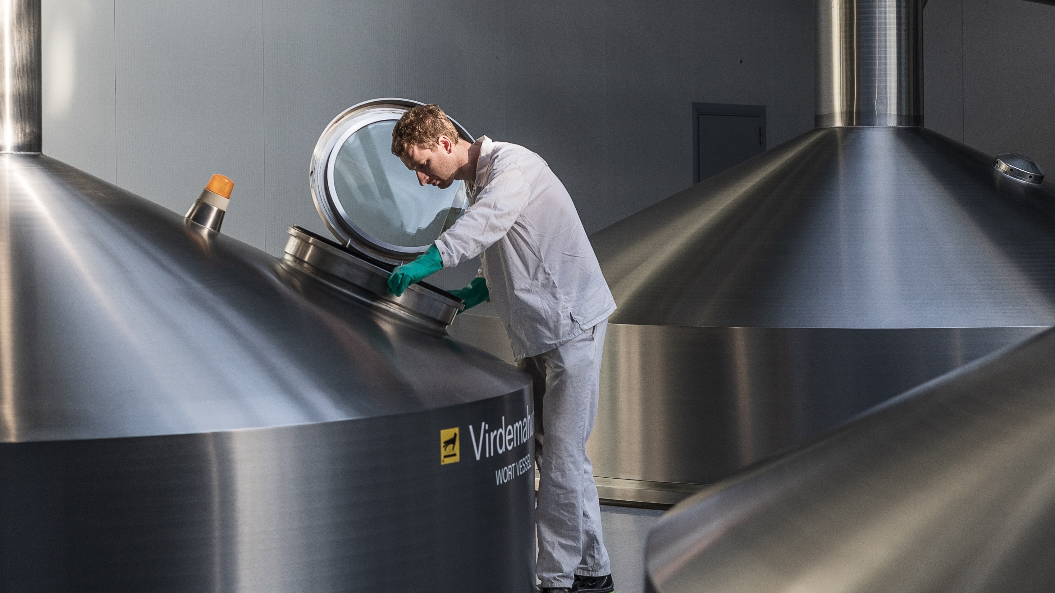
industry that delivers, without detours
agility
real-time data exchange between all parties
no siloed networks
trust
transparency built into our digital system
our cyber standards meet the highest expectations
experience in international collaboration
innovation
unified digital backbone allows to focus on innovation
Accelerate Estonia and trusted legal environment for experimenting
Notes:
Main problems in industry come from rising costs, slow and wobbly supply chains, over‑regulation and lots of paperwork. Estonia has tackled these challenges through digitalisation and efficient data exchange to make the whole process from idea to product faster and more cost‑effective. As Estonia is a small country, our focus is set on innovation and tailor-made solutions, where high‑volume players can’t compete on speed. Flexibility is more important to us than sheer volume.
We can divide the success of the Estonian industrial environment into three pillars:
AGILITY:
Because Estonia is a long‑established digital society, there is overall trust in the digital infrastructure (digital signatures, etc.). That speeds up everything regarding bookkeeping, permits, logistics information, the manufacturing chain and all other areas where data exchange is an integral part of industry.
Digital integration brings together private companies, R&D/academia, the public sector and suppliers. That eliminates delays and complexity often seen in larger supply networks.
TRUST:
In Estonia, transparency is not a demand from the outside but simply the way our system naturally works. Every secure digital signature and data exchange, every transparent process reduces friction and strengthens relationships.
As an EU and NATO member, Estonia has the highest standards for cybersecurity, digital infrastructure and governance. That of course applies to industry as well. Fraud and lacking security standards are not tolerated.
As a small country, Estonia is very export‑oriented, which means we have a lot of experience in international collaboration. Estonians are known for keeping their word and being trustworthy partners, and that’s why we have ties with a number of large global organisations.
INNOVATION:
Tying entrepreneurs, factories, research labs and the public sector into one ecosystem means innovation happens constantly and on the go. We are also seeing small companies and academia included, and that brings together expertise to create cross‑sector solutions.
Our flat hierarchy also means that decision- and policymakers are much more accessible, even to students or microbusiness owners.
Comparisons with other countries based on these three pillars:
Germany – industrial excellence but weighed down by bureaucracy and legacy systems.​
France – strong state support, but slow-moving public sector and complex regulation.​
Finland – smart but consensus-driven; decisions take time.​
Poland and the Czech Republic – good manufacturing scale but not as digitally integrated.

Slide 39
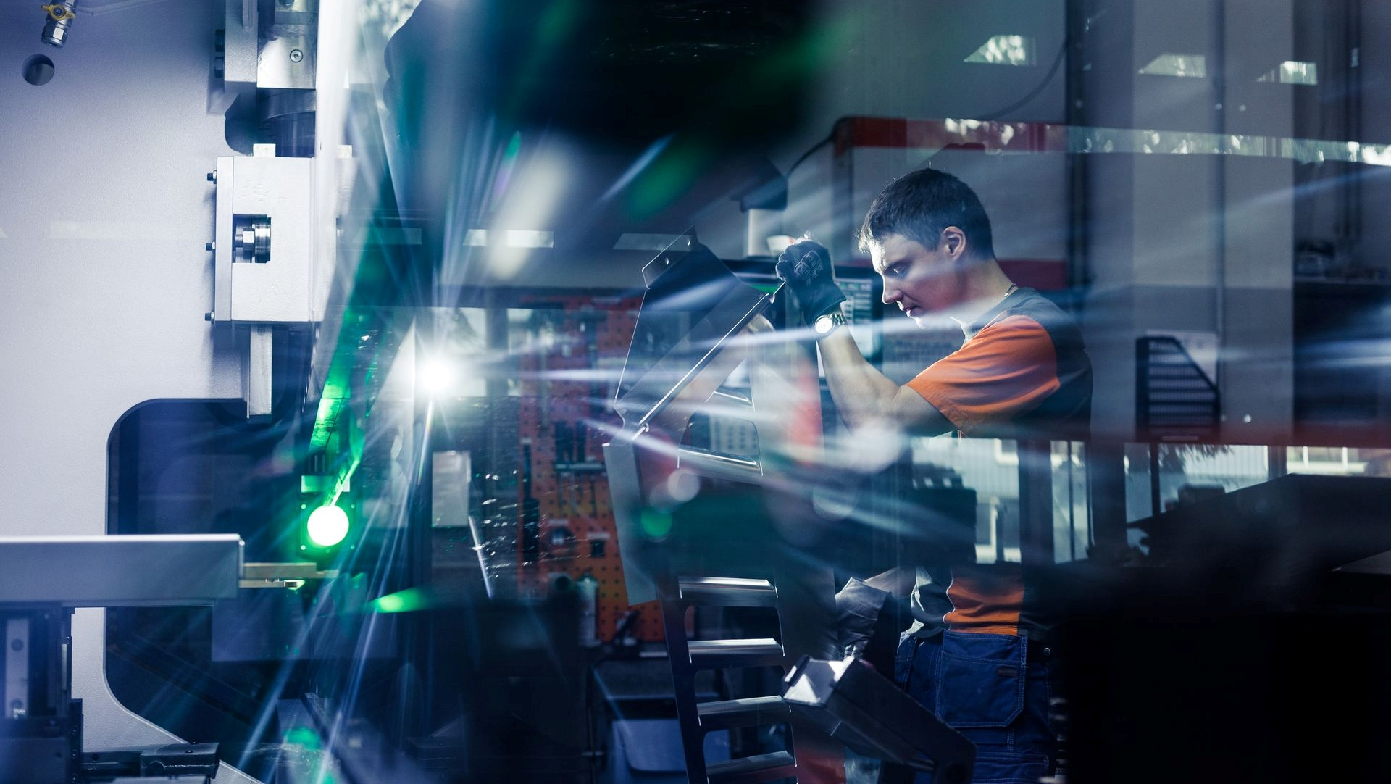






agility meets ambition
no red tape and direct contact with decision-makers
25% of university graduates come from STEM fields
connection to EU market and compliance with its security standards
fast and agile digital ecosystem
high environmental awareness expanding to industry
experience in global trade and international partners
Notes:
Estonia’s industrial sector is attractive to international partners and investors because it combines the agility of a small country with the capabilities and ambitions of a global player. Rather than competing with large-scale, high‑volume manufacturers, Estonia focuses on smart, innovative, and highly customized solutions.
Our industrial companies excel in flexibility, rapid development, and close collaboration with partners. This makes Estonia especially well‑suited for businesses looking for tailored hardware manufacturing, specialized engineering or R&D partners.
The following points illustrate the culture surrounding industry sector in Estonia:
DIRECT CONTACT: A key advantage of Estonian industry is its lack of red tape and the naturally flat structure of society. In Estonia, it is normal to communicate directly with the partner, engineer, specialist, policymaker, or even the final decision-maker. This is partly due to our small population, but it is also deeply rooted in our culture—every sector is closely interconnected.
As a result, development processes move significantly faster. We have effectively removed unnecessary middlemen at every stage, which allows ideas to move quickly from concept to execution and enables highly efficient cooperation between all parties involved.
DIGITAL ECOSYSTEM: Another major advantage is that Estonia is one of the most digital countries in the world. Practically every administrative process—permits, logistics, documentation, contracts, invoices, and more—moves through a fully digital environment. This dramatically reduces the time required for tasks that would take much longer if handled on paper.
Estonia’s digital infrastructure is not new. It has been in place for decades and has earned a high level of trust and security.
ACADEMIA: Another important strength of Estonian industry is its close connection with universities and vocational schools. Collaboration between academia and the industrial sector is active, practical, and long‑established.
Around 25% of Estonian university graduates come from STEM fields. This percentage is one of the highest in the EU. Many of these skills are gained through hands‑on experience in real laboratories that are directly linked to companies. This means Estonia’s education system not only strongly science‑oriented but also supports industry needs and adjusts when necessary.
SUSTAINABILITY: Efficiency has always been part of Estonia’s mindset, and this translates into industry. Companies here excel at reusing existing resources and creating solutions that are both cost‑effective and environmentally responsible.
This practical approach supports Estonia’s broader environmental awareness. As a result, we are strong in developing products that align with ESG requirements, circular business models, and lifecycle cost‑reduction goals.
EU(NATO): Estonia is closely integrated with the European Union and aligned with European and NATO security standards. This means that supply chains, data protection, and cybersecurity practices all meet the international requirements expected within these frameworks. Being part of the EU market also provides a practical advantage: cargo and goods move easily across European borders, allowing Estonian companies to operate smoothly within a large and highly regulated market.
PROFESSIONALISM: Estonia has extensive experience working with global markets and international partners. With a local market of only about one million people, Estonian industry has always been export‑oriented, developing strong cooperation with major international companies over the past decades.
Examples include Harju Elekter’s nearly €1 million contract with CERN, an Estonian company Eliko acting as a technology partner for Ericsson, and the Fermi Energia–Samsung nuclear plant collaboration. Estonian companies also work with organizations such as NATO, NASA, and global brands like Starbucks in the food sector.
This long history of international cooperation makes Estonian industry highly familiar with global market practices and a reliable, professional partner for any new company.
https://tradewithestonia.com/estonian-company-harju-elekter-signs-nearly-e1-million-contract-with-cern/
https://estonianelectronics.eu/elikost-saab-tehnoloogia-partner-ericssoni-industry-4-0-partnerlusprogrammis/​
​https://tradewithestonia.com/first-in-estonia-fermi-energia-and-samsung-have-signed-a-nuclear-plant-deal/N​

Slide 40
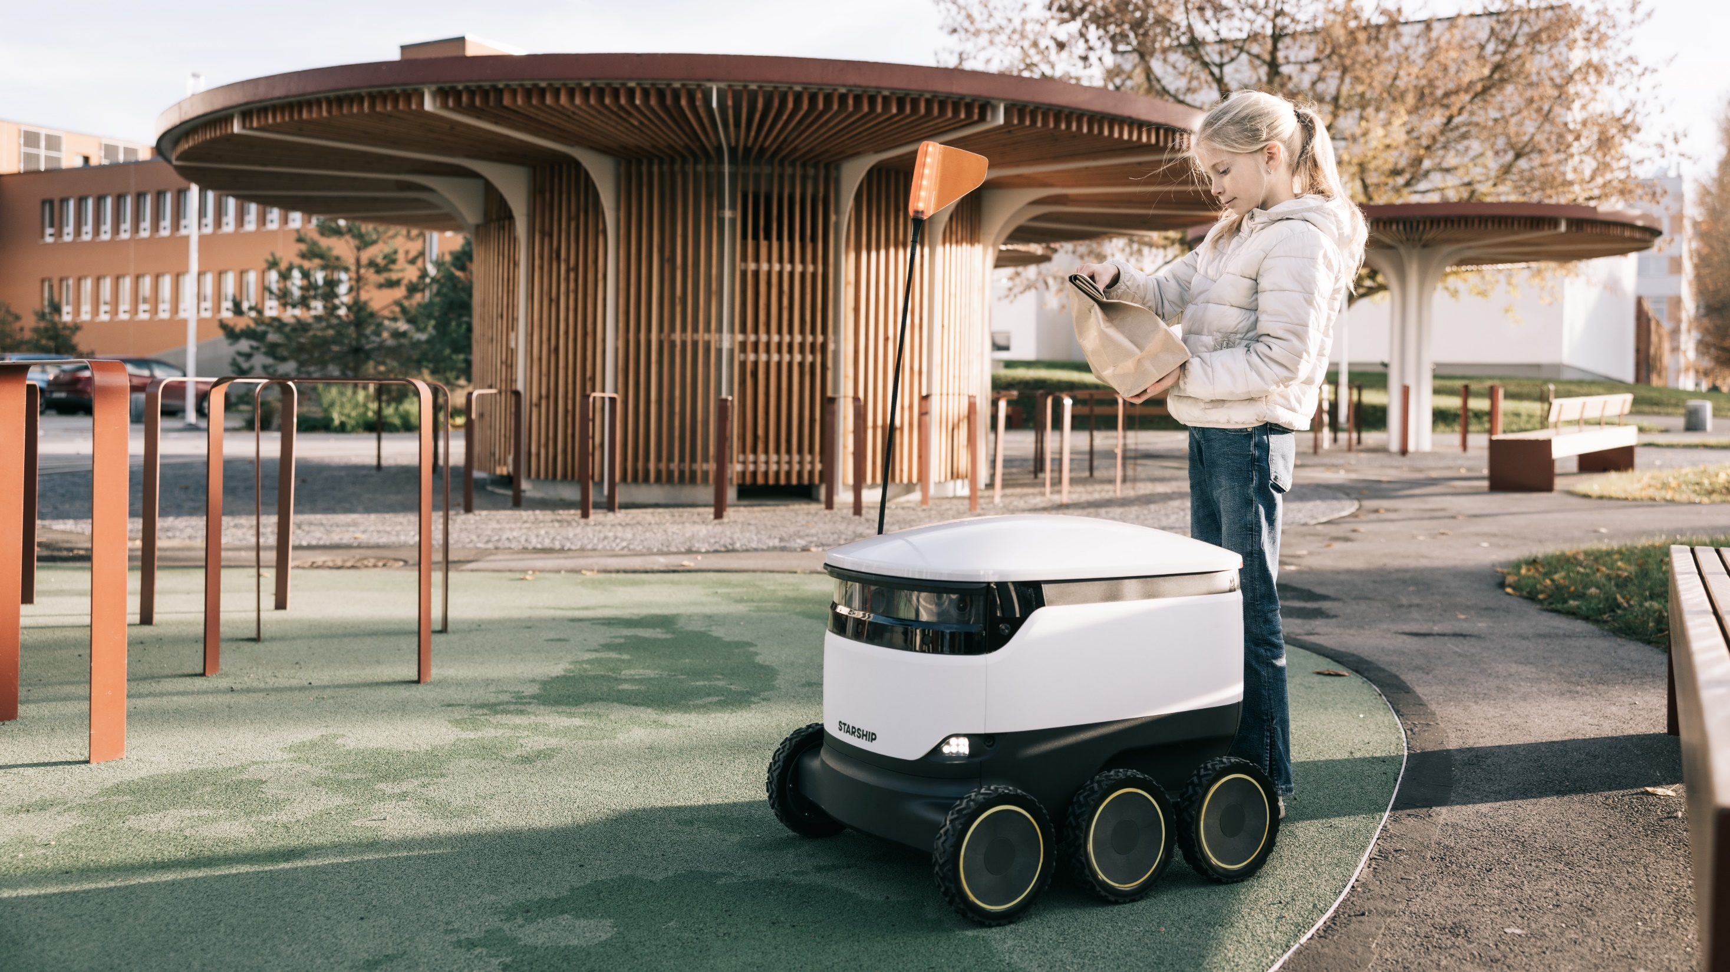
smart city
smartest living environment
shared platforms
cross-border projects
unique semi-autonomous solutions
urban data collection and sharing
Estonia as a testbed
Notes:
One of the hottest topics around the globe right now is smart cities. Estonia realised early on that the issue is often the limited viability or reach of smart City projects so it looked for cooperation partners. As a result, Tallinn and Helsinki have set up a shared public transport ticket solution and are also working on plans to construct a tunnel between the two capitals, thus linking the two economies even more closely together.
Furthermore, semi-autonomous solutions are in active use since 2017. They include self-driving buses and delivery robots that make the lives of us humans ever easier. Estonia also has the most self-driving vehicle projects per capita.
Moving vehicles also create a lot of data points and for that reason Estonian cities are focusing on offering more open data that could be used for various purposes.
One good example is the accident map which helps city planners structure potential changes to traffic flows, or converting crossings into roundabouts. http://kindlustus.maps.arcgis.com/apps/Viewer/index.html?appid=abd977aeea074631845cc67bfc3da87d
Also, for journey planning, Tark Tee shows the road surface quality, up-to-date flags for accidents etc: https://tarktee.mnt.ee/#/en
FinEst Twins: https://finestcentre.eu/project/finest-twins/
https://avaandmed.ee/Esileht

Slide 41

defence
hub of agile, adaptive and advanced defence
we make iron smart
providing advanced solutions to enhance global defence capabilities
rapid innovation and adaption enabled by favourable business environment
we pledge over 3% of GDP to defence, work closely with NATO and support Ukraine to contribute to global security
2/3 of the defence industry´s output is exported, exponential year-on-year growth with growing international demand
Notes:
Narrative
Estonia's defence industry is agile and adaptive, ensuring a swift and effective response to evolving global threats. We supply a broad range of advanced defence solutions to help other nations enhance their defense capabilities.
Estonia is ranked #1 in the EU for cybersecurity on the Global Cybersecurity Index and is home to the Cyber Defence Centre of Excellence. We are the home base for the world's largest international cyber exercises: Locked Shields and Crossed Swords. Through investments in technology and strategic partnerships, Estonia develops advanced cyber defense solutions (Cybers), robotics (Milrem Robotics), autonomous systems (DefSecIntel), sensors (ELSA Solutions), and communication technologies (Teleport) that aid battlefield superiority.
Estonia's defence industry operates within a private sector framework, benefiting from favourable business environment and efficient processes. This accelerates innovation and enables rapid adaptation to emerging defence needs.
We pledge over 3% of our GDP to defence investment and work closely with NATO and other international partners as an active participant in the EU’s Common Security and Defence Policy (CSDP). We are involved in joint exercises, defence planning, and cooperation within frameworks like the Nordic Defence Cooperation (NORDFECO) and the Baltic Defence Cooperation (BDC). We are also actively engaded in NATO's Defence Innovation Accelerator for the North Atlantic (DIANA) to support NATO’s mission of maintaining technological superiority and enhancing collective defence capabilities.
We are committed to supporting Ukraine in its defence against invasion. In addition to helping the people of Ukraine, this is also our contribution to global security and international order. We are not only preparing for potential scenarios of war but also building a safer, more secure environment to live in.
100% - All Estonian defence companies are private, boasting a favourable business environment for international export with low taxes and efficient processes.
One-stop shop for advanced defence - With expertise in manufacturing and innovation, Estonia stands ready to serve diverse defence needs efficiently and effectively. Our compact size makes us flexible and enables us to offer complex services. Estonia’s commitment to advanced defence technology is supported by R&D funding backed by the Ministry of Defence.
A proven track record of high-quality output, our commitment to transparency and collaboration ensure that we deliver on our promises. Internationally, we are leading numerous development initiatives and are actively enhancing new defence measures through the European Defence Fund.
Success Stories:
https://toolbox.estonia.ee/asset-page/598942-success-story-threod-systems
https://toolbox.estonia.ee/asset-page/598941-success-story-milrem
https://toolbox.estonia.ee/asset-page/598940-success-story-defsecintel

Slide 42

make everything more efficient
the journey never ends
cut your own Christmas tree
fishing and hunting licences
reporting a crime
cemetery Portal Haudi
vehicle history check
smart-road map
Notes:
When most governments discuss digitalisation and online services, they talk about more traditional areas that, in Estonia, are considered standard today – tax declaration, registering employment, and others. However, the closer you get to digital maturity, the more your engineers, politicians and thought-leaders will come up with small niche services that solve a particular problem but also serve to drastically improve the quality of life of your citizens. For example:
Estonians can go the the state forestry web portal and register to cut down a Christmas tree from the state forest. That way,citizens get a nice, fresh Christmas tree and the state forestry agency can keep track of where trees might have to be replanted:https://rmk.ee/christmastree
You can update your digital fishing licence or hunting licence here: https://www.eesti.ee/en/culture-and-leisure/leisure-time/recreational-fishing-and-hunting/
Reporting a crime is possible on the website of the police: https://www2.politsei.ee/en/teenused/politseile-avalduse-esitamine.dot
Estonian Cemetery Portal enables you to search for the information and find the last resting place of the deceased you are interested in. You can communicate with the cemeteries and register yourself as the plot owner to start using various e-services when logging into the system: https://www.kalmistud.ee/eng/
You can check any licence plate registered in Estonia and see the mileage, accident history, technical inspection faults etc. So, before you buy a used car you can check whether it’s a car worth buying, whether the price should be lower and so on. It creates a lot of added transparency on the used car market: https://eteenindus.mnt.ee/public/soidukTaustakontroll.jsf
The smart road map was introduced to help people get around Estonia safely. You can find out more about road conditions, accidents, traffic jams and speed cameras: https://tarktee.mnt.ee/#/en
As you can see, digitalisation never ends and there are always new solutions and improvements that can save your society money, time and nerves.

Slide 43

building a world free from financial crime
revolutionising the fight against financial crime
combating crime with smart tech and collaboration
building up global crime-fighting networks
the AML Bridge
Notes:
Financial crime remains one of the most pressing challenges of the digital age. Globally, criminals launder up to €4tn every year, with the proceeds of this continuing to fund some of the worst ills affecting society – the trafficking of drugs, weapons, even humans.
Currently, less than 1-2% of this money is successfully captured; despite the increasing number of new anti-money laundering regulations introduced by European and global regulators and the businesses increasing spend on crime prevention - financial institutions are spending around €150bn per year to combat financial crime.
The main reason for this is that organised criminal networks operate across multiple financial institutions, across borders, across legal jurisdictions, while individual banks or fintechs haven’t historically had the ability to share vital financial crime relevant information – either with each other, or with law enforcement agencies – to both successfully identify, and prosecute financial crime.
Estonia is no different and has faced similar challenges, being in the centre of some significant money laundering scandals in 2018. But as with many other challenges the country has faced (cyber attacks in 2007 for instance) Estonia's response to this, from the entire financial community has been nothing short of inspirational.
As an agile digital nation, Estonia has transformed these AML challenges into a success story and is leading the way in global crime fighting - by building up industry-wide global collaborative anti-crime networks.
In October 2020, a path-breaking new initiative was launched in Estonia, in a bid to combat growing rates of financial crime.
Estonian leading banks (SEB, Swedbank, Luminor and LHV) with regtech Salv and with support from Estonia’s Financial Intelligence Unit (FIU), Financial Supervision Authority (FSA) and Data Protection Inspectorate (AKI) together launched the AML Bridge.
In the first 5 months of AML Bridge usage (August-December 2021):
- Banks have started 700+ collaborative investigations, around 50 new investigations started each week to help prevent fraud, scam and money laundering cases.
- Banks have estimated €2-3mn worth of fraud losses prevented / money laundering identified so far. Currently it means up to €1mn a month of illicit funds detected and customer money saved from ending up to criminals.
It used to take an estimated 1-2 days for banks to process incoming requests from other banks. Today the most urgent requests are handled within 18 minutes or less and most cases within 2 hours. The 20-80X speed up fundamentally changes how much fraud and AML banks can stop.

Slide 44

digital agenda 2035
Estonia, full of digital might
© Renee Altrov
human-centred, trustworthy, efficient and resilient digital society.
secure, personalised and proactive public services powered by AI agents.
transparent and human-controlled use of data and artificial intelligence.
secure cyberspace and reliable ultra-fast connectivity across Estonia.
Notes:
Vision
Estonia has a human-centred, trustworthy, efficient, innovative and resilient digital society.
The legal framework, technology and use of data underpinning Estonia’s digital state protect people’s fundamental rights, make their lives easier, strengthen the economy’s global competitiveness, and make society more cohesive and inclusive.
Objectives
- A secure, personalised, AI-agent-powered digital state that safeguards freedoms
- The world’s freest and most autonomous AI-enabled state, controlled by its people
- A secure and protected cyberspace
- Estonia with ultra-fast connectivity
Foundations
Estonia’s digital state is built on trust, public oversight of data use, cooperation, openness, strong data literacy, widely adopted digital skills, and top-level digital expertise in the public sector.
Main topics and objectives of the Digital Agenda 2035:
1. A secure, personalised, AI-agent-powered digital state that safeguards freedoms
Estonia’s public services are secure, personalised, proactive and based on life or business events. Effective data governance, coordinated ICT management, resilient infrastructure and a legal framework that protects individual freedoms support the digital state.
Expected outcomes:
Seamless, accessible and proactive services across institutional and national boundaries.
Secure, reliable and cost-effective services with minimal administrative burden.
Strategically managed and measurable digital government development.
Continuous development of digital, data, AI and cybersecurity skills.
Future scenario: “Zero Bureaucracy”
In 2035, Epp tells her eID assistant that her family is moving to Saaremaa. With her authorisation, the system securely coordinates changes across registers, local authorities, schools and tax systems. Relevant information and personalised service offers reach her automatically.
Objective 2. The world’s freest and most autonomous AI-enabled state, controlled by its people
Estonia uses data and AI securely and transparently across all sectors. Individuals retain control over their data, while domestic infrastructure supports secure processing and helps preserve the Estonian language and culture.
Expected outcomes:
Human-centred and secure use of data and AI across society.
Domestic infrastructure and trusted partnerships for developing and operating AI systems.
Individuals control how AI uses their data and can choose less automated services.
AI-assisted decisions are transparent and explainable.
Future scenario: “Zero Bureaucracy”
In 2035, a small business owner asks Bürokratt how to export handmade furniture to the EU. The system creates a personalised action plan, checks regulatory compliance, identifies sales channels, compares transport emissions and prepares an export guarantee application. The state operates as a real-time strategic partner.
3. A secure and protected cyberspace
Estonia’s secure and trustworthy cyberspace supports its digital society, economy and statehood. Cyber defence is centrally coordinated, adaptable and based on cooperation across society and with international partners.
Expected outcomes:
Purposeful and coordinated national cybersecurity governance.
A society capable of preventing and responding to cyber threats.
Strong international cooperation and a sustainable pipeline of cybersecurity experts.
Future scenario: “Operation Icebreaker”
During a global cyberattack against critical infrastructure, Estonia detects the threat early through international cooperation and automated intelligence sharing. Its Cyber Shield blocks the attack before it reaches critical systems, allowing energy, healthcare and payment services to continue operating.
4. Estonia with ultra-fast connectivity
Ultra-fast, reliable and affordable connectivity is available throughout Estonia. It supports the digital state, economic competitiveness, innovation and equal opportunities.
Expected outcomes:
A regulatory environment that supports innovation, investment and stable market development.
Nationwide deployment of very-high-capacity, 5G and 6G networks.
Reliable and resilient communications under all circumstances.
Future scenario: “Uninterrupted Connectivity”
In 2035, a storm damages terrestrial communications lines, but Estonia’s distributed network automatically reroutes traffic. Critical services—including medical drones and hospital systems—continue operating without interruption.

Slide 45
shaping an AI-literate future
eesti.ai
economic growth enabled by AI:
2030 ↑ 25%
2035 ↑ 50%
Notes:
Eesti.ai is Estonia’s national programme for systematically adopting artificial intelligence across the economy and the public sector. It responds to a structural challenge: Estonia’s workforce is not growing, so future economic growth must come from higher productivity and greater value created by each person.
The programme aims to double the value of work by 2035 and contribute to economic growth of 25% within five years and 50% within ten years. It focuses on a limited number of high-impact projects, developed through cooperation between government, businesses, researchers and international experts.
AI literacy is an important foundation, but the programme is broader: it includes developing AI skills, testing and scaling practical solutions, improving public-sector efficiency and strengthening companies’ export capacity. https://riigikantselei.ee/en/eestiai-Initiative

Slide 46
shaping an AI-literate future
healthcare
quality of care
doctor time optimization
chronic disease prevention
AI-skills
100 000 AI-literate citizens
1 000 000 free lessons
business
added value per employee %
export increase %
1000 AI companies
governing
increase in service quality
education
AI-literate teachers and students
increased quality of education
IT-hardware
covering the increasing GPU needs of public and private sector
eesti.ai
economic growth enabled by AI :
2030 ↑ 25%
2035 ↑ 50%
Notes:
Eesti.ai translates Estonia’s overall AI ambition into six practical areas of action.
In healthcare, the focus is on improving the quality of care, reducing the administrative burden on medical professionals and using data and AI for earlier disease prevention. The skills programme aims to provide 100,000 people with practical AI knowledge and make one million free learning opportunities available.
For businesses, the objective is to help companies adopt AI, increase value added per employee and strengthen export capacity. In government, AI should reduce routine work and improve the quality and efficiency of public services, while humans remain responsible for consequential decisions.
Education is a central part of this transformation. Estonia is developing the AI literacy of teachers and students and exploring how AI can improve learning without replacing critical thinking or the role of the teacher. The final foundation is sufficient computing capacity: Estonia must assess and meet the growing demand for GPUs and other AI infrastructure across both the public and private sectors.
Together, these measures support Eesti.ai’s wider ambition: to double the value of work by 2035 and enable substantial economic growth through the systematic and responsible adoption of AI.

Slide 47

bürokratt
virtual assistent for government services
all government services & info from one place
works 24/7
channel and device agnostic (chat, sms, e-mail, phone, voice assistant)
open-source and free
Notes:
Project goal
Bürokratt chatbot is developed and implemented at three agencies.
Future benefits
People can communicate with the government 24/7, and thanks to the interoperability of bots, it is possible to interact with the whole government from one communication channel
First chatbots developed for:
Police and Border Control
Consumer Protection and Technical Regulatory Authority
National Library
Future developments:
Further onboarding
Speech recognition and synthesis
Personalized services (both public- and private sector)
Government mobile application and alternative communication channels.
Budget and team:
Over the next four years, the total budget will be close to €13 million. Bürokratt will be developed in collaboration with RIA, the State Information System Authority. Other partners are involved in the development, such as the Estonian Language Institute and Ministry of Education and Research, as well as multiple private partners, including Net Group, Texta, Stacc, Microsoft, and Solita.
While the most visible element of Bürokratt is its virtual assistant or chatbot, Bürokratt encompasses more than just that tool. Instead, it is an interoperable network of AI applications accessible via voice. In a way, it is similar to X-Road, the data exchange layer that serves as the backbone for Estonia’s ecosystem of digital services, called e-Estonia.

Slide 48
kratt
national AI strategy
public-private partnerships
government initiative
200+ use cases in public sector
Notes:
First of all, what is Kratt? Well, Kratt is a creature from Estonian mythology and is used as a term for AI in Estonia. The Estonian government has made AI a priority topic on the national level based on the Digital Agenda 2020 for Estonia. The general objective is to have at least 50 use-cases of artificial intelligence in the public sector in Estonia by 2020. The government has launched an expert task force, led by Government Office and the Government CIO. From 2019-2021, the Estonian government has pledged more than €10m to implement this national AI strategy.
Existing use-cases in the Estonian public sector. To give you some examples:
The Information System Authority of Estonia is using machine learning for detecting anomalies and incidents on the traffic of the Estonian data exchange layer – X-Road.
Predictive analytics is used to decide where to send the police for traffic regulation. The system is well used in cities; however the algorithm does not yet work well in rural areas.
The Estonian Unemployment Insurance Fund matches job seekers with open positions using AI. It helps job seekers get matched with the right job. The current job matching algorithm is developed further with job seeker profiling algorithm.
Estonian Agricultural Registers and Information Board is using machine learning to detect land mowing. Satellite images are analysed to detect whether agricultural land has been mowed. This is necessary as mowing land is one of the requirements for receiving government grants. Before satellite image analysis this work was carried out manually using on-spot control.
A chatbot that introduces Estonia in all the world’s languages
Data analysis tool OTT by The Estonian Unemployment Insurance Fund. OTT is a data analysis tool that forecasts the probability of the unemployed getting a job, identifies the factors influencing it and thus helps to offer the unemployed assistance based on individual needs and increase the efficiency of the Unemployment Fund.
Transcription of emergency calls by Emergency Response Centre - AI solution transcribes calls made to the number 112.
Usecases: https://www.kratid.ee/en/ai-use-cases
https://www.kratid.ee/in-English
https://www.mkm.ee/sites/default/files/digital_agenda_2020_estonia_engf.pdf

Slide 49

international cooperation
Estonia cooperates with digital-minded countries: D9+, Digital Nations, DGX
public-private partnership that works beyond borders
NGOs’ power in digitalisation: Estonian Association of Information Technology and Telecommunications
EU Global Gateway
Notes:
We don’t have to look far to see evidence of good international cooperation. These are just few examples of how Estonia is adding value to digitalisation on an international scale.
As the digital frontrunners of Europe, the signatory D9+ countries seek to contribute to the formulation of the roadmap and the 2030 goals for Europe in terms of digitalisation and technological advancements. Estonia meets together with other D9+ countries twice a year.
Estonia was a founding member of D5 that eventually developed into Digital Nations. Digital Nations consists of leading digital nations to harness the potential global power of digital technology and help one another to become even better digital governments, faster and more efficiently through sharing and learning from each other.
The Digital Government Exchange (DGX) is an annual global gathering of CIOs and public sector leaders from digital governments and smart cities. Organised by the Smart Nation and Digital Government Group since 2016, DGX is a one-of-its-kind international platform that has developed a community of like-minded leaders who can engage in information exchange, sharing of experiences, and mutual learning, while exploring future collaboration opportunities.
Our ICT companies are helping other countries to create interoperability, ensure cybersecurity, create digital IDs, build key infrastructure components, contricute to e-health, e-education and so much more. Additionally, if countries need assistance with creating strategies or plans to start then modernising their digital nation or further developing it, we have several companies just for that. They are actively helping countries and international organizations with digitalisation efforts and ensuring that digitalisation would go smoothly. Find out more information about the private sector created solutions here: https://digiexpo.e-estonia.com/
Besides public sector cooperation and public-private, we are proud to have NGOs that are actively making sure that key components of digital societies stay strong and that countries can start laying the Foundation for a well-working digital society.
ITL
IS a cooperation network in the field of ICT that speaks for the innovation of the digital society - their vision is a smart Estonia. They are improving cooperation between the private and public sectors. The turnover of companies belonging to ITL makes up over 70% of the total turnover of the Estonian ICT sector.
EU Global Gateway
Global Gateway, a €300-billion European Union investment package aimed at help centering the international and economic rules-based global order, sees Europe's closest partners brought on board in countries as far afield as Rwanda, Namibia and Chile, at a time of continued Russian aggression in Ukraine and other challenges facing the union.
This is the commitment of Global Gateway, the EU's €300 billion investment package to help re-anchor the international and economic rules-based global order.
Launched in 2021, it embodies an approach Estonia has championed much earlier than many others: trusted connectivity. An approach that has assumed an even greater urgency with Russia's unjustified aggression and gross violation of international law.
https://valitsus.ee/en/news/trust

Slide 50

personal government
redefined relationship between a citizen and the government in the post-digital era
90%
user satisfaction goal by 2030
Notes:
Our goal is 90% user satisfaction by 2030. Seamless and human centric (digital) society (personal state).
Redefining the relationship between citizens and the government
Human-centric.
The government should feel like one person—not a maze of institutions and rules. I only need to understand what directly affects me or my loved ones.
Accessible.
I want to access services through the channels I prefer, in a way that’s easy and convenient for me.
Proactive.
If I’m eligible for something, the government should take the initiative. I shouldn’t need to apply if they already have the information. I give consent for them to act on my behalf.
Trustworthy.
I’m more likely to trust what I understand. If things are clear and I see the value, I’m open to trying them.
Empowering.
I should be offered opportunities and support tailored to me. It should feel like I matter—that I’m a valued part of society and equipped to reach my goals.

Slide 51

our children, raised in a digital society, never having had to visit a government office – how will they imagine the future?

Slide 52

welcome to post-digital era
decades of digitalisation has resulted in a society where almost everything is digital. and that opens new possibilities.
Digitization era
2000–2010
e-Government
Enhanced traditional public services online. More efficient information processing.
Digital transformation era
2010–2020
Digital Government
End-to-end digital replacement of traditional public services. Whole-of-government approach to service delivery.
Post-digital era
2020–…
Personal Government
Citizen-centric digital-first new type of services and capabilities without traditional analogues. Whole-of-society approach to service delivery.

Slide 53

estonishing future
seamless e-services available 24/7
proactive government
AI in government services
cross-border digital governance
personalised medicine
environmentally sustainable digital state
citizen-centric data governance
Notes:
So when you see all this, you might wonder: What does the future have in store for Estonia? Well, it is clear that Estonia is doing its best to remain an innovative, efficient and successful Northern country that leads by example. Here are some of the plans that are in the works as we speak.
One of the big steps is to create what we call proactive government services. Even though 100% of public services are available digitally at this point, it would make citizens’ lives even easier if government would automatically approach them when it knows that they are entitled to a certain service. This would also further decrease the burden of bureaucracy for both the people and the state.
The first of these services actually came online in October 2019 – since then, parents automatically get a notification after their child is born to ask them to which bank account they would like their child´s benefits transferred.
Another big trend is that of seamless services and life events centred around particular situations, bringing different kinds of information from different authorities and databases to make life easier for us. This means with a maximum of one interaction, or ideally, based on existing data, automatically.
Compared to current e-services, the new seamless services are supposed to function automatically and be more user-centred. If the first step of developing e-services meant making different systems communicate with each other, then life-event / business-event services are activated automatically based on the events taking place in a person’s life.
The idea was approved by the government in December 2018, though the work for it started much earlier, with ideas dating back to 2011. The concept of life-event service design is also embedded in the Digital Agenda 2020 for Estonia.
Another topic for the upcoming decades is cross-border digital governance. Estonia is the 1st in the world to interconnect decentralised components of state and public sector databases on an international level via the X-Road data exchange system. This public sector data exchange facility was created in 2017 between Finland and Estonia. Depending on future policy decisions, this could mean that health, education or business data regarding Estonian citizens and entities could also be accessed by the Finnish government or private sector, regardless of whether the person lives in Estonia or Finland. Hopefully, cross-border data exchange will soon become possible between all European countries.
Currently, Estonians can travel to Portugal, Finland, Poland, Spain or Croatia (and to many more European countries) and receive their prescription medicine from a pharmacy with their electronic ID card without ever having to seek for a local doctor, simply based on the prescription by their native doctor.
Estonia is a leading user of AI solutions: our government and society is AI-powered.
+ 100% of central government
+ 75% of companies
+ goal for 2030 - 80% elementary data and AI skills in the society
Citizen-centric data governance" – This focuses on managing data in a way that prioritizes the individual's control and consent.
Citizen's digital twin
Data tracker
Consent service

Slide 54
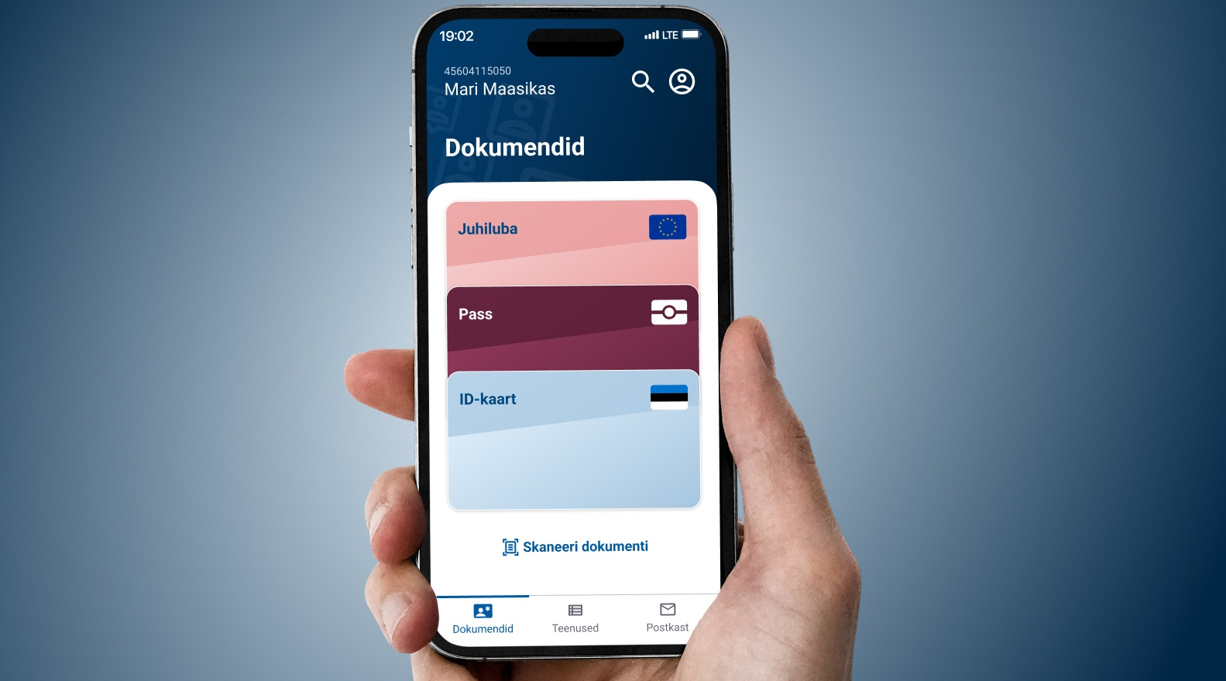
eesti.ee app
digital state in your pocket
potential substitute to physical documents
convenient access to one’s information
fast communication with local authorities
view and manage e-prescriptions
receive notifications on accidents, natural disasters etc.
use the data tracker
access to virtual assistant bürokratt in the future
Notes:
The Eesti.ee mobile app, launched in December 2024, was created to provide users convenient and easy access to government services via their smart devices, regardless of location or time. It is a logical next step after having our state portal on a website as more and more people prefer touchscreens to a mouse and keyboard. The Estonian Information System Authority(RIA) is responsible for the creation and ongoing development of the Eesti.ee app. The plan is to add more services to it in the future.
In the first months, it was downloaded by tens of thousands of people.
The app uses the same backend framework as the state portal website to reuse an existing system. It was just modified to adjust to the specific conditions of a mobile app. The app, just like the state portal website, makes all data queries through X-road to ensure safety.
To use the app, you need a stable internet connection.

Slide 55

proactive government
starting a business
childbirth
buying
a car
driving
licence
start of
school
unemployment
& job search
marriage
divorce
disability
military
service
change of residence
retirement
death (succession)
building
houses
falling victim to an accident
falling victim to a crime
Notes:
The logic for proactive government services is quite simple: Yes, most of our services are available online, but how about government approaches us to offer them to us when it knows that we are entitled to them? This would also further decrease the burden of bureaucracy for both the people and the state.
The first of these services actually came online in October 2019 – since then, parents automatically get a notification after their child is born to ask them to which bank account they would like their child benefits transferred.
Compared to current e-services, the new seamless services will function automatically and are more user-centred. If the first step of developing e-services meant enabling different systems to communicate with each other, then life-event/business-event services are activated automatically based on the events taking place in a person’s life.
Currently available pro-active services:
Childbirth – In its final form, the service would start when a pregnancy is detected at the clinic by a doctor who then makes the entry to the health registry. This entry triggers family planning services (info, including a partner, benefits planning calculator, etc.), health services for pregnant women, maternity and fraternity leave planning calculator and offers, birth services by the hospital and registration of the new citizen. Parts of this service are already available and offered proactively, like the birth benefit, is offered for the parent after the newly-born is being registered in the population registry, also an only service where the parent can give a name to the child online. This service is a work in progress, but the proactive elements are already there.
Starting a business – An event-logic-based service for starting a business is already available on the entrepreneur portal. The service combines the company registration process, applying for the VAT nr and registration of employees. By the end of 2021, the government is developing the service to make it available from eesti.ee and include services like applying for various business permits.
Proactive services, that are currently planned or in development:
Becoming a pensioner – this is the first life-event service that will be fully implemented and piloted. At least 6 months before reaching the retirement age a person would receive an offer from the government to the eesti.ee portal about this life event occurring. The offer will layout various paths regarding their pensions savings, will give a total amount of what the person will be receiving from the state as an old-age pension. On that life-event page, a person could also either postpone the pension (continue working) or apply for an early leave. The citizen will go through the planning within a single interface, but in the back, at least four institutions are offering more than six services services.
Change of residence (moving, selling or buying property) or building houses – as these life-events usually mean plenty of paperwork, especially building, so being able to handle them in a single gateway saves time, and being up to date in real-time how far the administrative process is, should also save some nerves.
Driving license and buying a car – this service will gather application for driver licenses, change of licenses, health-related documentation regarding licenses, vehicle ownership and the change of ownership into a single source.
Military service – as the service is mandatory for most men in Estonia, every year more than 3000 citizens encounter this life-event. Here we have gathered the information regarding the service as well as the application process, so from the first info letter about a youngster being listed, an invitation to medical examination, expressing preferences regarding the type of service, etc. This also includes the services needed while being in the service and after the service, in the reserve.
Most difficult services to develope:
Marriage – the first life-event based service launched for two persons to express their intention to get married digitally, also decide upon the date, who will carry whose name, the marital assets agreement and then only show up on the designated date to say „I do“. On that date, the person whose name changed will get the new ID-card and other documents already made to the new name since the agencies invovled already knew the change was about. As there was a need to fundamentally change the family law, the amendmends were previously passed in Estonia’s Parliament and service came to effect in December 2022.
Death of a close one – also falls to the difficult category, because of legal challenges and multiple stakeholders / rooted processes. At the moment the state issues the death certificate, digitally of course and at the same time makes the necessary registration to the population registry. Local government is also involved with funeral subsidy and the burial place, then the private sector offers burial related services – each of these stakeholders use a different system, so for the person handling the event, it seems fragmented and complicated. Life-event of this mournful case should make it easier to fulfill the wishes of the one who left (burial grounds, ceremony, etc.), to handle the paperwork regarding the funeral and aid offered by the local municipality, and offer the private companies their way in as well. As we want this service to be as intuitive as possible for the citizen, it will take more time to figure out the most effortless and painless route.

Slide 56

lessons learned
how Estonia succeeded
© Johannes Arro
digital-minded leadership
keep it short and simple
transparency works
shared platforms are quicker
service design matters
public-private partnership
start-up mentality
Notes:
As we are nearing the end of this presentation, what are our main takeaways? Well, here are a few points to bear in mind for your digital journey.
First, digitalisation is rarely a question of technology. The technology exists today. Right now. Ideally, you need digital-minded leadership that is determined to make e-governance a reality. Estonia had this general push for digitalisation in the 1990s, which propelled the country to where it is today. And it takes time. The 1990s were a long time ago, and I wish you patience with digitalisation because it truly is a long process. And we must remember that no solution works 100% and that is okay. But our innovation must not get stuck behind that. If we have a solution for 80% of the people, then we have decided to go with it and then afterwards look through the 20% of exceptions.
Second, short and simple laws and online services are crucial. They need to be understandable and graspable to the general population and simple for government authorities and private sector companies to enact and follow. Innovation tends to thrive in a free environment. If you restrict the playing field, then it is probably going to take much longer. In Estonia, we have a principle with laws that we are regulating processes, not technologies.
Transparency must be upheld to maintain the trust of society. This must also be the case in a situation of crisis – when Estonia faced a theoretical weakness in its ID cards, it practised open and daily crisis communication with the population. More generally speaking, transparency also helps avoid data siloes and corruption inside state authorities.
Shared platforms like the X-Road have speeded up the development of new services immeasurably and made it easier for new players and stakeholders to join the data exchange network. This is simpler, cheaper and faster than if every entity attempts to reinvent the wheel.
Service design is irreplaceable. It has to be citizen/customer-focused. As an example, digital prescriptions are easy to use, as you only need to take your ID card to any pharmacy in the country. Because of this accessibility and user-friendliness, within 9 months, Estonia had reached a share of 99% of prescriptions being digital. This idea seems to get lost in government systems: the end-user is the citizen, not the government officials. This is why we are also developing our state app at the moment, because we have a new generation coming on that is more used to screens than a mouse and keyboard. We need them to feel that using state services is as convenient and pleasant as using their social media apps.
Finally, the Estonian government has been very open towards public-private partnerships. The logic was simple: the government would set certain parameters and service expectations, but the execution was left to the specialists in the various areas that usually reside in the private sector.

Slide 57


stronger together
let’s keep in touch!
sign up to our newsletter and follow us:
e-Estonia
e-estonia@eis.ee
materials
Notes:
And this marks the end of the presentation about e-Estonia – its past, its present and its future. I hope you learned something new today and are going home with lots of food for thought.
Also, I can highly recommend staying up-to-date with what’s happening in digital Estonia. You can do so by visiting e-estonia.com or following the various social media channels. You can also find this presentation in English, German, French, Spanish and Japanese in addition to a multitude of factsheets, Q&A’s, articles and a podcast. Thank you for your attention! ☺

