Slide 1
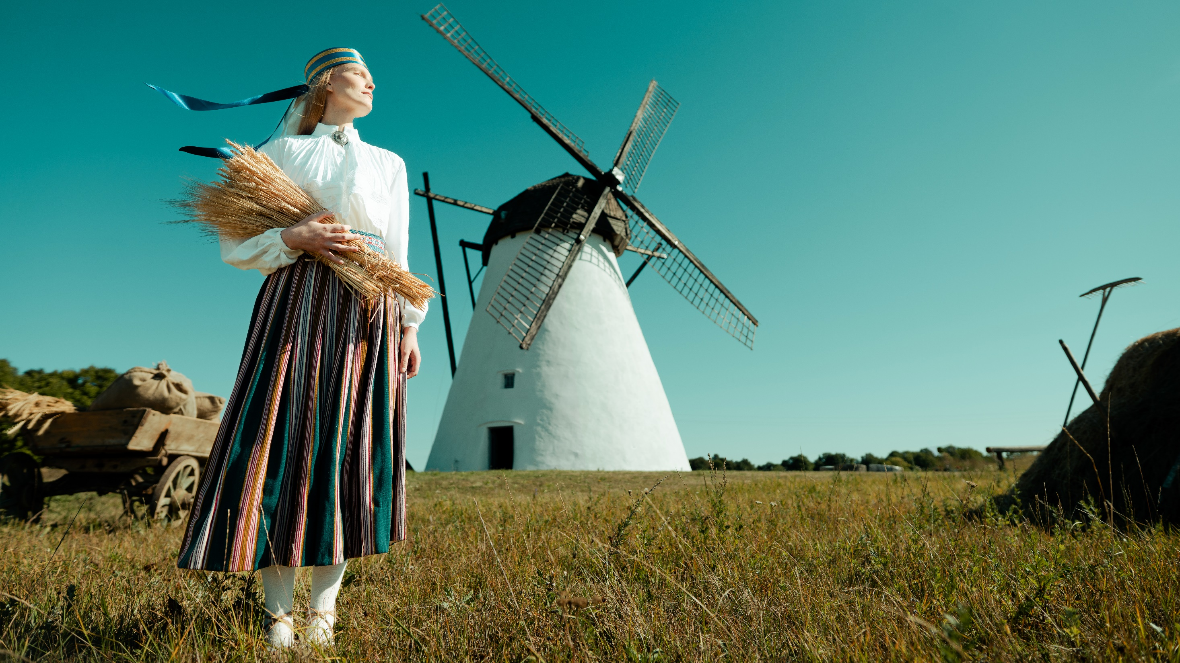
tere!
all about Estonia
Notes:
Hi. Nice to see you all.

Slide 2
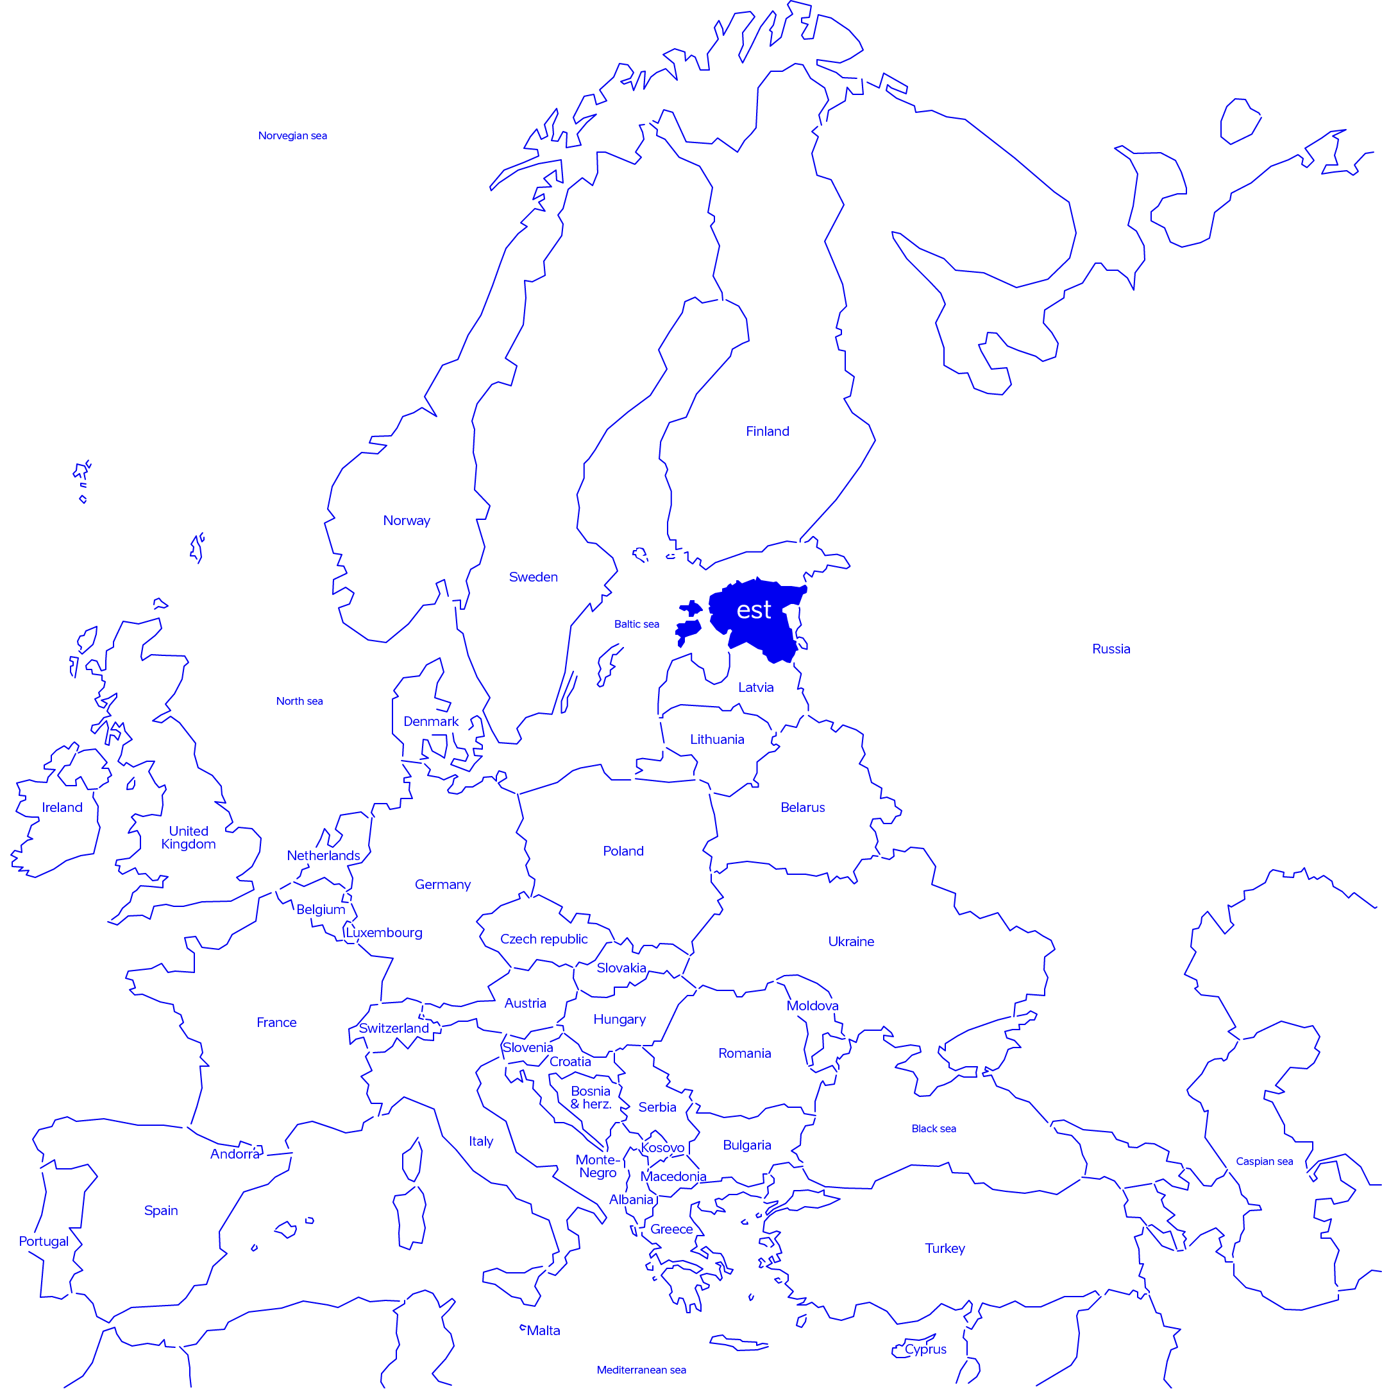
a modest country
extending beyond its borders
population: 1.4 million
area: 45,339 km²
100% digital
member of: UN, EU, NATO, OECD, WTO, CERN
Notes:
Estonia is a land of vast forests, clear lakes, and quiet bogs, and of people who may be few but strong in spirit.
We’re not much for talking; we prefer to get things done.
The result?

Slide 3
our highest rankings
#2
#1
#1
#2
Liberal Democracy Index 2025
PISA 2025
cleverest children in the EU
OECD 2025
tax competitiveness index
World Press Freedom Index 2025
Notes:
Today, we are among the global top five in liberal democracy, serving as a leading example of transparent governance and democratic values. (Expert estimates of the extent of voting rights, the freedom and fairness of elections, freedoms of association and expression, civil liberties, and executiveconstraints. Only Danes rank above us.)
Our education system is among the top five in the world, boasting the cleverest children in Europe.
Globally, we have been first in the International Tax Competitiveness Index for the better part of two decades and second in the Freedom on the Net report.
We are a world leader in venture funding, relative to our GDP and other metrics, like Estonia, having the highest number of startups and unicorns per capita in Europe.
We rank among the world’s top countries in terms of press freedom, ensuring our press remains impartial and unbiased.
But how do we do it? We’ve distilled „doing things the Estonian way“ into 4 core principles

Slide 4
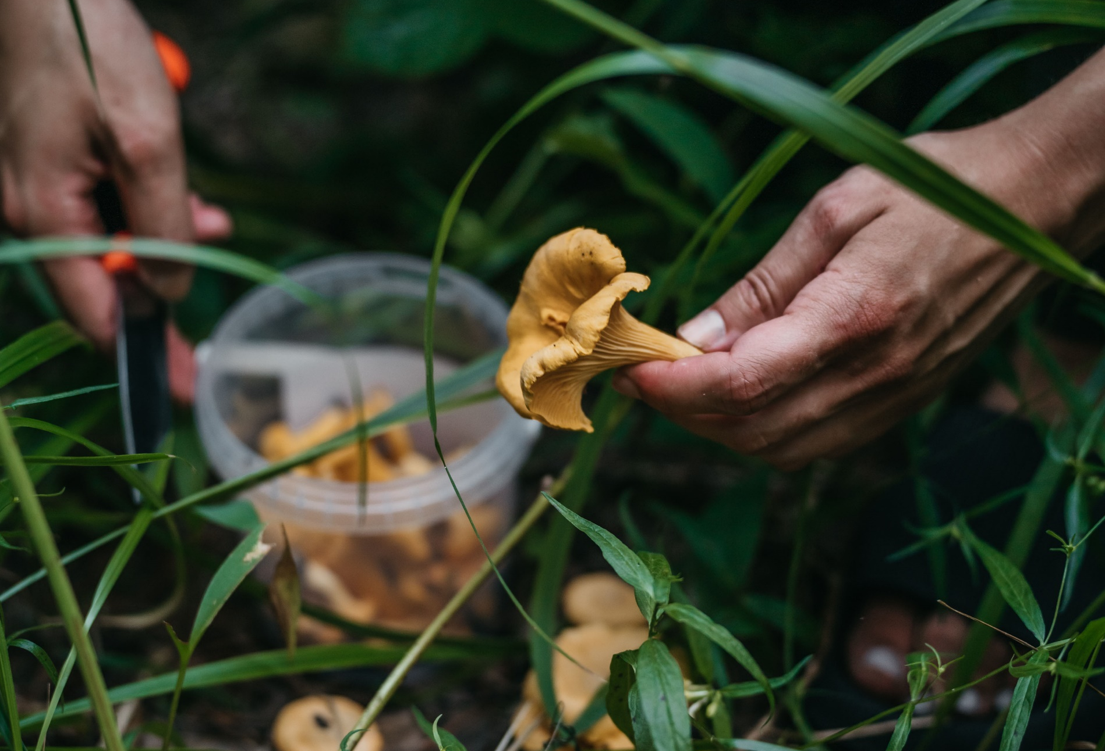
Our principles
make
shortage an advantage
→ resourcefulness
Notes:
First, we make a shortage an advantage.
We don’t have many people or resources in excess, so we must be innovative and clever.
Education has always been the cornerstone of our society.
Estonian pupils receive one of the best educations in the world, regardless of their location or social background.
Thanks to that, our innovation is built on knowledge, high-end technologies, and the latest scientific developments.

Slide 5
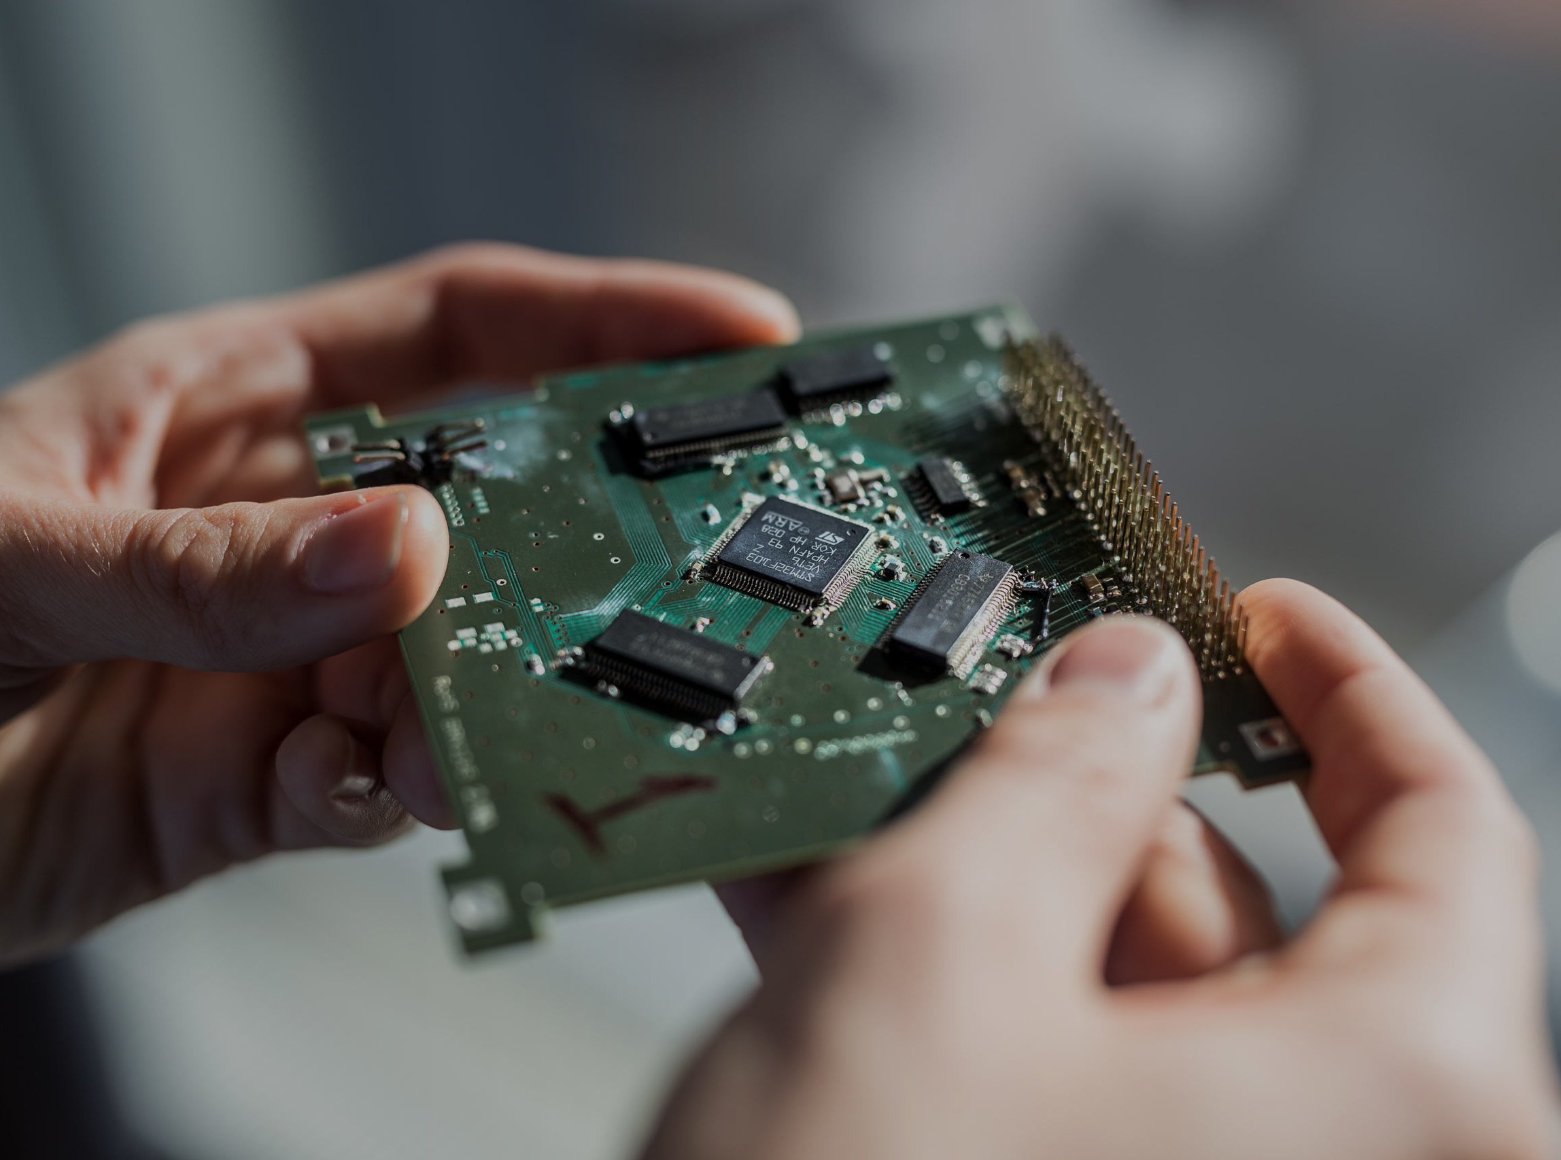
Our principles
driven by discontent
→ ambition
Notes:
Second. Do you know what the most common word in Estonia is?
It’s “normaalne.”
“100% of Estonian public services are digital.” – “Normaalne.”
“I can vote, fill my prescription, or even get a divorce online.” – “Normaalne.”
Estonians are rarely fully satisfied; a touch of discontent is what drives us.
We don’t see obstacles, we see solutions.
We think creatively and have a growth mindset, because that’s the only way ahead.

Slide 6
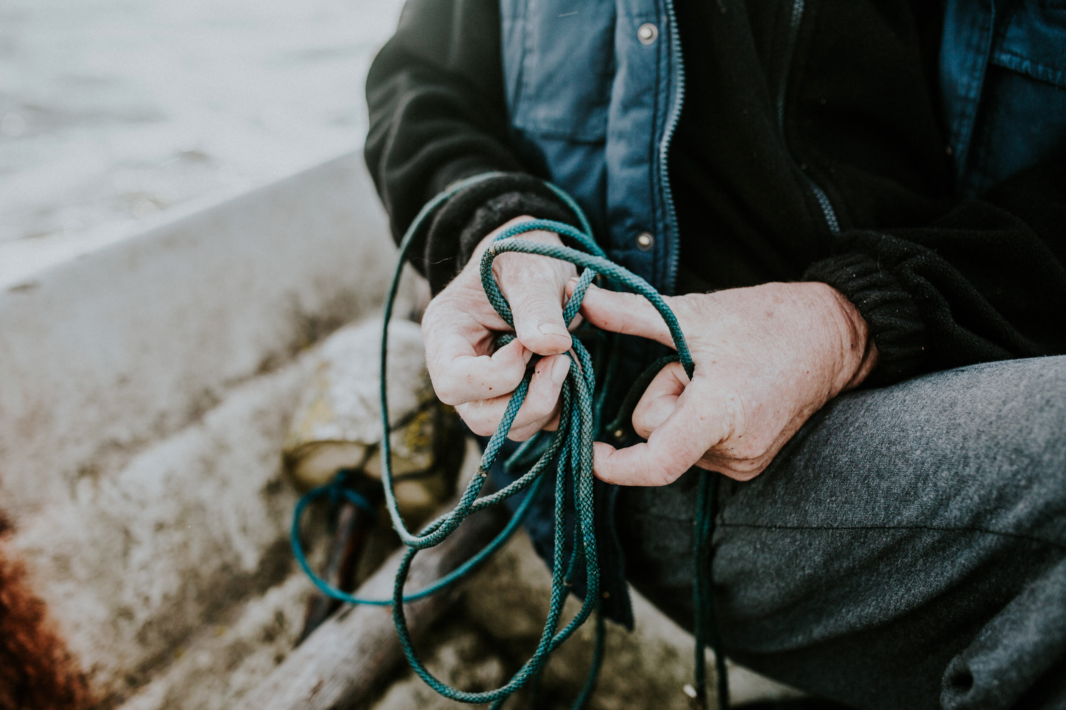
Our principles
have a
heart and a
backbone
→ integrity
Notes:
Third. Have a heart and backbone yet be adaptable.
Big nations have the luxury of being slow and comfortable, but if Estonia talks and doesn’t deliver, we cease to exist.
Digitalisation for us is existential. We must develop new ideas and be prepared to adapt.
We’re like a fishing boat among large tankers. To manoeuvre, those big countries or tankers require a lot of space, infrastructure, negotiations, documents, and most of all time.
Fishing boats like Estonia need only two seconds and a pair of hands to change direction 180 degrees.
Succeeding at change is our superpower.

Slide 7
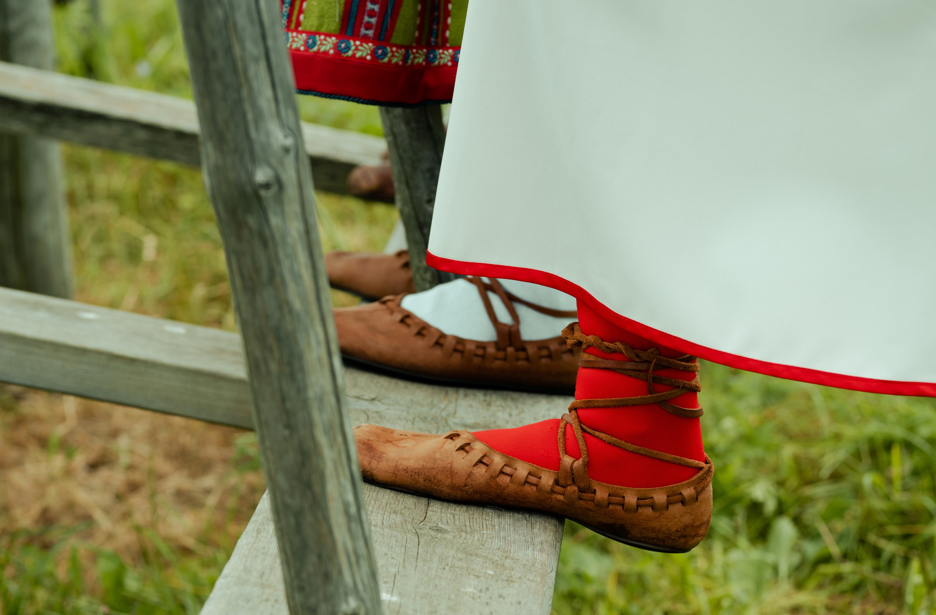
Our principles
sometimes
it takes a
village
→ cooperation
Notes:
And fourth. As I mentioned, when you travel through the Estonian countryside, you rarely see houses.
It’s not that we don’t have people, they live far from the roads and far from each other.
But being distant doesn’t mean being alone. Since ancient times, we’ve collaborated.
First, in villages, when one family needed to pick potatoes, the whole village helped out.
Now, when the government needs something, the private sector comes in and helps.

Slide 8
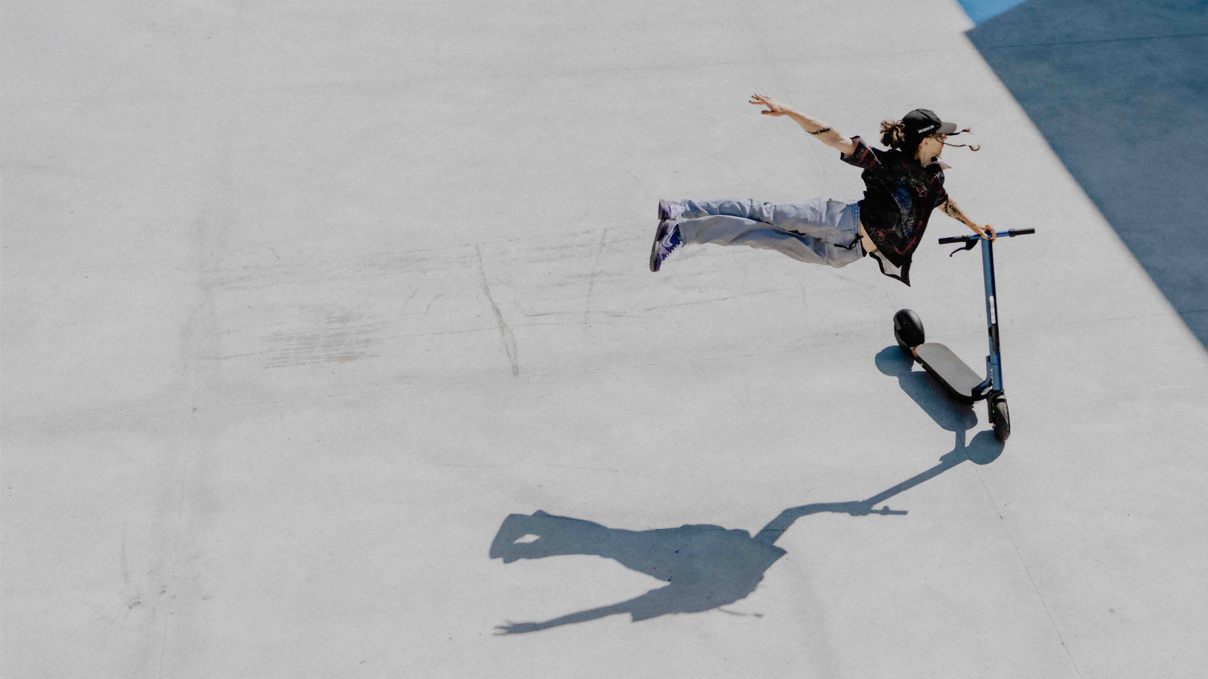
Our story
succeeding
at change
is our superpower
Notes:
So, what is Estonia?
It’s a small country with highly educated people, driven by the need to be innovative, fast, intelligent, creative, and globally minded.
We are champions of change and even though there are so many areas where we’re already at the very top of the world, but we’re still discontent.
The work continues.
Thank you.

Slide 9
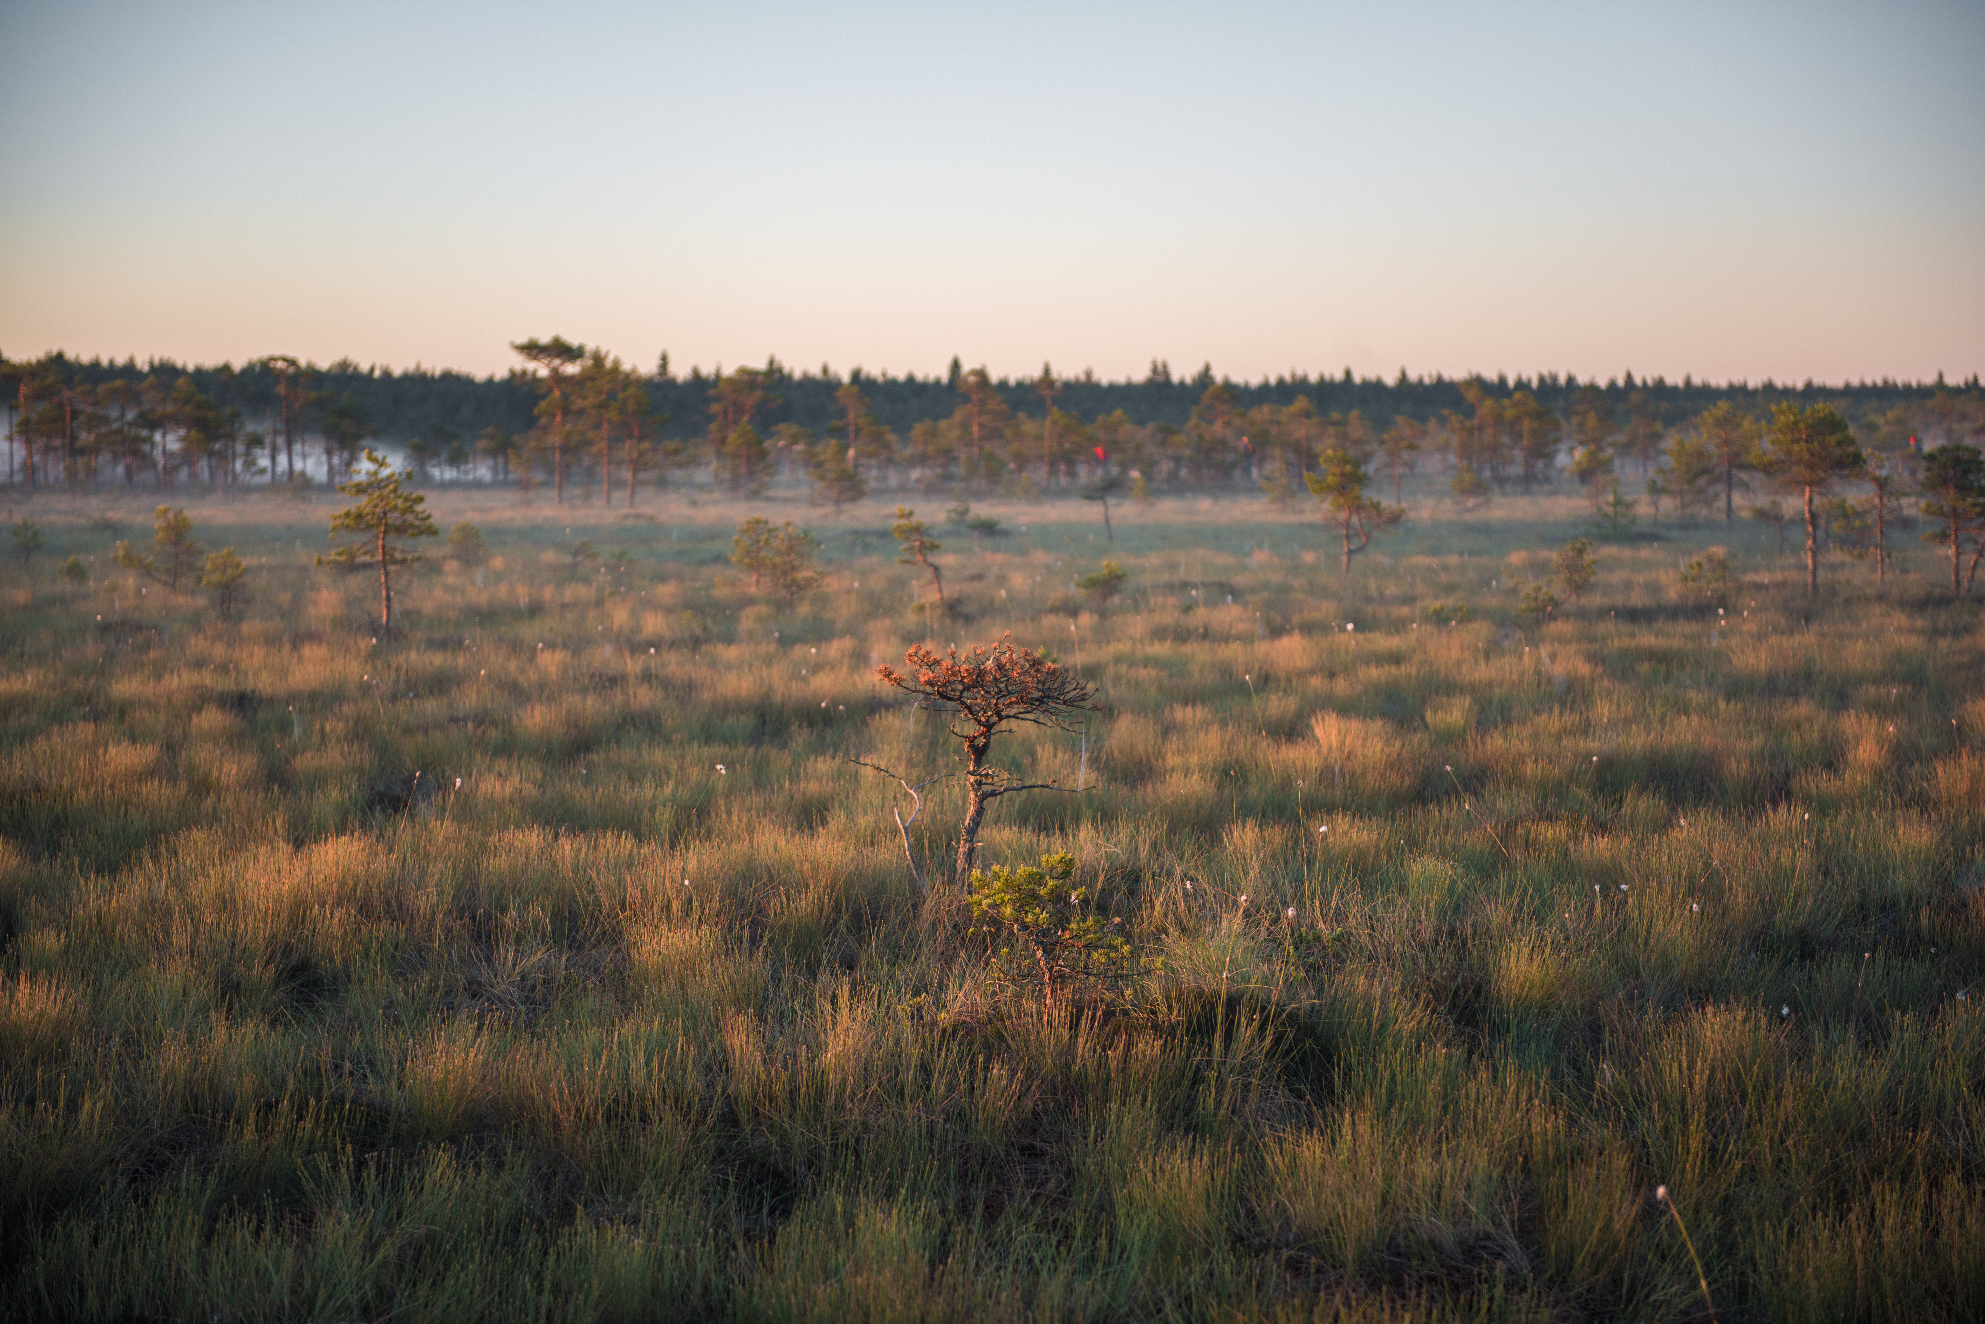
thank you!
Enterprise Estonia
Notes:
So, what is Estonia?
It’s a small country with highly educated people, driven by the need to be innovative, fast, intelligent, creative, and globally minded.
We are champions of change and even though there are so many areas where we’re already at the very top of the world, but we’re still discontent.
The work continues.
Thank you.

