Slide 1
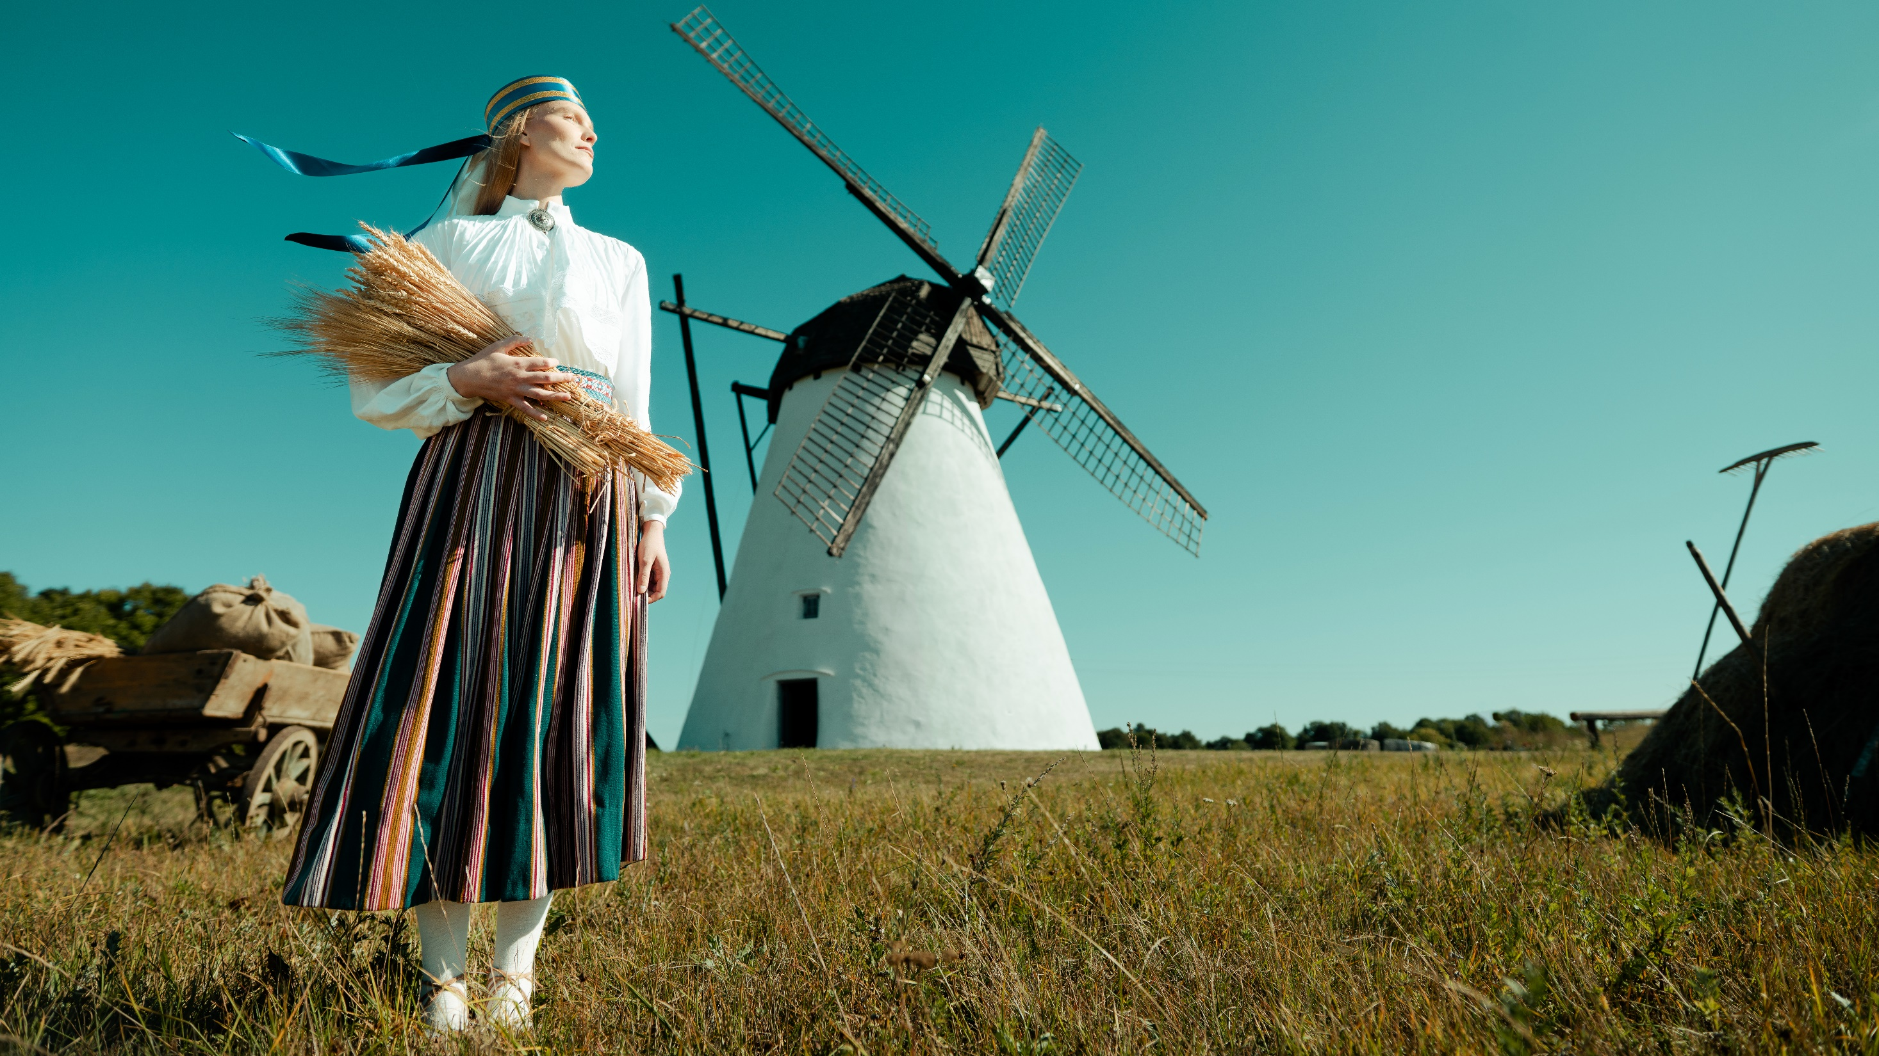
tere!
all about Estonia
Notes:
Hello
I would like to begin with some traditional Estonian proverbs that reflect the Estonian mindset.
For example:
The bird is made for flying, the man – for working.
You don’t buy a pig in a bag. In other words, you must know what’s in the bag; you must earn trust.
The dog needs praise to live, but not the man.
Meaning, in Estonia, you work, you deliver, but you always want something more.
As you heard, all the proverbs are about nature: birds, pigs, and dogs.
It’s not a coincidence because we are very close to nature.

Slide 2
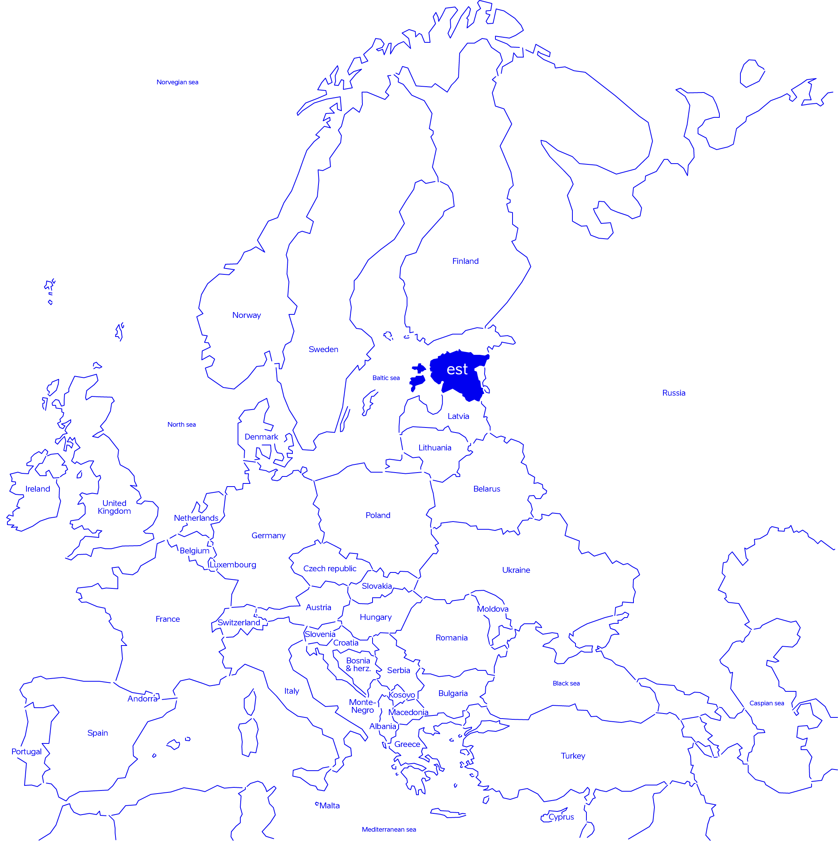
a modest country
extending beyond its borders
population: 1.4 million
area: 45,339 km²
member of: UN, EU, NATO, OECD, WTO, CERN
fans of: singing, dancing and sauna
Notes:
Estonia is as au naturelle as it gets, with forests covering more than half of the country, bogs another 22%, and our air among the purest in the world.
So, take a breath and lean back.
We’re not much for talking; we prefer getting things done.
The result?

Slide 3
our highest rankings
#2
#1
#1
#2
Liberal Democracy Index 2025
PISA 2025
cleverest children in the EU
OECD 2025
tax competitiveness index
World Press Freedom Index 2025
Notes:
Today, we are among the global top five in liberal democracy, serving as a leading example of transparent governance and democratic values. (Expert estimates of the extent of voting rights, the freedom and fairness of elections, freedoms of association and expression, civil liberties, and executiveconstraints. Only Danes rank above us.)
Our education system is among the top five in the world, boasting the cleverest children in Europe.
Globally, we have been first in the International Tax Competitiveness Index for the better part of two decades and second in the Freedom on the Net report.
We are a world leader in venture funding, relative to our GDP and other metrics, like Estonia having the highest number of startups and unicorns per capita in Europe.
We rank among the world’s top countries in terms of press freedom, ensuring our press remains impartial and unbiased.
But how do we do it? We’ve distilled „doing things the Estonian way“ into 4 core principles

Slide 4
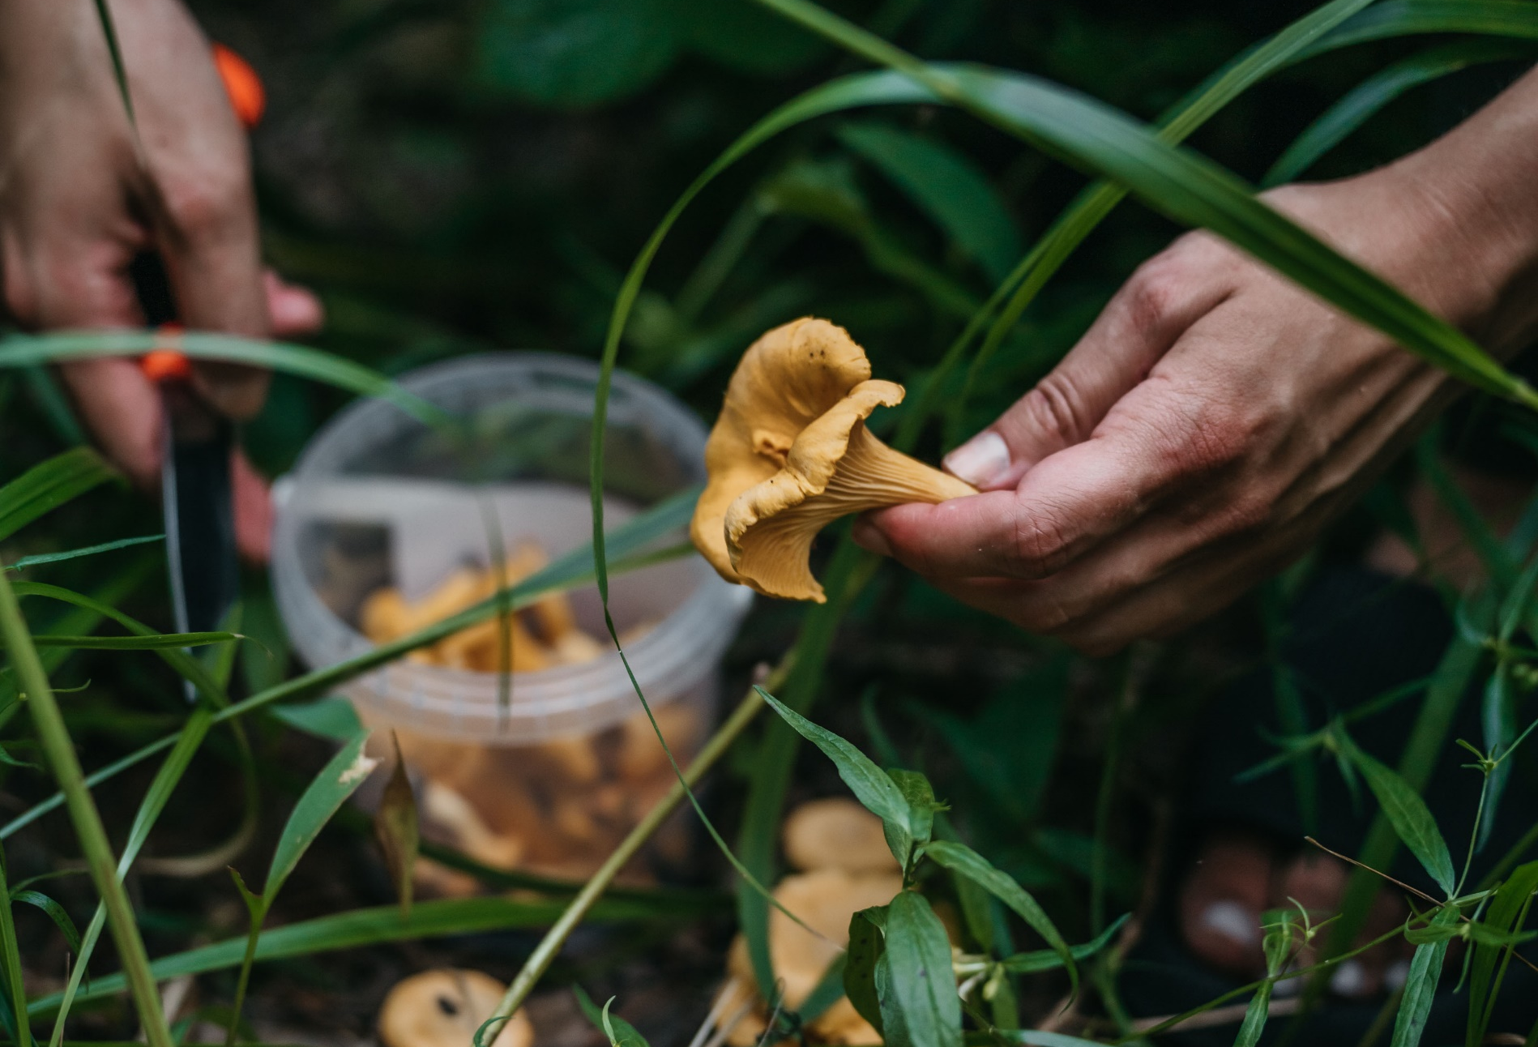
Our principles
make
shortage an advantage
→ resourcefulness
Notes:
First, we make a shortage an advantage.
We don’t have many people or resources in excess, so we must be innovative and clever.
What do you do in such a situation? You must be inventive and smart. Education has always been the cornerstone of our society.
It’s our only way to make ourselves bigger than we are. That’s how Estonia has managed to adapt, develop, and exceed expectations far beyond its size.
Estonian pupils receive some of the best educations in the world, regardless of their location or social background.
Thanks to that, our innovation is built on knowledge, high-end technologies, and the latest scientific developments.

Slide 5
notably knowledgeable
Europe’s smartest children
digital by default
safety through smart regulation
AI Leap, Formula Student and HK Unicorn Squad
Notes:
Fun facts:
Today, Estonia ranks alongside Finland and Singapore as one of the world's top educational systems. We are also number one globally in creative thinking and growth mindset.
Estonian innovation is driven not by scale, but by knowledge and science. Many enterprises use advanced technologies in medicine, energy, defence, and beyond. Our legendary startup ecosystem is possible for many reasons, but first and foremost because our national mindset mirrors the startup mindset: you constantly have to come up with something new and clever.
Being innovative, using knowledge and the latest scientific developments to create cutting-edge technologies, is a structure we’ve built since kindergarten, where 3- to 4-year-olds learn to read. It continues throughout the years, ensuring that Estonian pupils receive one of the best educations in the world, regardless of their location or social background.
The world’s fastest student formula car was built in Estonia.
Our students have even sent their own satellite into space through EstCUBE.

Slide 6
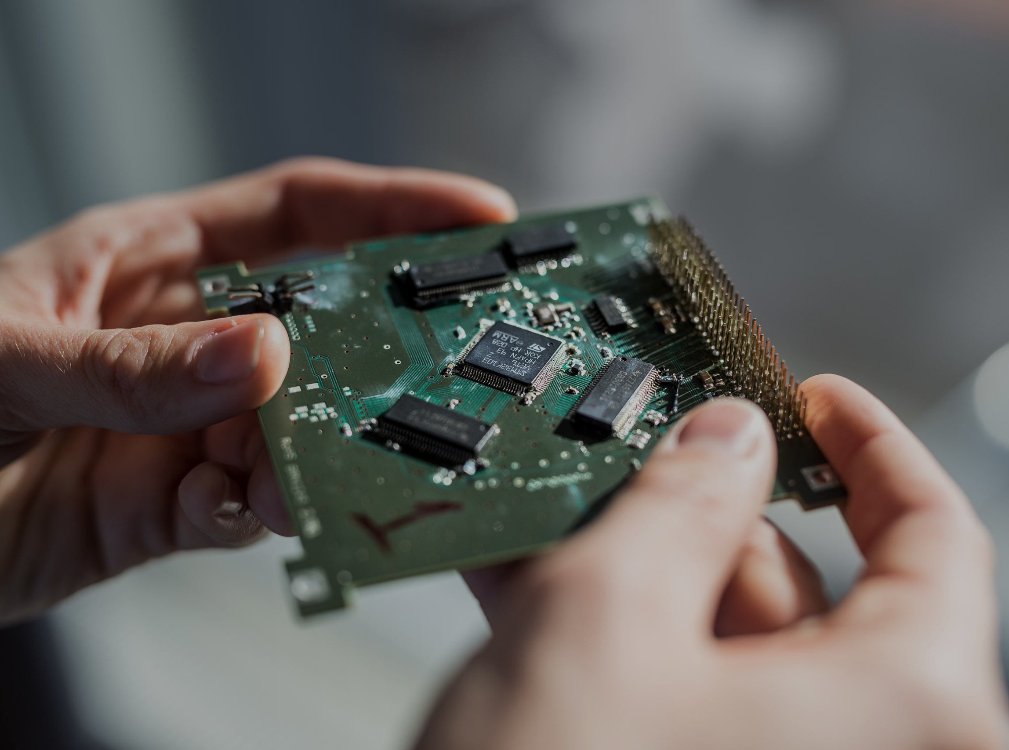
Our principles
driven by discontent
→ ambition
Notes:
Second. Do you know what the most common word in Estonia is?
It’s “normaalne.”
“100% of Estonian public services are digital.” – “Normaalne.”
“I can vote, fill my prescription, or even get a divorce online.” – “Normaalne.”
Estonians are driven by discontent, but it is not an opposing force; it’s our driving force.
We don’t see obstacles; we look for solutions. We’re not frustrated but motivated. We have a growth mindset.
That’s also where creativity kicks in. It starts in our educational system.
Our teachers are very independent with no unnecessary restrictions.
Therefore, they must and can be creative, devising their own solutions.

Slide 7
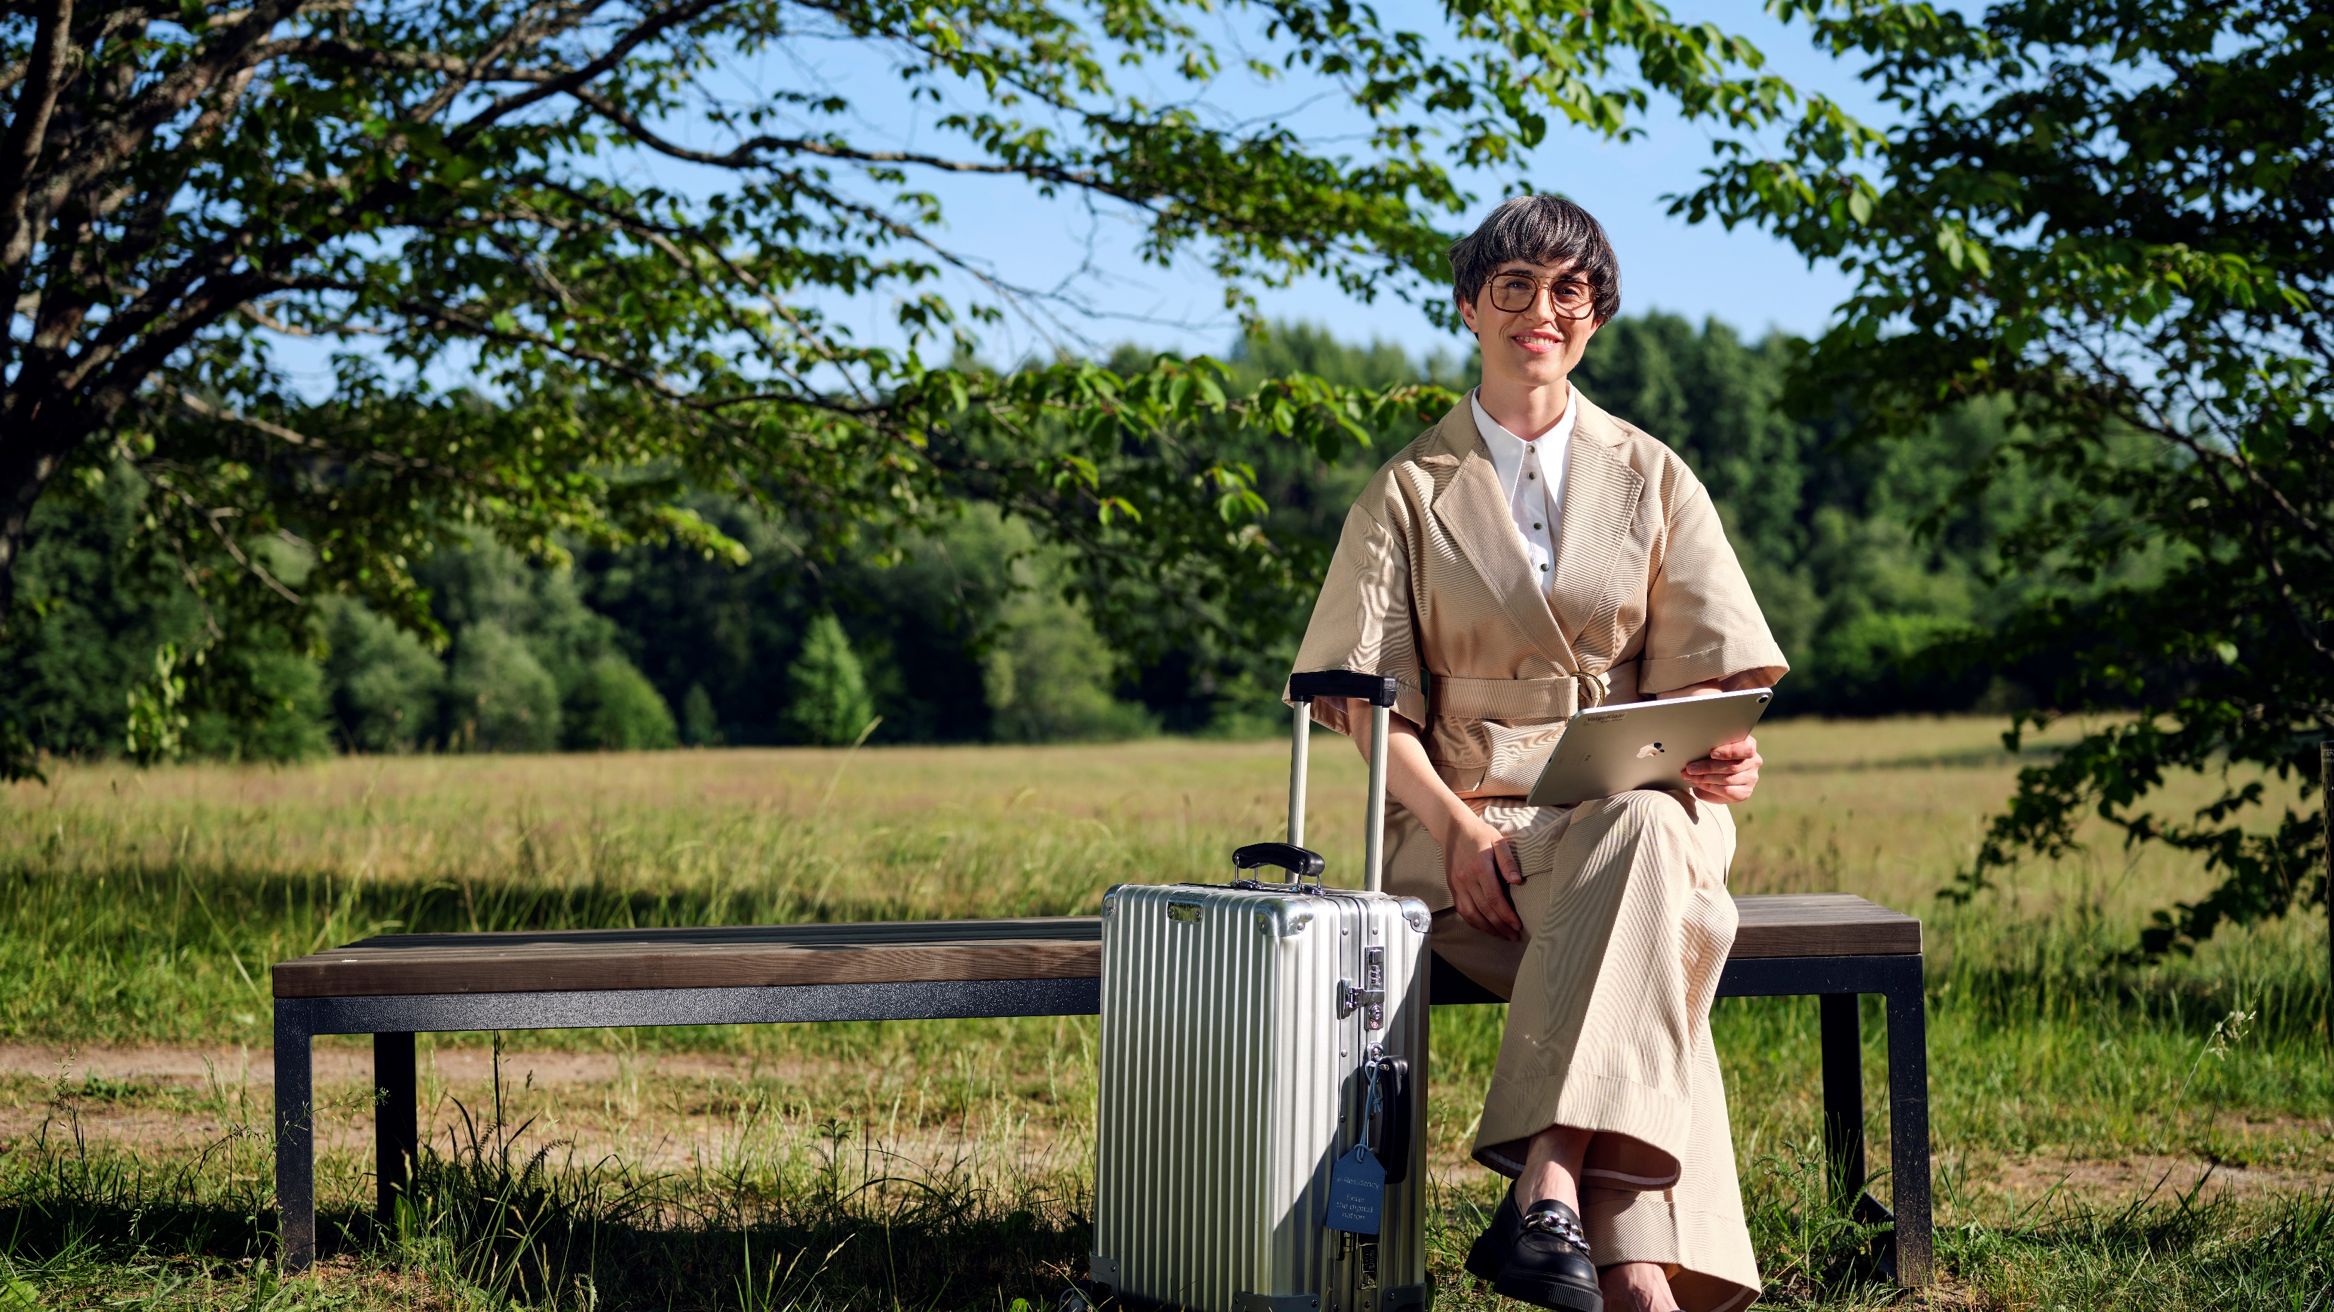
digitally native
100% digital, 0% bureaucrazy
citizens initiative portal
first nation to embrace i-voting
taxes done in minutes
Notes:
How does this digital discontentment look like?
We have a website where people can propose ideas, start petitions, and engage in discussions.
If you gather more than 1,000 signatures, the Parliament must discuss your concern. That’s how closely people are involved in governance and decision-making in Estonia.
Estonia was the first country in the world to implement i-Voting. Over the past 20 years, it has been closely monitored to such an extent that the system is now bulletproof and widely trusted. Last time, more than half of voters cast their votes online from their summer cottages or other remote locations.
Thanks to our digital signature, we save 2% of GDP and years of our lives. It’s not paper or ink we save; it’s time!

Slide 8
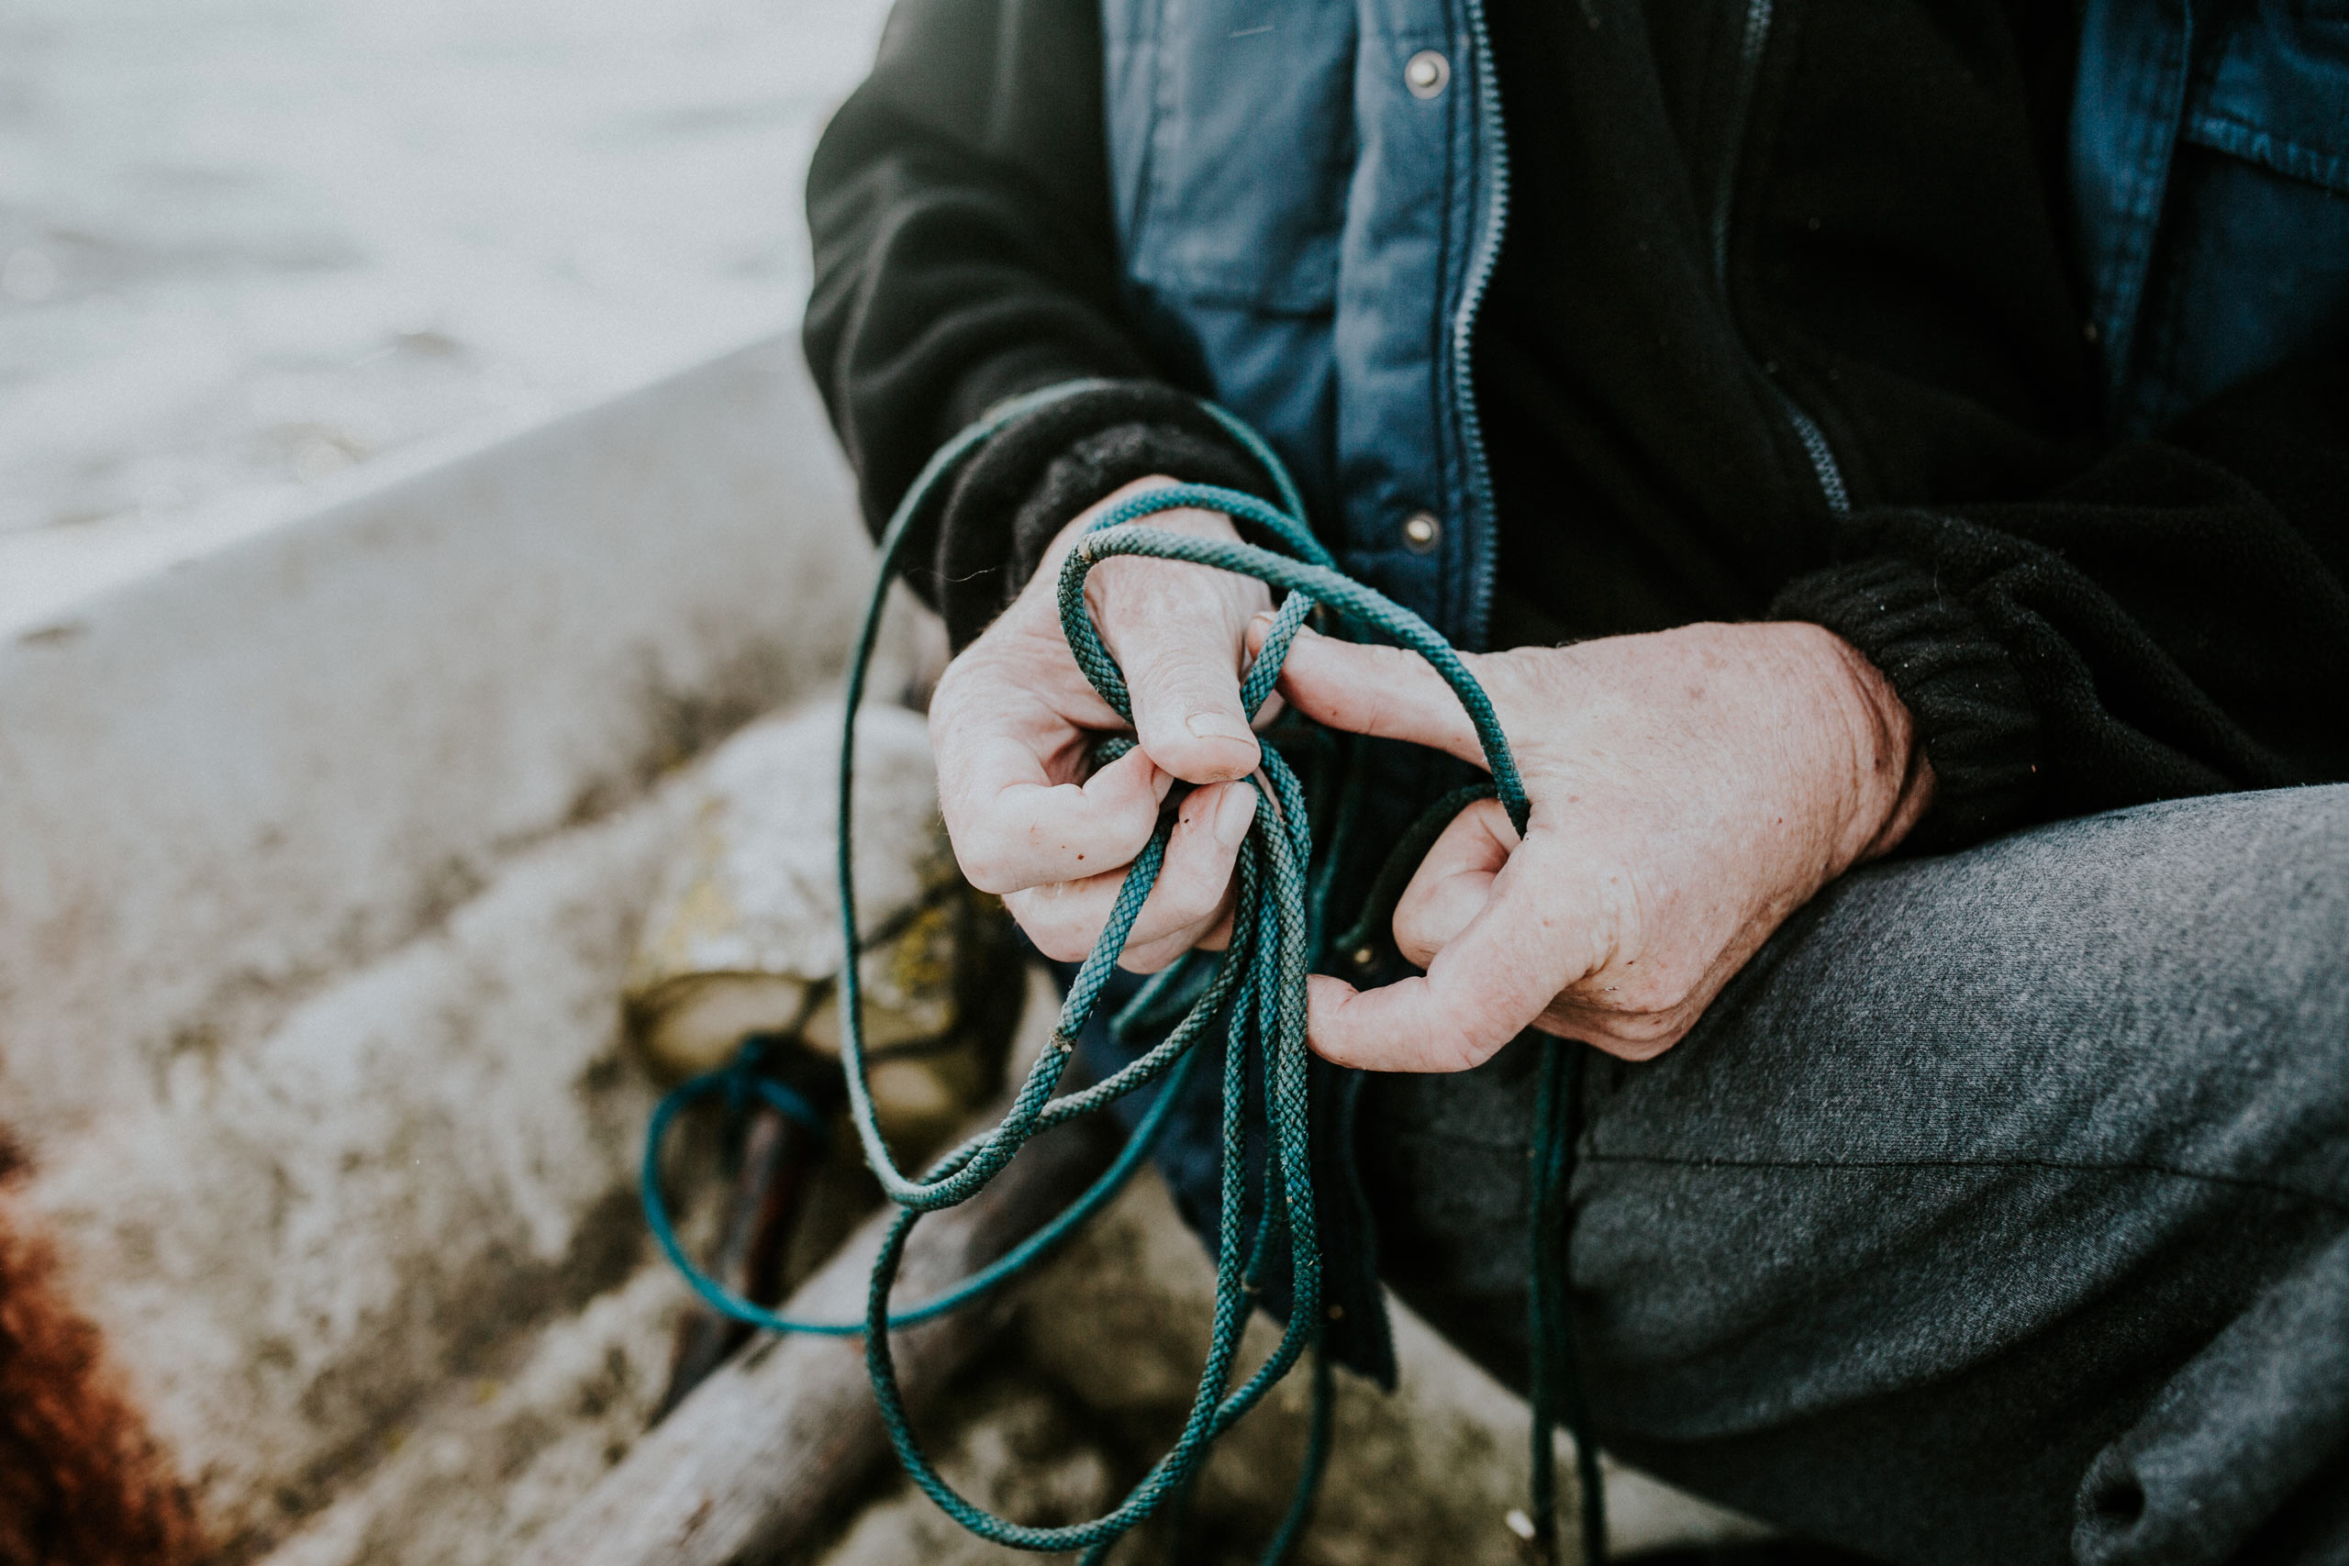
Our principles
have a
heart and a
backbone
→ integrity
Notes:
Third principle. Have a heart and backbone – yet be adaptable.
Big nations have the luxury of having time and being comfortable sometimes, because they know nothing bad will happen. They will not disappear.
That’s not the case for Estonia. If we are slow, complacent, or talk without delivering, we cease to exist.
Digitalisation for us is existential. We must grow and innovate.
At the same time, we’re ready to adapt. We’re like a fishing boat among large tankers.
To manoeuvre, those tankers need space, infrastructure, negotiations, and, most of all, time.
Fishing boats need only two seconds and a pair of hands to change direction 180 degrees.
That’s also why our digital companies have been so successful globally, adapting our experience to larger societies. What we’ve done here is also possible elsewhere. We’re not an exception.
Succeeding at change is our superpower.

Slide 9
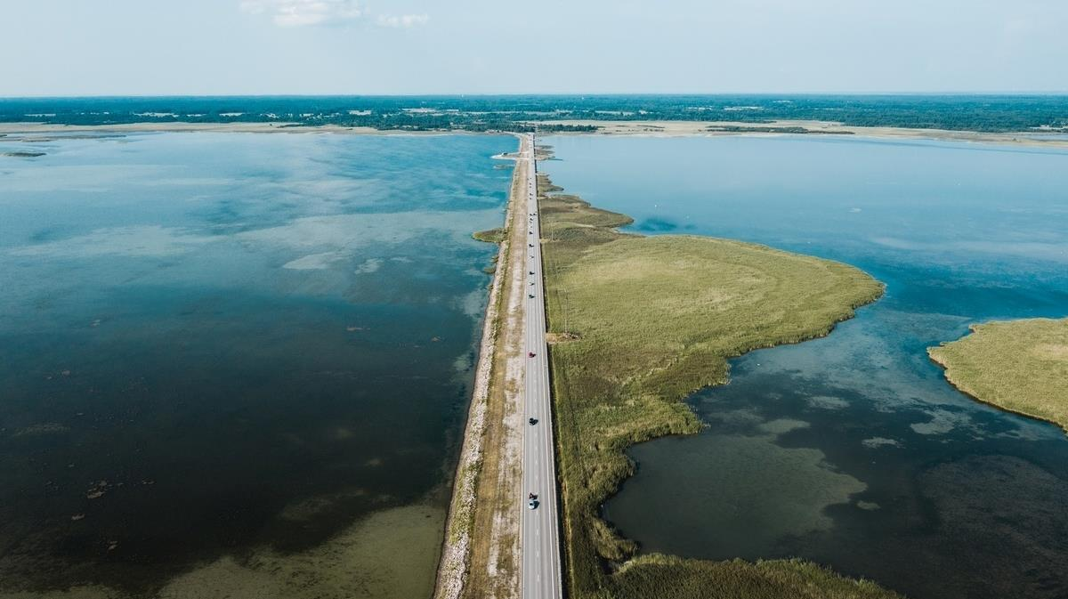
internationally cooperative
they know us, therefore they trust us
low-hassle, transparent taxation
talented, ambitious workforce
Notes:
Fun fact:
Several international organisations have their digital brain here – NATO Cyber Defence Centre, Hitachi, Helsing, and eu-LISA (the EU Agency for Large-Scale IT Systems in Freedom, Security and Justice).
They know we have talent, we deliver, and we’re trustworthy.

Slide 10
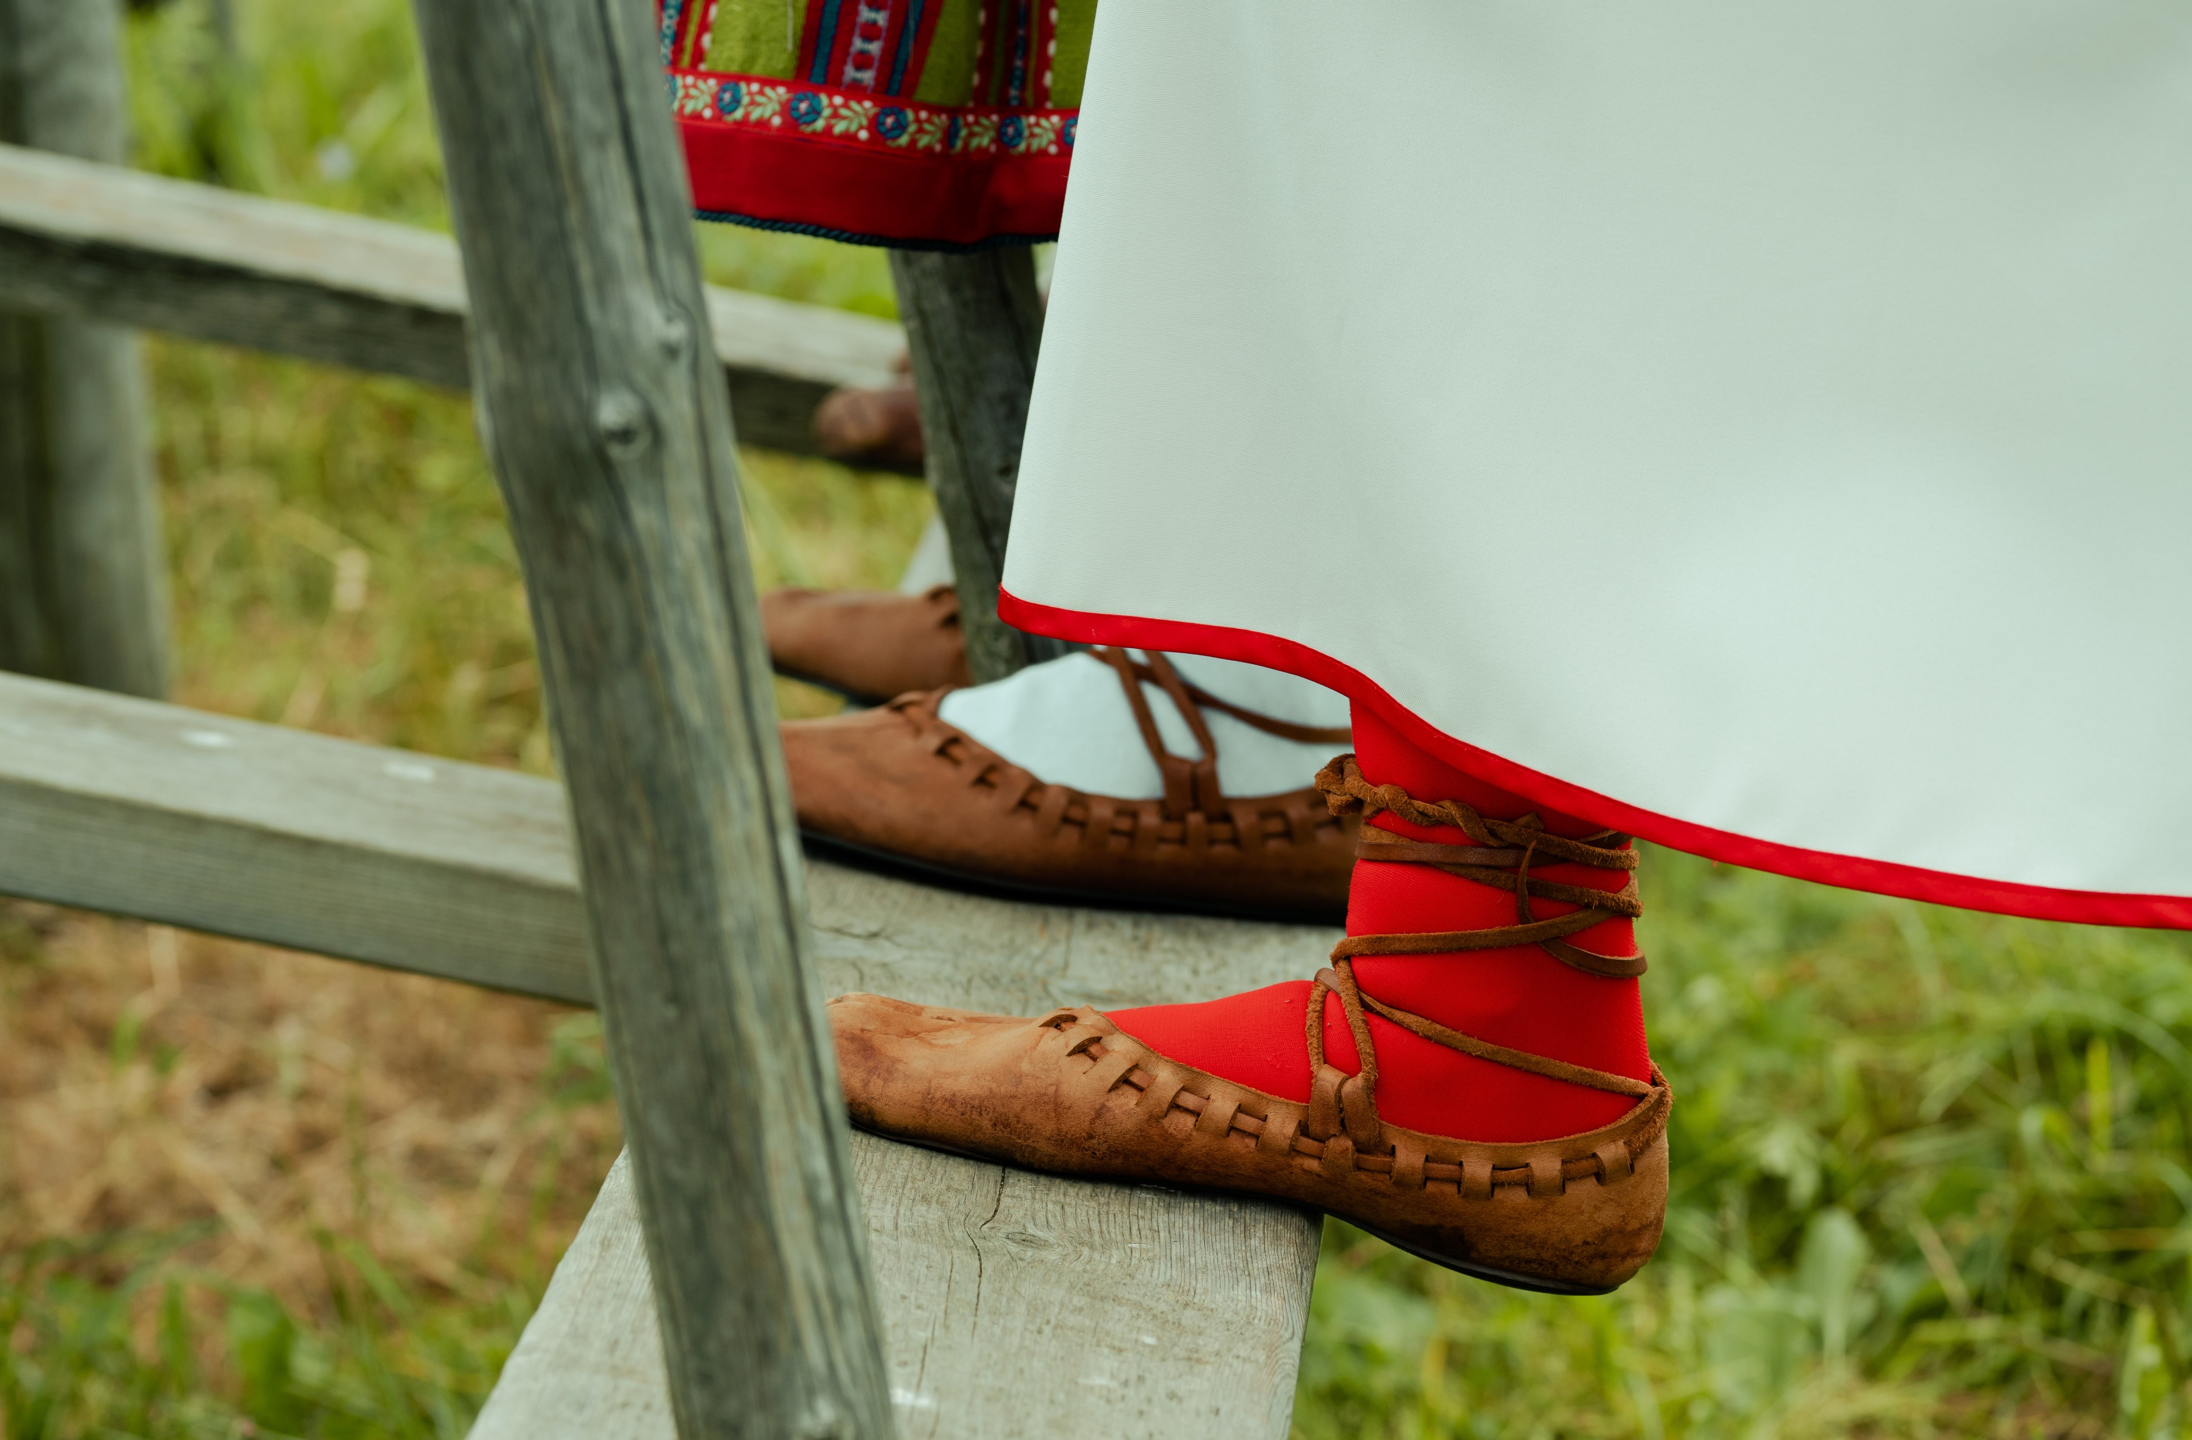
Our principles
sometimes
it takes a
village
→ cooperation
Notes:
The fourth principle is collaboration.
An old Estonian is saying: “The church is to be built in the middle of the village.” It means that everyone has different interests, and everyone wants the church to cater to their own needs. The solution is therefore a compromise that takes everyone’s needs into account.
As I mentioned, when you travel through Estonia, you rarely see houses.
It’s not that we don’t have people, they live far from the roads and far from each other.
But being distant doesn’t mean being alone. Since ancient times, we’ve collaborated.
First, in villages, when one family needed to pick potatoes, the whole village helped out.
Now, when the government needs something, the private sector comes in and helps.

Slide 11
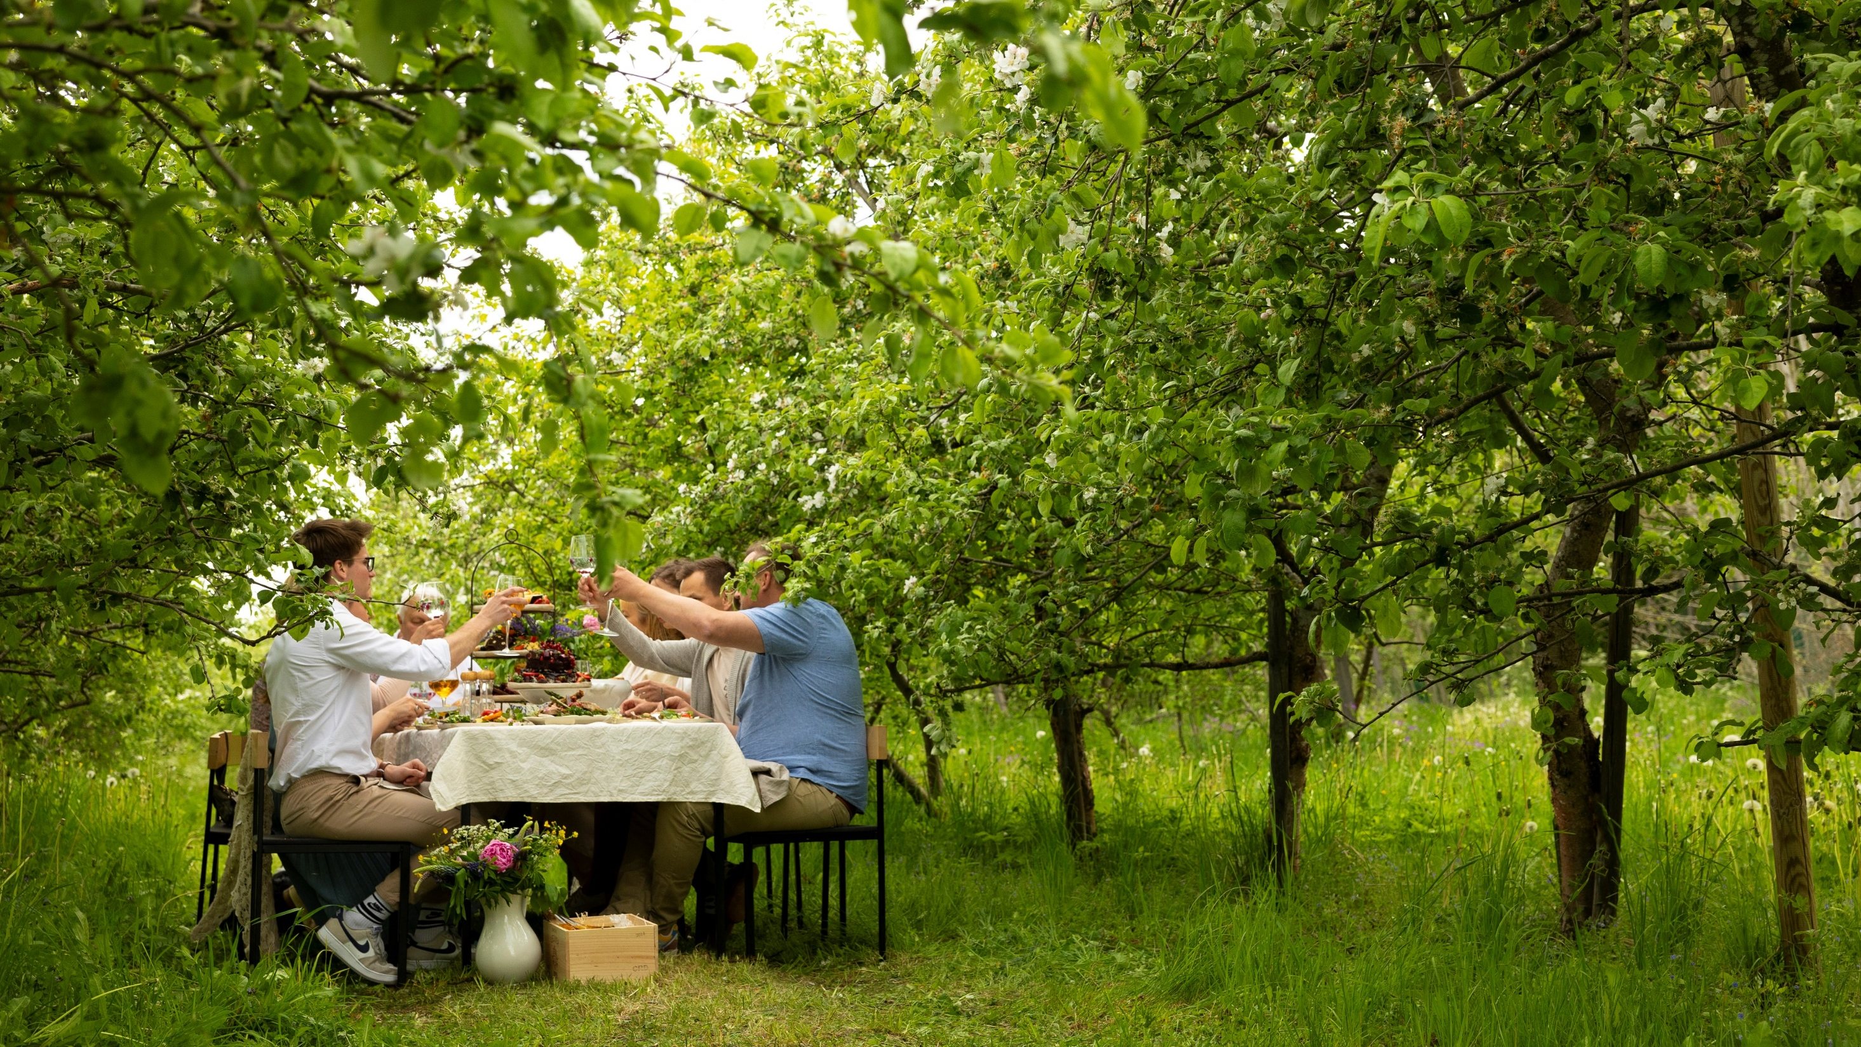
creatively collaborative
shared responsibility and teamwork inspire innovation
digitally minded leadership
citizen-centric service design
supportive legislation
Notes:
Our X-Road data exchange platform, which connects hundreds of public and private databases, was developed in collaboration with the Finnish government.
Our digital prescription system is now used in 11 EU countries.
Accelerate Estonia was established to streamline the legislative landscape for innovation, again through public-private collaboration.
Public-private partnerships come so naturally in Estonia that they often surprise others. The foundation of that partnership is trust. Those never-satisfied Estonians do trust the state. Why?
Because digitalisation has been transparent, and transparency builds trust. Secondly, we don’t have any super-databases; information is distributed and impossible to manipulate.
Thirdly, we openly discuss mistakes, which also fosters trust.
People often think the foundation of digitalisation is hardware or software.
The real foundation is mindware. The base of digitalisation isn’t your phone, server, or database. It’s what’s in your head.

Slide 12
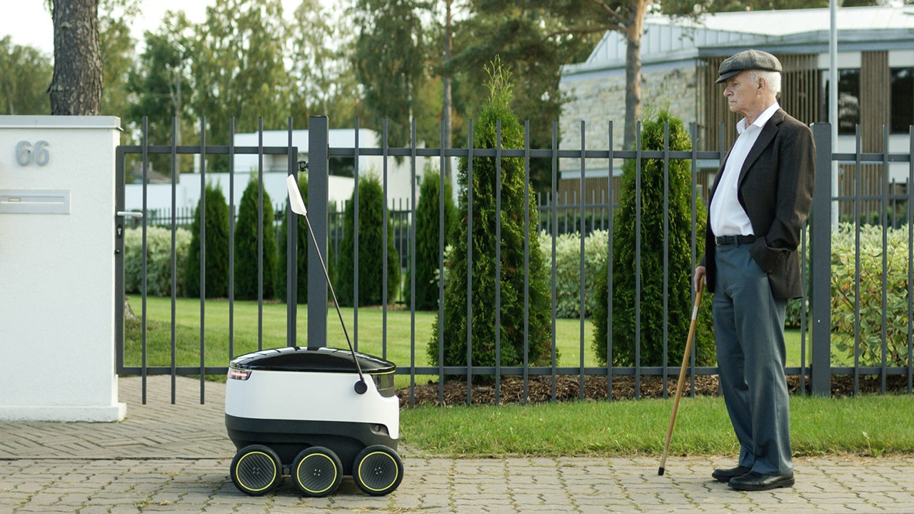
futuristically traditional
future-ready is our starting point
simple in nature / keep it simple
clear in message / keep it clear
reliable in promises / keep our word
Notes:
To wrap up.
Estonian digitalisation stands on four pillars:
Be smart. Education is in our DNA – it’s a social and national elevator that lifts both individuals and the state.
“Normal.” Driven by discontent, we always want to move forward. We have a growth mindset.
We don’t small talk, we deliver. We have experts, experience, and knowledge, and we’re open-minded and adaptable.
Collaboration. Estonia is both geographically and socially flat. No rigid hierarchies, no bureaucracy. Collaboration is in our DNA.
These four pillars form the foundation of our digital mindset. Of course, there are many more factors:
Safety: We have a proven track record of combating cyberattacks. We know how to keep data safe. It’s no coincidence that NATO’s cyber defence centre is based in Estonia.
Education: Our education system is of world-class quality.
Digital-minded leadership: Our previous president launched a programme to integrate digitalisation into schools. Our current president followed up with AI Leap to teach artificial intelligence skills to teachers and students.
Legislation: Our legal framework has always supported digital solutions and innovation. Digitalisation has largely shaped legislation, rather than the other way around. For example, our ID card was made mandatory early on, but private entrepreneurs developed the technology.

Slide 13
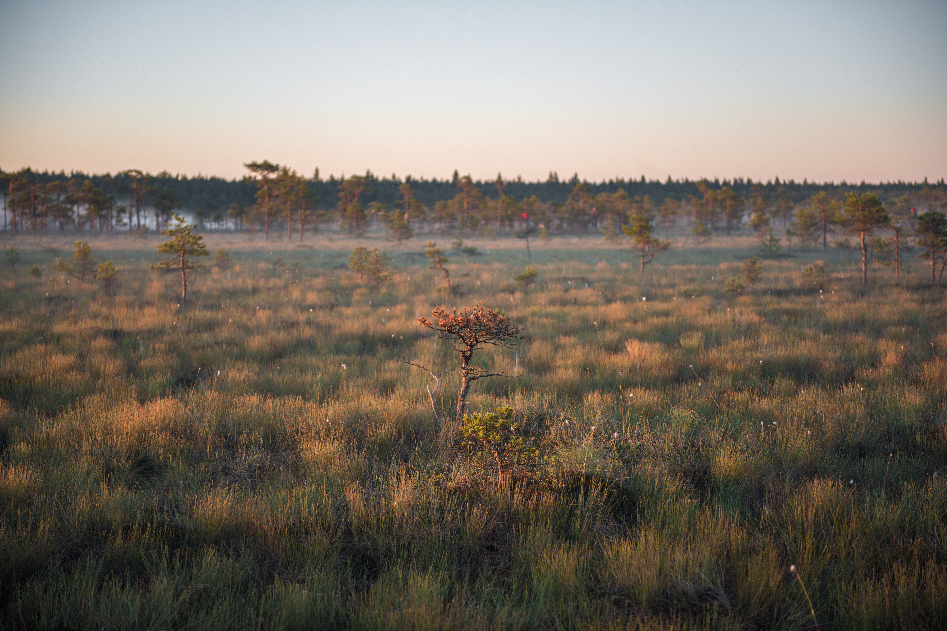
thank you!
Notes:
So…
if you want to visit a place with a mild climate, fresh air, and lots of nature, that’s Estonia.
if you want to invest and are seeking the world’s most entrepreneur-friendly tax system, it’s here.
if you’re looking for a partner who knows how to collaborate, a place where children are raised to be creative and smart like nowhere else, or people who are digitally talented and always eager to grow and invent, you’re welcome here.
I have many more fun facts, examples, and experiences, but I suggest we start with your questions and a dialogue.
Thank you.

